Slide 1
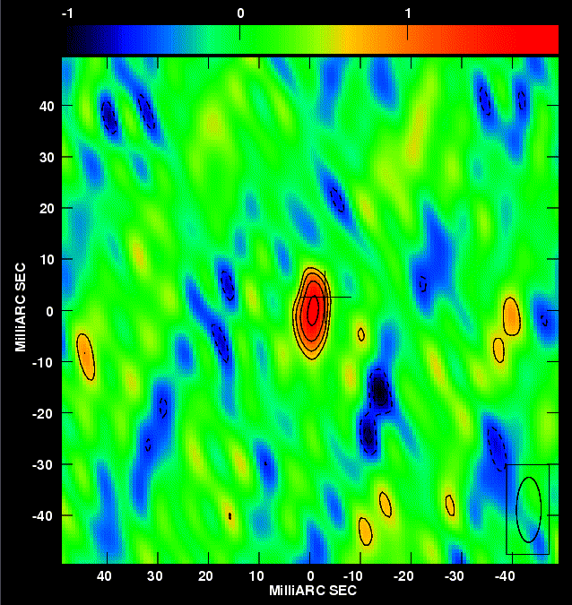
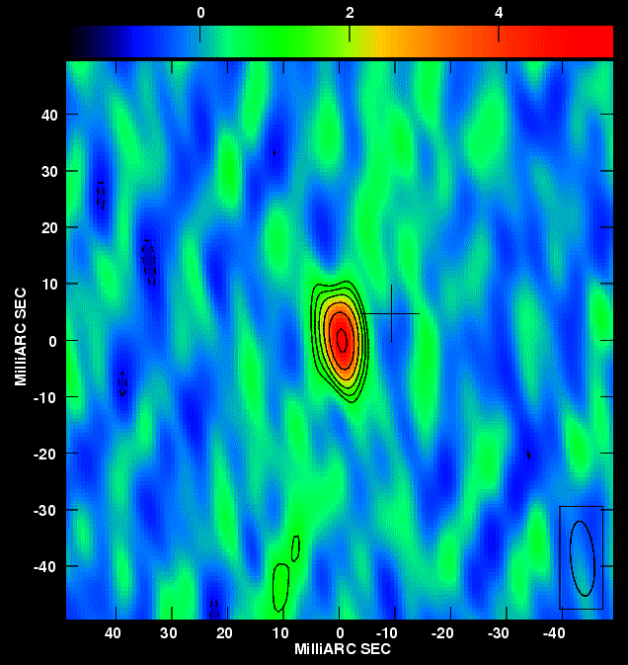
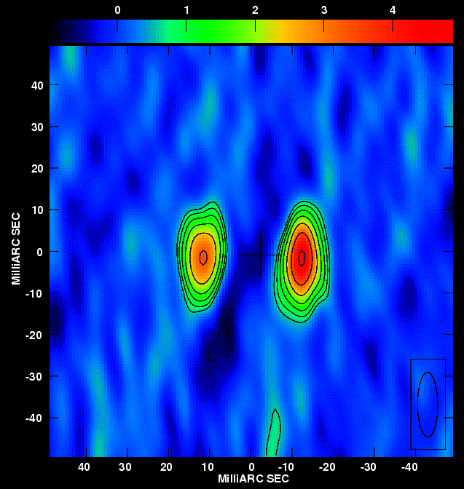
Hitting the JACPOT: Testing Accretion Disk – Radio Jet Coupling Over Entire Outbursts
2009 May 28
2009 Jun 5
2009 Jun 6
Gregory R. Sivakoff on behalf of the JACPOT XRB collaboration
Web: http://www.astro.virginia.edu/xrb_jets
Notes:
Brief overview current paradigm of disk-jet coupling
Describe JACPOT that will test paradigm
Probe similarities and differences to prove necessary and sufficient conditions for launching relativistic jets.
In this presentation, I will give a brief overview of the current paradigm for the disk-jet coupling in stellar-mass compact objects, and then describe the large VLBA project that we are currently undertaking to investigate the similarities and differences between the jets in three different classes of stellar-mass compact objects; black holes, neutron stars and white dwarfs, to probe the necessary and sufficient conditions for the launching of relativistic jets.

Slide 2
Jet Acceleration and Collimation Probe of Transient X-Ray Binaries
James Miller-Jones (ICRAR-Curtin) Gregory Sivakoff (U Virginia) Diego Altamirano (U Amsterdam) Vivek Dhawan (NRAO) Rob Fender (U Southampton), Sebastian Heinz (U Wisconsin) Elmar Koerding (U Nijmegen) Hans Krimm (NASA GSFC) | Dipankar Maitra (U Michigan) Sera Markoff (U Amsterdam) Simone Migliari (ESA Madrid) Ron Remillard (MIT) Michael Rupen (NRAO) David Russell (U Amsterdam) Craig Sarazin (U Virginia) Valeriu Tudose (ASTRON)
Notes:
ACRONYM
People in room
Expertise spans theory and observations, and throughout wavelengths, which is needed to probe physics.
Following modern traditions for large projects, we have created a catchy acronym.
Our team, led by James Miller-Jones, involves a large number of people involved in this project. I have highlighted those whom are sitting in this room. Our expertise spans both theory and observations across the entire electromagnetic spectrum, enabling us to obtain full multi-wavelength coverage of any outburst, from the radio band through infrared, optical and ultraviolet observations to the X-ray band. Such an approach is crucial for understanding the physics underlying the accretion/ejection coupling in X-ray binaries.

Slide 3
Accretion – Jet Coupling
Notes:
In all of these source, there is a coupling between mass inflow, typical in the form of accretion disks, and mass outflow, typically in the form of jets. By studying such disk-jet coupling, we hope to understand the underlying physics of both processes, and the conditions needed for such a coupling.

Slide 4
The Universal Nature of Jets
Notes:
The launching of jets is a seemingly universal astrophysical phenomena: From opitcal/IR observations of protostars

Slide 5
The Universal Nature of Jets
Centaurus A: NASA/CXC/CfA and R.Kraft et al.
Notes:
To X-ray jets of supermassive black holes in active galaxies

Slide 6
Slowly Evolving Black Holes
Myrs - Gyrs
Centaurus A: NASA/CXC/CfA and M. Hardcastle et al.
Notes:
Although astrophysical jet studies were originally begun in active galactic nuclei, such massive objects have long timescales. Entire outbursts of AGN activity may last millions of years, with multiple bursts occurring over billions of years. One of the allures of studying X-ray binaries is the graduate student timescale for such lower mass objects.

Slide 7
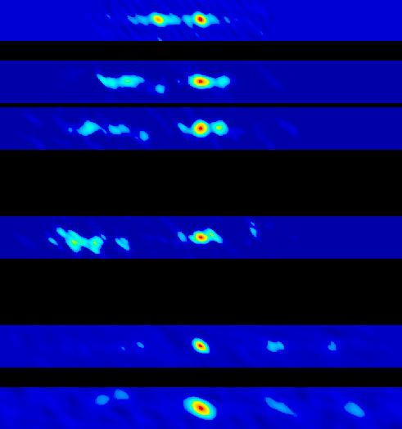
Rapidly Evolving Black Holes
Days - Months
X-Ray Nova GRO J1655-40 NRAO/AUI/NSF and R. Hjellming & M. Rupen
Notes:
Single outbursts can take days to months, with multiple outbursts on year long timescales.

Slide 8
The Disk-Jet Coupling Paradigm
Disk Dominated
Power-law Dominated
Bright
Faint
R. Fender et al. (2004)
Notes:
These rapid timescales have allowed us to build a paradigm for how disks and jets couple, at least for black hole X-ray binaries.

Slide 9
The Disk-Jet Coupling Paradigm
Disk Dominated
Power-law Dominated
Bright
Faint
R. Fender et al. (2004) & CXC/ M. Weiss
Notes:
While most transient sources spend most of their time in quiescence, we are interested in their outbursts. Rising from quiescence, XRBs are typically in a hard state, which is interpreted as being dominated by power-law emission. Correlations between the radio and X-ray luminosities have led to the picture that the source has a compact, spectrally flat steady jet at this stage.

Slide 10
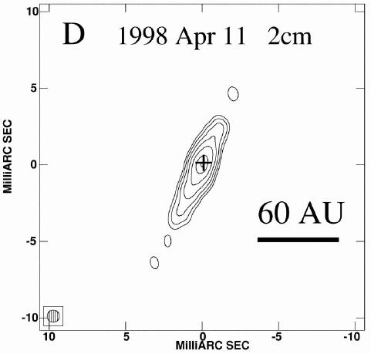
The Disk-Jet Coupling Paradigm
Disk Dominated
Power-law Dominated
Bright
Faint
R. Fender et al. (2004) & V. Dhawan et al. (2010)
Notes:
And indeed, high resolution radio imaging have revealed a compact steady jet.

Slide 11
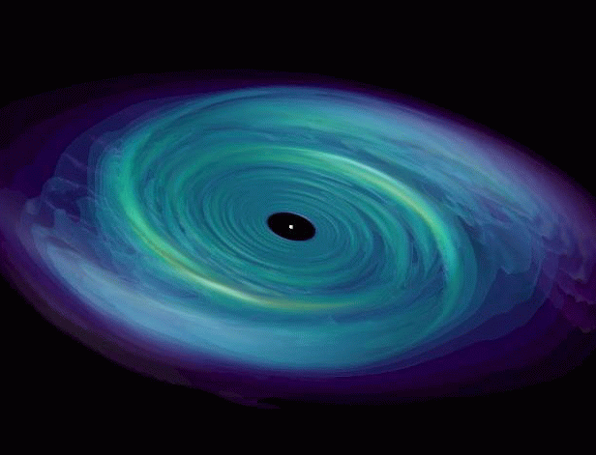
The Disk-Jet Coupling Paradigm
Disk Dominated
Power-law Dominated
Bright
Faint
R. Fender et al. (2004) and M. Owen & J. Blondin
Notes:
At the peak of the hard emission, a soft spectral component, which is interpreted as a multicolor disk black body begins ramping up. The source transitions to the soft state. We believe that during this transition, the jet lorentz factor increases, and eventually jet ejecta are launched.

Slide 12
The Disk-Jet Coupling Paradigm
Disk Dominated
Power-law Dominated
Bright
Faint
R. Fender et al. (2004), F. Mirabel & L. Rodriguez (1994), and R. Fender et al. (1999)
Notes:
And again, high resolution radio imaging has helped build this picture.

Slide 13
The Disk-Jet Coupling Paradigm
Disk Dominated
Power-law Dominated
Bright
Faint
R. Fender et al. (2004)
Notes:
But this entire picture, has impressively been built piecemeal. Until JACPOT, no experiments had tracked an entire outburst using the power f high resolution radio imaging to probe the jet.

Slide 14
Extending Disk-Jet Coupling To Neutron Stars & White Dwarfs
E. Koerding et al. (2008)
Notes:
Ad in fact, the X-ray state transitions can also be applied to cataclysmic variables, if one plots the fraction of luminosity in a power law versus the total intensity. Radio emission had been detected in both the Atoll NS Aql X-1 and the CV SS Cyg, but high resolution radio imaging was not available prior to our recent efforts.

Slide 15
Extending Disk-Jet Coupling To Neutron Stars & White Dwarfs
f_{8GHz,pk}
~10 mJy @ 8 kpc
~0.7 mJy @ 5 kpc
~1 mJy @ 0.1 kpc
E. Koerding et al. (2008)
Notes:
This is not surprising when one considers the peak radio luminosities of the sources. JACPOT’s goal was to trace the jet behavior and its connection to the accretion disk by observing one BH, one NS, and one CV over an entire outburst with the VLBA.

Slide 16
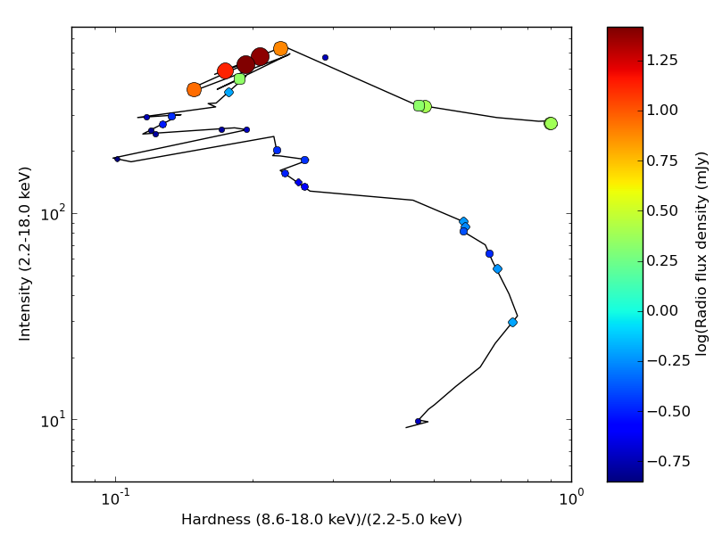
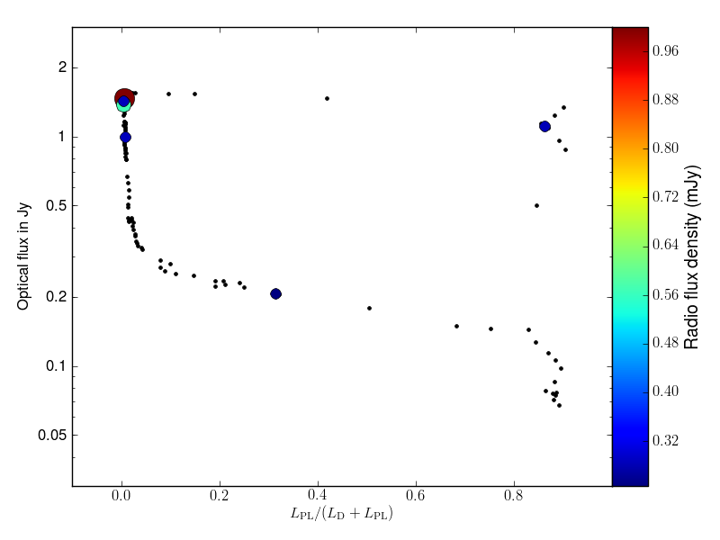
Hitting The JACPOT
H1733-322
Aql X-1
SS Cyg
Intensity
Hardness
JACPOT XRB
Notes:
This is not surprising when one considers the peak radio luminosities of the sources. JACPOT’s goal was to trace the jet behavior and its connection to the accretion disk by observing one BH, one NS, and one CV over an entire outburst with the VLBA.

Slide 17
2009 Coverage of H1743-322
JACPOT XRB & Motta et al. 2010

Slide 18
2009 Coverage of H1743-322
Jet Quenching!
JACPOT XRB & Motta et al. 2010

Slide 19
HID + Radio of H1743-322
JACPOT XRB

Slide 20
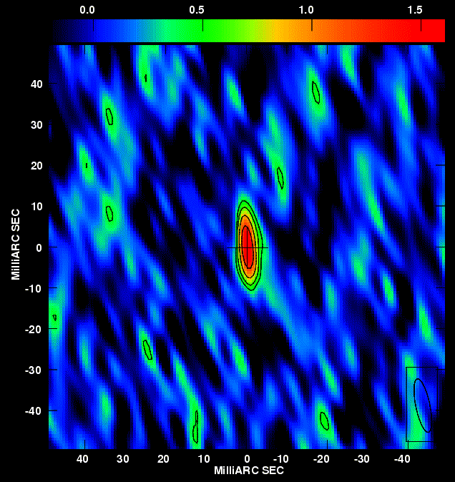
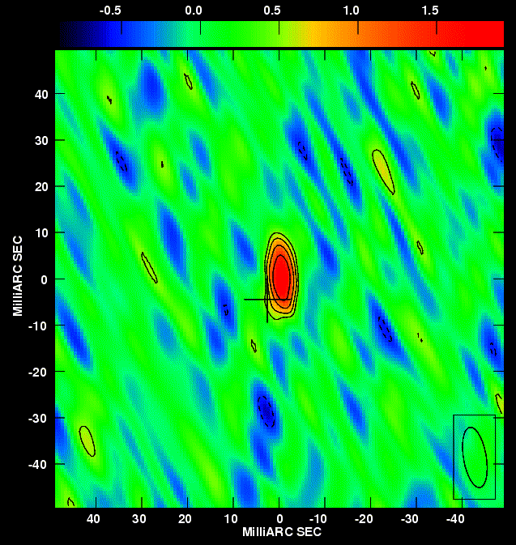
Ejecta Launching In H1743-322
2009 May 28
2009 May 30
2009 Jun 2
2009 Jun 5
2009 Jun 6
JACPOT XRB

Slide 21
2009 Jet Line of H1743-322
Jet line?
JACPOT XRB

Slide 22
2003 vs. 2009 for H1743-322
JACPOT XRB

Slide 23
2009 Coverage of Aql X-1
J. Miller-Jones et al. 2010

Slide 24
First mas Images of Aql X-1
J. Miller-Jones et al. 2010

Slide 25
First mas Images of Aql X-1
J. Miller-Jones et al. 2010

Slide 26
HID/CCD + Radio of Aql X-1
J. Miller-Jones et al. 2010

Slide 27
HID/CCD + Radio of Aql X-1
J. Miller-Jones et al. 2010

Slide 28
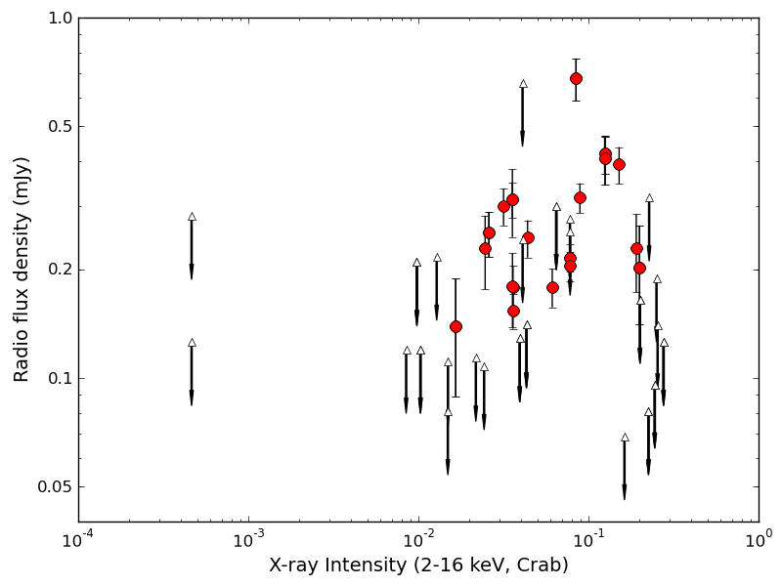
Compact Jet Quenching in Aql X-1
J. Miller-Jones et al. 2010

Slide 29
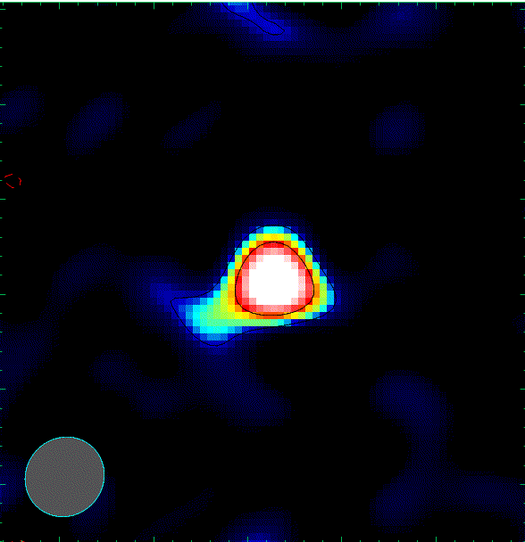
JACPOT Project Status
BH Candidate H1743-322 (2009 Jun)
Paradigm of ‘unified model’ largely verified
Quenched core emission prior to major flaring
Jet line does not appear to be constant
Atoll NS Aql X-1 (2009 Nov)
First VLBI detection of Aql X-1
Radio emission switches on at state transitions
No evidence for transient ejecta
Quenching of radio emission in soft state
WD/CV SS Cyg (2010 Apr) – Ask Me Later
2 more targets approved by NRAO
2009 Jun 5
2009 Jun 6
2009 Nov 19

Slide 30
The Future Is Now
EVLA sensitivity ~ 5-20 X VLA
Better coverage of faint emission in rising/decaying hard state
Constraints on soft state quenching
Automatic spectral indices
Less observing time required
VLBA Backend/Correlator Upgrades
Factor of 2-4 sensitivity increase
Imaging fainter states
Better snapshot capability
Closer calibrators: better astrometry
<10μas astrometry on a 1mJy source
Proper motions and parallaxes
Notes:
Looking forward, the work on quiescent black hole systems and the extension to NS and WD systems will benefit hugely from the extra sensitivity of the EVLA, which I hope to spend some time next year helping to commission. The huge increase in bandwidth, from 50MHz to 8GHz will lead to a factor 5-20 improvement in sensitivity.

