Slide 1
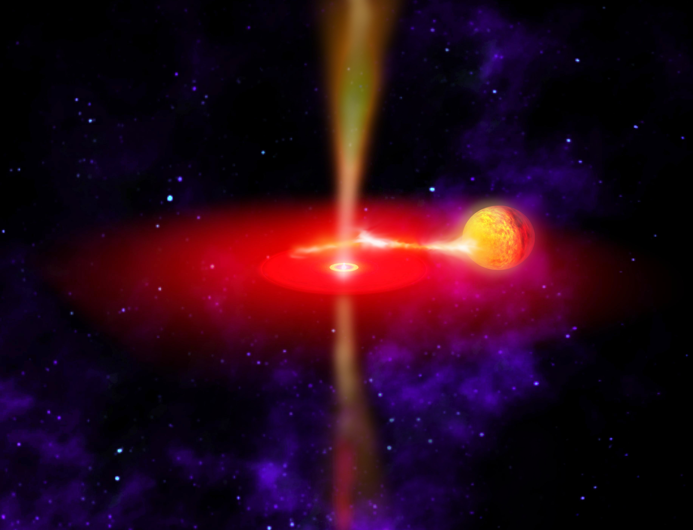
Ultraluminous X-ray sources
Tim Roberts
Jeanette Gladstone (Alberta)
Floyd Jackson, Andy Sutton, Matt Middleton, Chris Done, Martin Ward, Mark Swinbank (Durham)
Mike Goad, Simon Vaughan, Lucy Heil (Leicester)
Andrew Levan (Warwick)
Luca Zampieri (Padova)

Slide 2
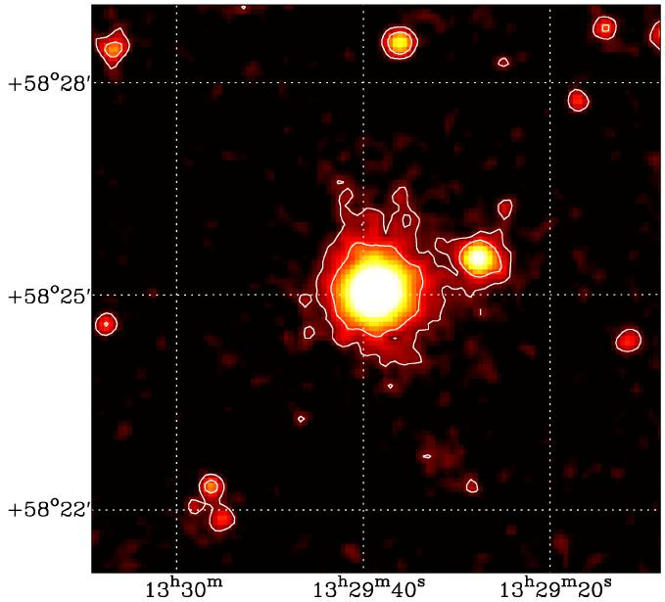
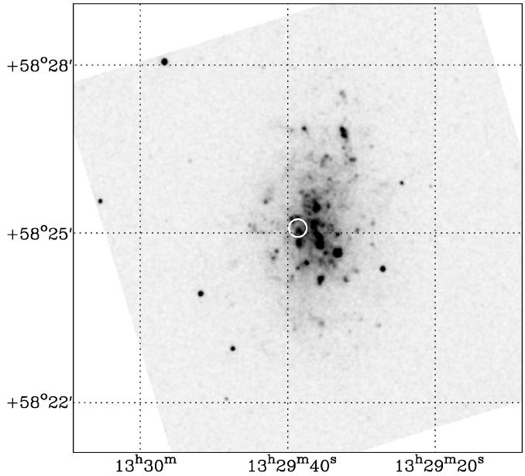
Ultraluminous X-ray sources (ULXs)
EINSTEIN (early `80s) - some galaxies dominated in X-rays by one or more extremely luminous extra-nuclear sources (Fabbiano 1989)
Brightest extra-nuclear X-ray sources, with L_{X}>10³⁹ erg s⁻¹: ultraluminous X-ray sources (ULXs)
Once rare; now know of 400+ candidates (Walton et al. in prep.)
NGC 5204 X-1 L_{X} ~ 5 × 10³⁹ erg s⁻¹
XMM-Newton/EPIC
NGC 5204 (UVW1)
XMM-Newton/OM

Slide 3
Why care about ULXs?
10³⁹ erg s⁻¹ is ~ Eddington limit for a 10 M black hole
Which implies either a new ~ 10² – 10⁴ M class of intermediate-mass black holes…
Remnant seeds of SMBHs?
…or stellar mass (< 100 M) black holes that exceed the Eddington limit
Most extreme accretion environments

Slide 4
A strong steer against IMBHs
Early Chandra results: multiple ULXs (10+) are found in Starburst galaxies
Most ULXs inextricably linked to star formation (e.g. Swartz et al. 2009)
Ongoing star formation → ULXs are intrinsically short-lived → can’t ALL be IMBHs (King 2004)
Alternative: high-mass X-ray binaries (HMXBs)?
From Gao et al. (2003)

Slide 5
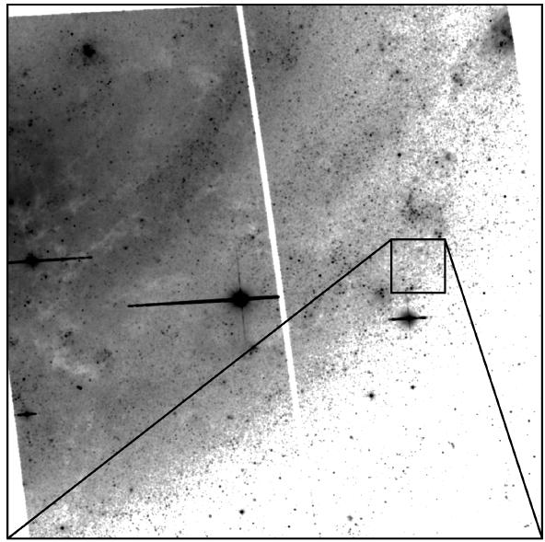
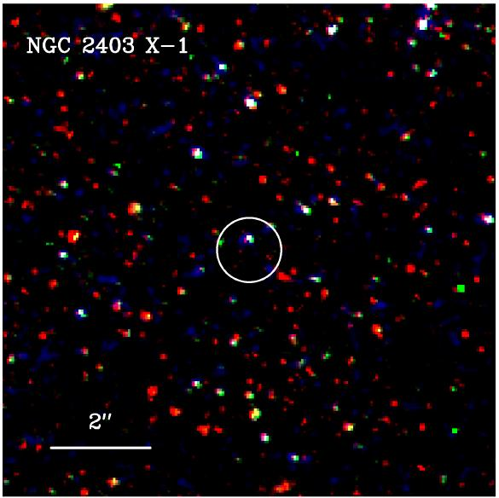
ULXs as HMXBs
From Roberts, Levan & Goad (2008)
Super-Eddington mass transfer in HMXBs (Rappaport et al. 2005)
Blue stellar counterparts to ULXs – possible high mass donors
Still need to break the Eddington limit; possibilities:
Relativistic beaming (e.g. Körding et al. 2002)
Radiative anisotropy (e.g. King et al. 2001)
Truly super-Eddington discs (e.g. Begelman 2002)
Blue counterpart consistent with late O or early B star
m_{F606W} = 24.9

Slide 6
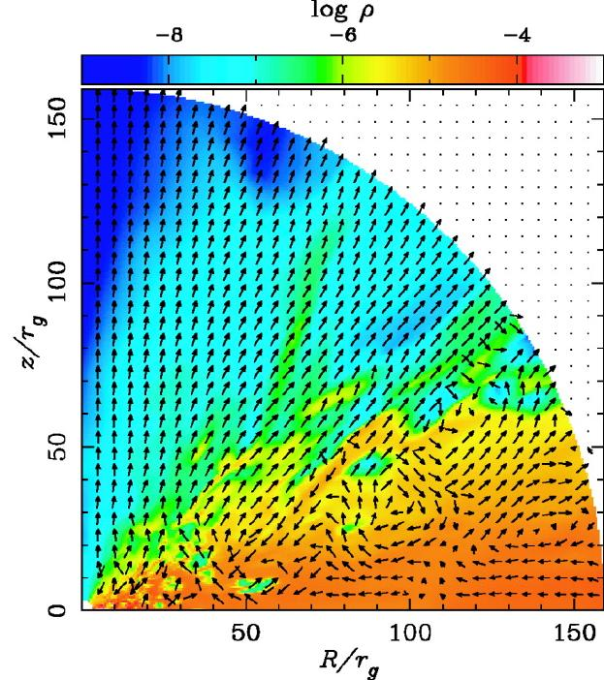
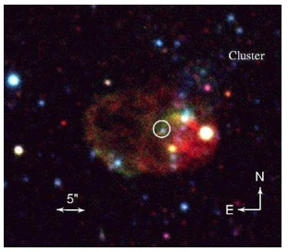
Physical processes
From Ohsuga (2006)
Combination of super-Eddington flow & radiative anisotropy, e.g. Poutanen et al. (2007), King (2008)
ULX nebulae imply outflows
Super-Eddington emission seen in many accreting source types – NS (Circinus X-1), BH (GRS 1915+105), AGN (IRAS 13224-3809)…
Outflow
For beaming factor b and super-Eddington rate M/M_{Edd}
. .
Disc flow
NGC 1313 X-2 nebula (from Pakull et al. 2006)

Slide 7
Important caveat for BHB comparisons
BHBs from RXTE
ULX data is low quality (only a handful with > 1 ct s⁻¹ from XMM-Newton)
Bandpass must be considered (RXTE vs XMM-Newton); worse for IMBHs!
ULXs from XMM
From Remillard & McClintock (2006)

Slide 8
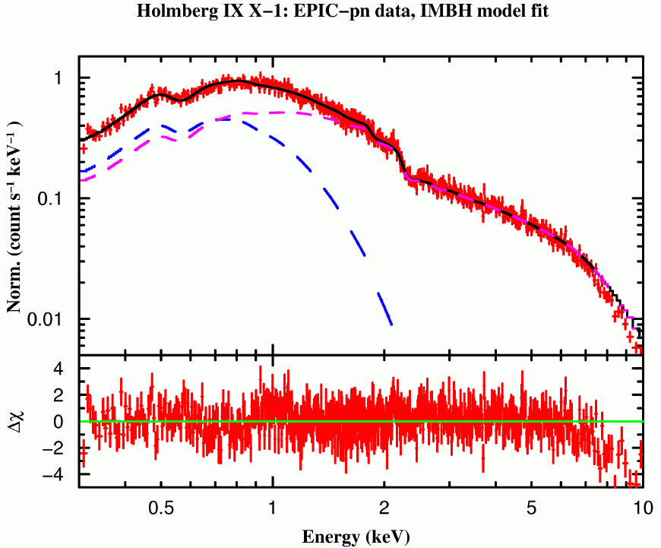
ULX X-ray spectra
Fitting empirical disc + power-law to ULX spectra supports IMBHs (Miller et al. 2003, etc)
But hard component not a power-law (Stobbart et al. 2006)
Analogies to sub-Eddington accretion states don’t hold – new super-Eddington ultraluminous state (Roberts 2007)?
Accretion disc
Power-law

Slide 9
Physical models
Gladstone, Roberts & Done 2009
Disc plus corona models (illustrated above) – fits give cool discs (0.2 - 0.8 keV), optically thick coronae (6 < τ < 80) in all cases
But assumptions made - inner disc visible, unaffected by optically thick corona
Can correct for energy used to launch corona, obscuration of inner disc (Done & Kubota 2006)

Slide 10
ULX spectral sequence
Recover disc temps ~ 0.6 - 1 keV for 8/12 ULXs; form a spectral sequence
Modified disc regime – ~Eddington-rate: big stellar BHs or beamed?
Ultraluminous regime – truly super-Eddington, optically thick coronae
Extreme ultraluminous regime – cool disc component remains
1 10 1 10 1 10
Energy (keV)

Slide 11
The influence of winds on ULX spectra
Toy model from Middleton et al. (2010)
Theory predicts a key characteristic of super-Eddington accretion is a radiatively-driven wind (e.g. Poutanen et al. 2007, King 2008), driven from photospheric radius
Emergence of this optically-thick component provides ‘cool disc’; becomes increasingly important with accretion rate
Supported by spectral variation of this component – L_{x} goes as T^{-3.5}, not T⁴ (Kajava & Poutanen 2009)

Slide 12
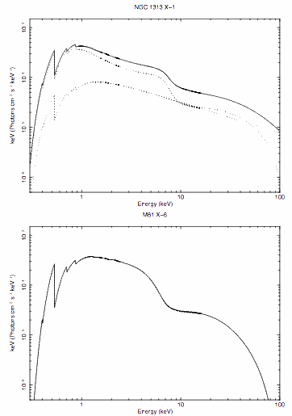
Other products are on the market!
Spectral analysis degenerate for ULXs
Kerr disc models (Makishima et al. 2000)
“Slim” accretion discs (e.g. Watarai et al. 2000)
Consistent with some ULX spectra (e.g. Vierdayanti et al. 2006, Mizuno et al. 2007).
Reflection-dominated, highly relativistic emission from inner edge of accretion disc (Caballero-Garcia & Fabian 2010)
Common thread: high accretion rate, small black holes (M_{BH} < 100 M).
From Caballero-Garcia & Fabian 2010

Slide 13
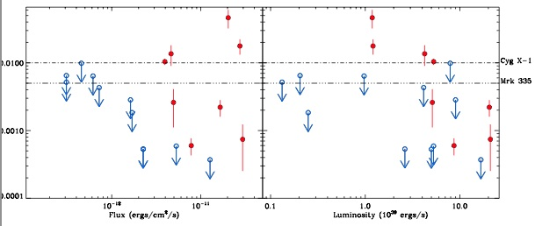
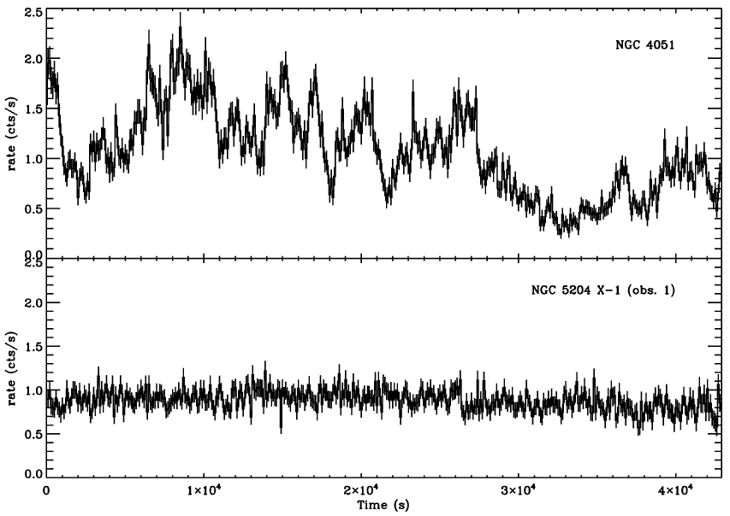
What about X-ray timing?
Heil, Vaughan & Roberts 2009
We’re claiming a new accretion state – but this requires timing information too!
Majority of ULXs have suppressed variability
Variability of ULXs, modelled by constraining PSD shape & normalisation
Variability of NGC 5204 X-1 compared to the AGN, NGC 4051. The count rate of NGC 4051 is scaled to that of NGC 5204 X-1

Slide 14
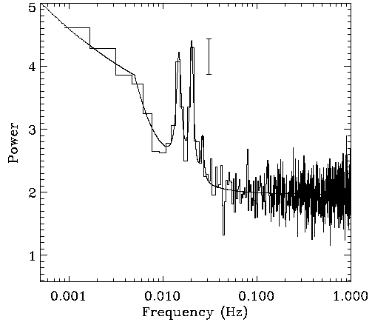
An interesting case – NGC 5408 X-1
ULX with peak L_{x} > 10⁴⁰ erg s⁻¹, highly variable on short timescales
Double QPO detected – if type C, frequency scaling implies an IMBH (e.g. Casella et al. 2008, Strohmayer & Mushotzky 2009)
Also a possible period at ~115 days (Strohmayer 2009)
Double QPO in NGC 5408 X-1 (from Strohmayer et al. 2007)

Slide 15
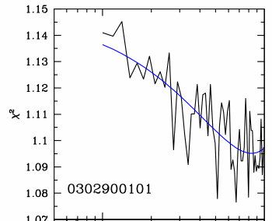
Why NGC 5408 X-1 isn’t an IMBH
Middleton et al. 2010
X-ray spectrum – extreme ultraluminous regime (photosphere dominated)
Doesn’t obey f_{break} – f_{QPO} relationship of Wijnands & van der Klis (1999)
But consistent with ULF QPOs of GRS 1915+105
Energy spectrum (in keV)
Simulations constrain f_{break}; find f_{break}/f_{QPO} > 0.7, should be ~0.1

Slide 16
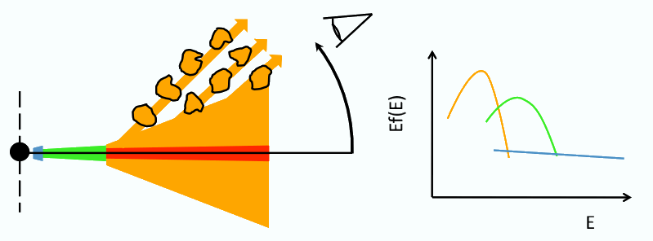
Why the high variability?
rms spectra show high fractional variability (~ 50%) above 1 keV
Viewing angle effect?
Extrinsic variability imprinted by clumpy outflow obscuring inner regions
rms spectra for NGC 5408 X-1 – integrated over timescales of > 20 s, > 100 s, 20 - 100 s

Slide 17
Connection to sub-Eddington states?
Where do ULXs sit on outburst cycle?
For ULXs at ~10³⁹ erg s⁻¹, switch from PL-like to disc-like as L_{x} increases (Gladstone & Roberts 2009; Yoshida et al. 2010)
Γ ~ 2 – either LHS or HIMS, to modified (slim) disc?
?
From Belloni (2010)

Slide 18
M82 X-1 and state changes
Most extreme ULX within 10 Mpc; peak L_{x} ~ 10⁴¹ erg s⁻¹, QPOs etc
Feng & Kaaret (2010) – change from PL-like spectrum + QPOs to disc-like, low variability power
LHS to TD transition; M_{BH} = 200 – 800 M
Alternative: same transition as other ULXs; but M_{BH} 10 times larger (≈ 100 M)
X-1 in here somewhere
0.5 Ms Chandra LP data

Slide 19
How big are ULX black holes?
Zampieri & Roberts 2009
Reasonable limits for MBH at ~ 100 M in many ULXs
Possible if BHs formed in low-metallicity environments!
E.g. Belczynski et al. (2009); Mapelli et al. (2010) etc
Higher rate of ULXs per unit mass already noted for dwarf galaxies (Swartz et al. 2008; also Walton et al. in prep)
~30 M BH in dwarf starburst IC 10 (Prestwich et al. 2007)
From Walton et al. in prep
Notes:
Nothing much to add beyond text.

Slide 20
Hyperluminous X-ray sources (HLXs)
2XMM catalogue detection of L_{X} > 10⁴¹ erg s⁻¹ HLX in the d ~ 30 Mpc galaxy NGC 470
HLXs best remaining IMBH candidates, L_{X} > 10⁴¹ erg s⁻¹
< 10 known! ESO 243-49 HLX-1 the highest L_{X} (Farrell et al. 2009)
Open question: extreme peak of ‘normal’ ULX population; or physically different objects (e.g. accreted dwarf AGNs)?
Sutton et al. in prep

Slide 21
The key observation
As with Galactic BHs, the ultimate test of the compact object mass in ULXs must be dynamical studies.
3-step programme:
Identify counterparts from Chandra astrometry and HST imaging (Jeanette Gladstone thesis; Gladstone et al. in prep.)
Obtain pilot optical spectroscopy observations to identify useful spectral features
Undertake the RV measurements campaign

Slide 22
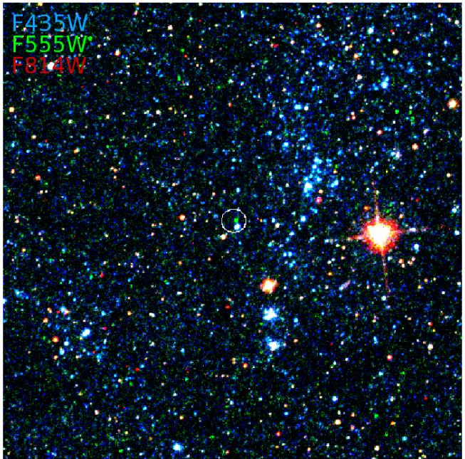
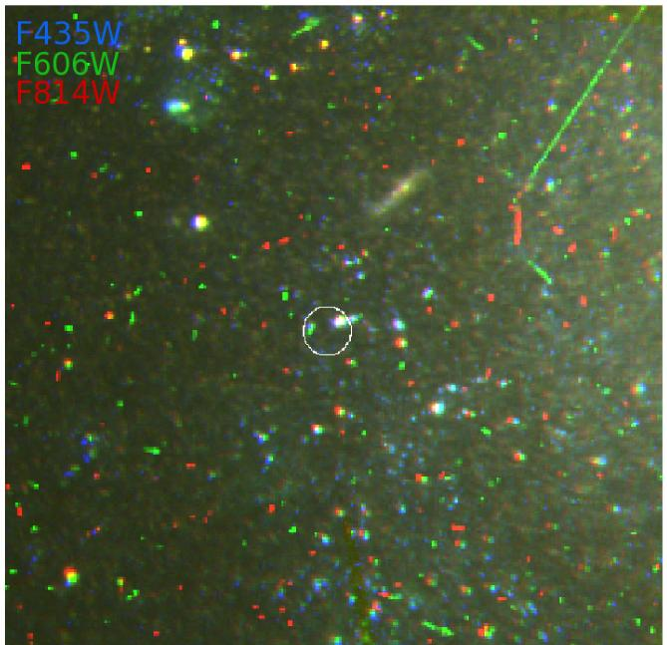
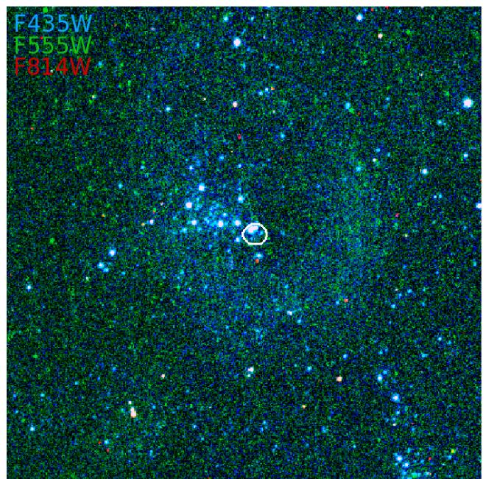
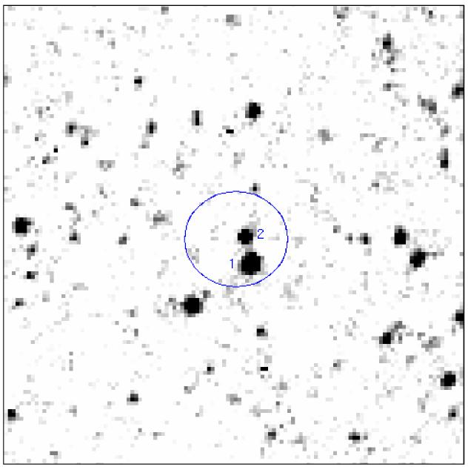
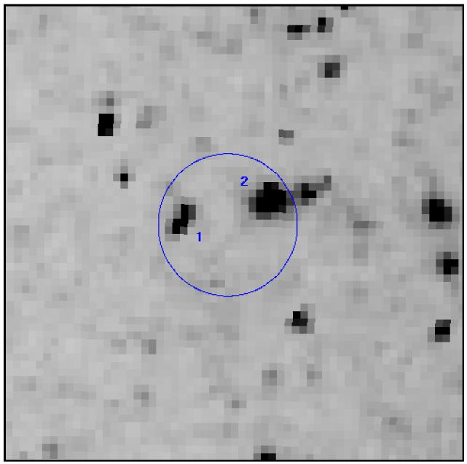
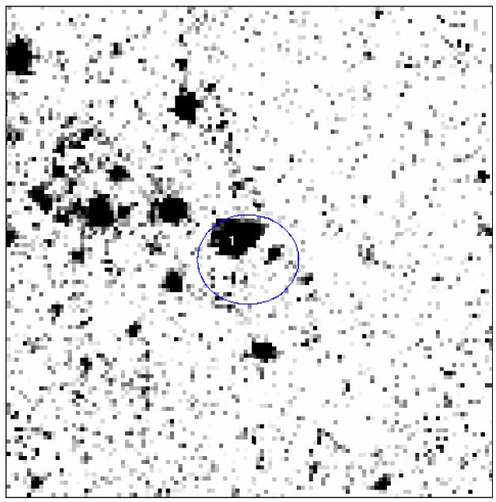
Best targets
Luminous ULXs (> 5 ×10³⁹ erg s⁻¹)
NGC 1313 X-2
m₅₅₅ = 23.3
NGC 5204 X-1
m₆₀₆ = 22.3
Ho IX X-1
m₅₅₅ = 22.5

Slide 23
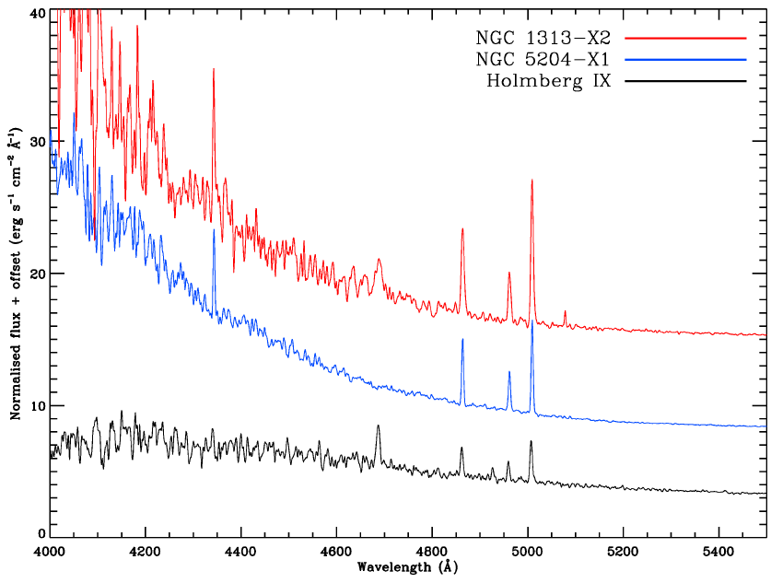
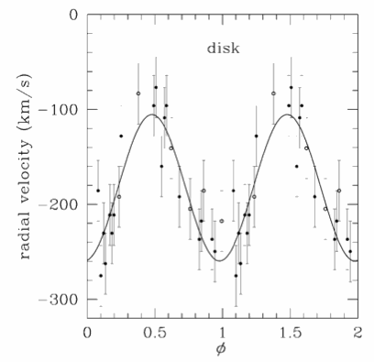
Chasing ULX mass functions
Pilot spectroscopy with Gemini GMOS show broad He II 4686Å lines
Likely to be from the accretion disc – not ideal, but possible tracer of orbit of BH around star
Obtained ~ 50 hours of Gemini time to chase radial velocity measurements, mass function
Radial velocity curve of GRO J1655 from He II line (Soria et al. 1998)

Slide 24
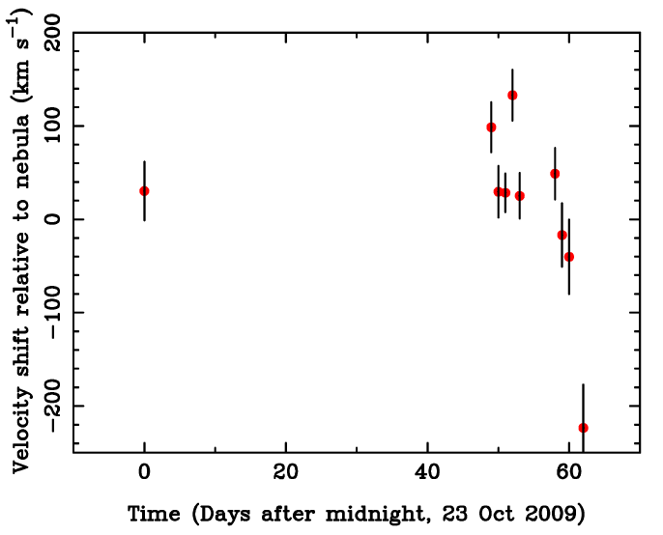
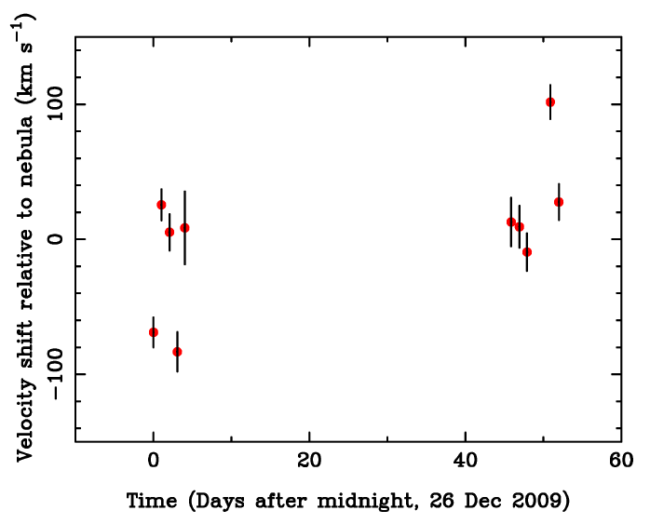
Radial velocity variations
Roberts et al. 2010
Preliminary result: Not periodic, no mass functions
NGC 1313 X-2 Ho IX X-1

Slide 25
But still some interesting science!
He II 4686Å line very variable on timescales of days
Ho IX X-1
NGC 1313 X-2
But not broad enough for accretion disc – systems close to face-on? Or other origin (e.g. wind)?

Slide 26
Nature of the counterparts
Stack all 10 spectra per object
Virtually featureless – accretion-disc-dominated?
Stellar features at short wavelengths?

Slide 27
State of play
Emerging picture of ULXs as a population of super-Eddington, small(ish) stellar remnant black holes
Key characteristic: radiation-driven winds
Best remaining IMBH candidates – HLXs
Still require mass functions – isn’t easy!
Face-on objects suggested by initial data; consistent with super-Eddington models

