Slide 1
Exploring the Nature of the Brightest
Hyper-luminous X-ray Source
Sean Farrell
XMM-Newton Survey Science Centre
University of Leicester, UK
(soon to be University of Sydney, Australia)
In collaboration with…
D. Barret, S. Corbel, G. Dubus, R. Fender, N. Gehrels, O. Godet, A. Gosling, I. Heywood, C. Knigge,
J-P. Lasota, E. Lenc, T. Maccarone, S. Oates, B. Plazolles, M. Servillat, N. Webb, K. Wiersema

Slide 2
Overview
Overview
Discovery of ESO 243-49 HLX-1
X-ray properties:
Energy spectrum
Long-term variability
Multi-wavelength studies:
Optical spectroscopy (VLT)
Low-resolution UV imaging (GALEX, Swift)
High-resolution NIR/optical/UV imaging (HST)
Radio observations (ATCA)
Conclusions

Slide 3
Discovery
HLX-1 discovered serendipitously in 2XMM catalogue (Farrell+ 2009)
Coincident with edge-on S0a spiral galaxy ESO 243-49 at ~100 Mpc
At galaxy distance, unabsorbed L_{x} ~ 10⁴² erg/s in 0.2 – 10 keV band
Brightest ULXs prior to this discovery had L_{x} ~ 1 x 10⁴¹ erg/s (e.g. Cartwheel, M 82, NGC 2276 hyper-ULXs)
Observed luminosity ~400 times greater than Eddington limit for 20 M_{sun} BH

Slide 4
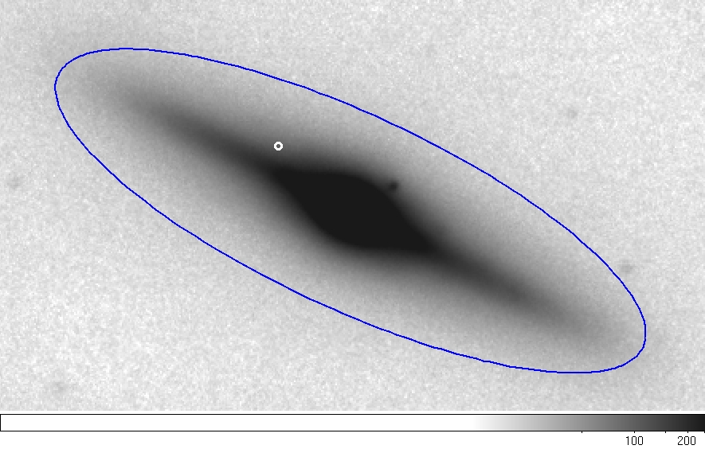
Discovery
Chandra position of HLX-1, error ~ 0.3”
Magellan J-band image of ESO 243-49

Slide 5
X-ray Properties
Observed with XMM-Newton on 3 occasions so far (2004, 2008, 2010)
Spectral shape and luminosity highly variable
Best fit spectral models…
XMM1: simple absorbed power law, Γ = 3.4 +/- 0.3
XMM2: power law + DBB, Γ = 2.2 +/- 0.3, kT = 0.18 keV
XMM3: simple absorbed power law,
Very recent Chandra ACIS-S observation → purely thermal spectrum (kT ~ 0.25 keV, L_{x} ~8 x 10⁴¹ erg s⁻¹)

Slide 6
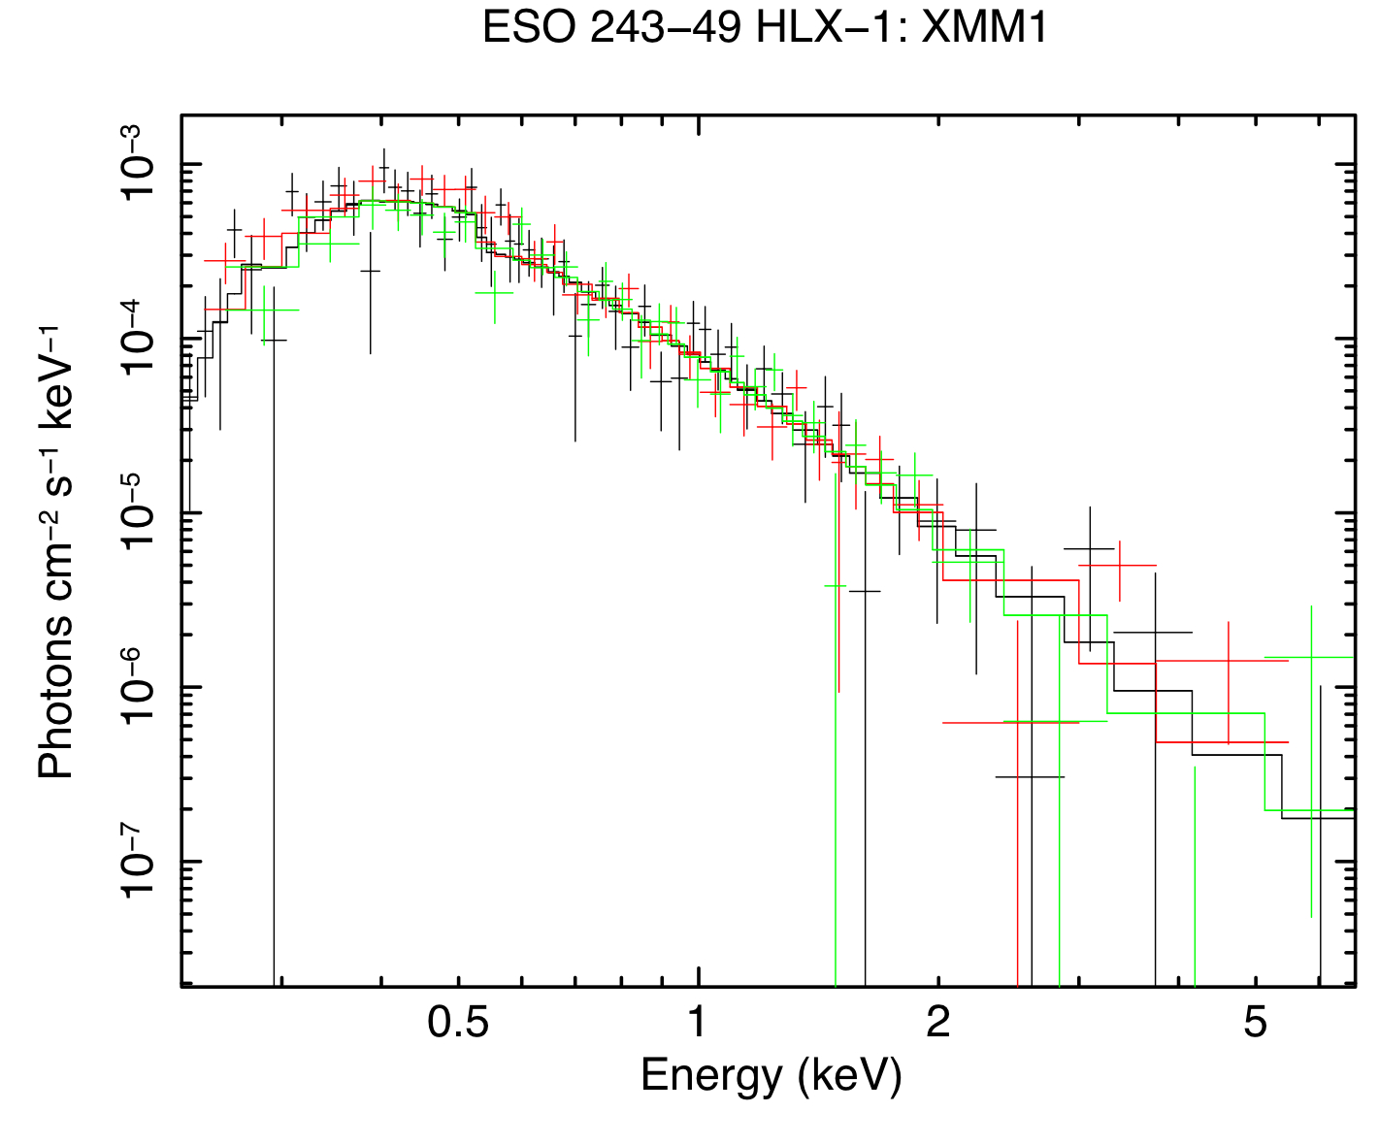
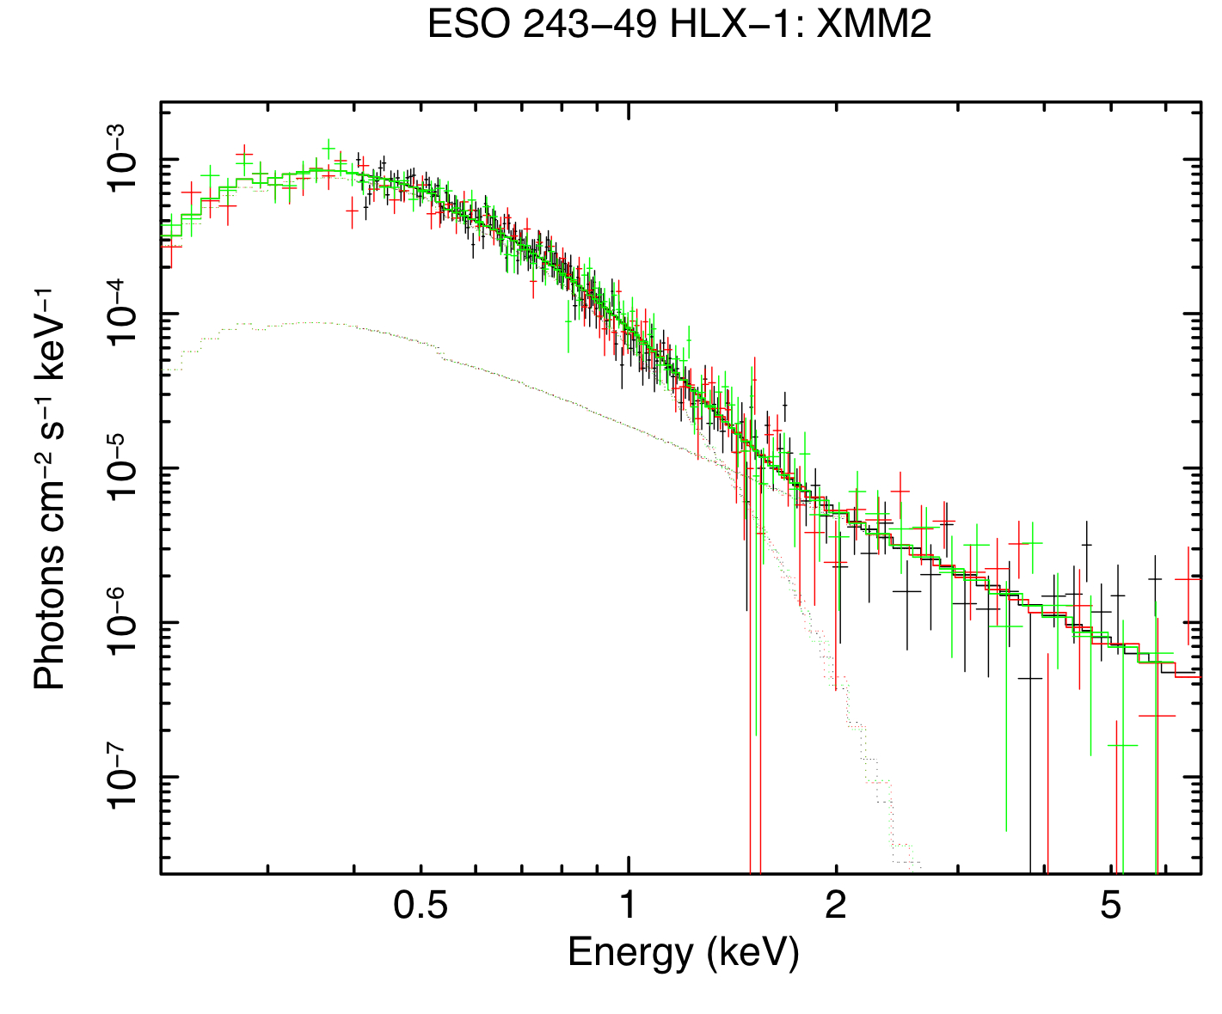
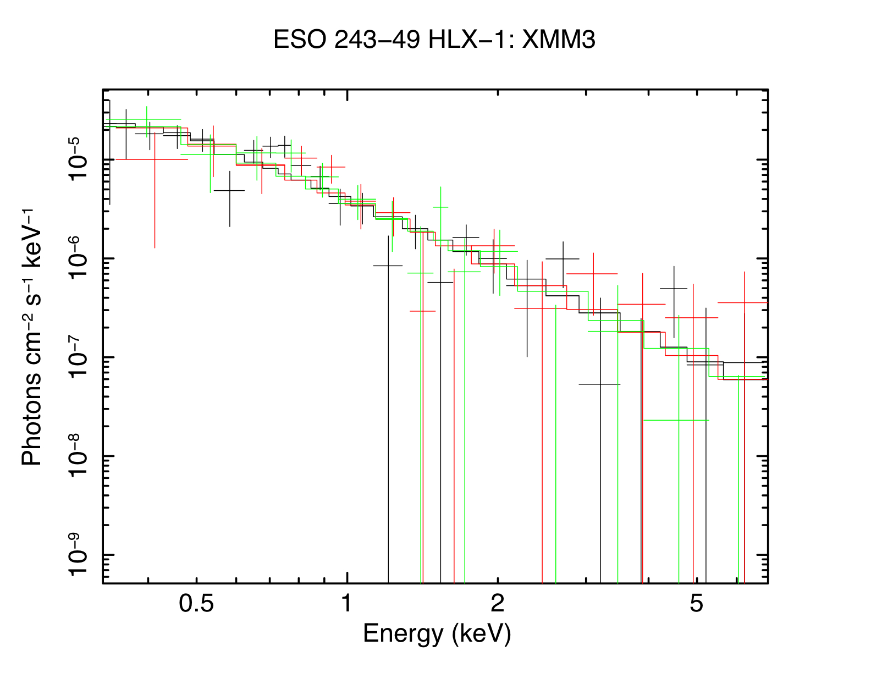
X-ray Properties
2004-11-23
2008-11-28
2010-05-14

Slide 7
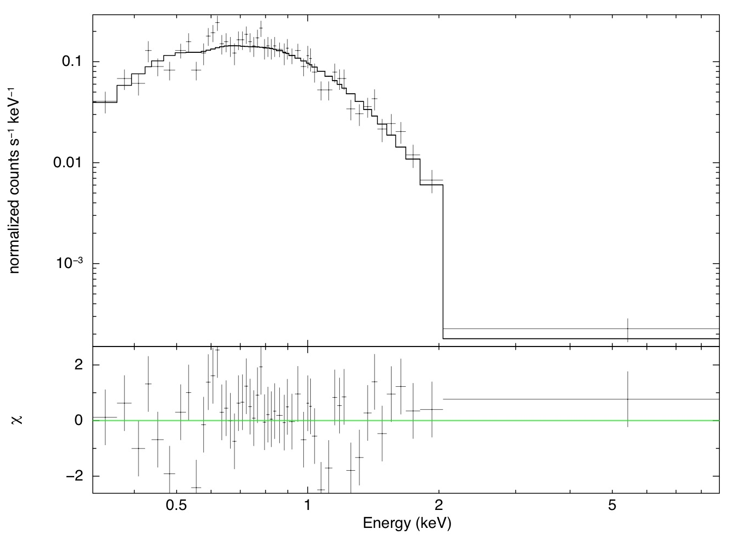
X-ray Properties
Chandra ACIS-S
06-Sept-2010

Slide 8
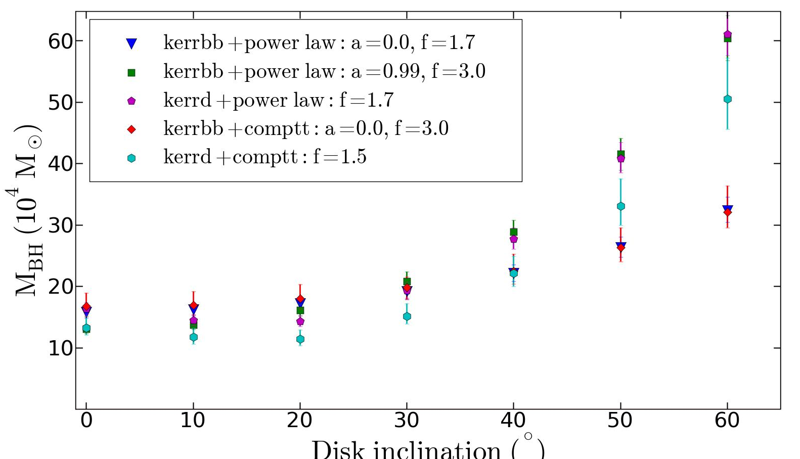
X-ray Properties
a = 0.99
3
a = 0
Fits to XMM2 spectrum using Kerr black hole disc black body models gives masses between ~10,000 – 60,000 M_{sun}

Slide 9
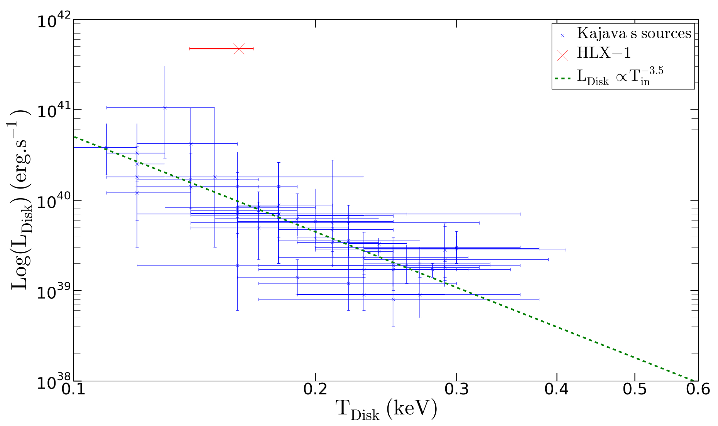
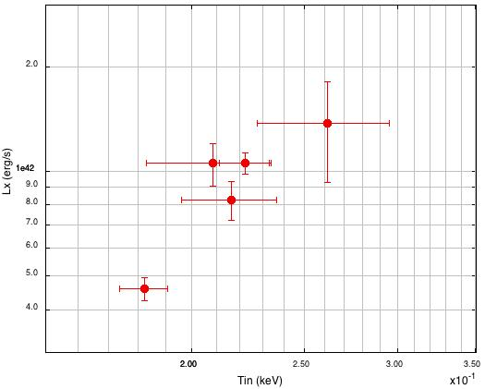
X-ray Properties
XMM2
HLX-1
T_{in} ~ L_{d}³
Blue points from Kajava & Poutanen (2009)

Slide 10
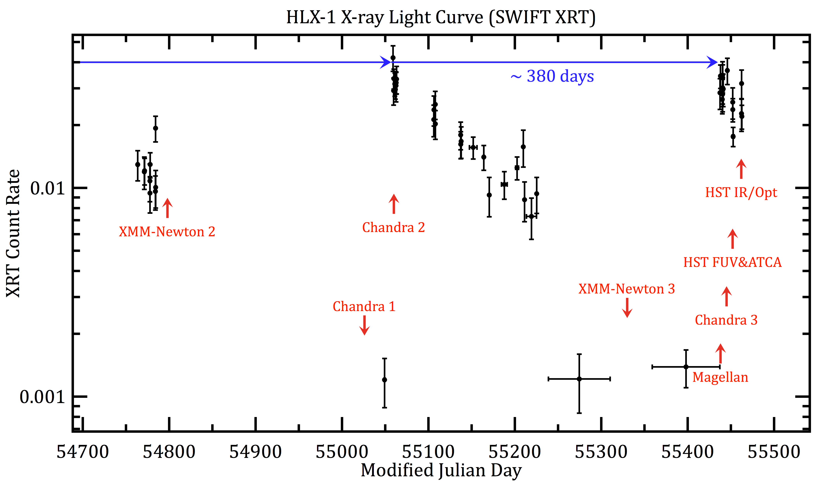
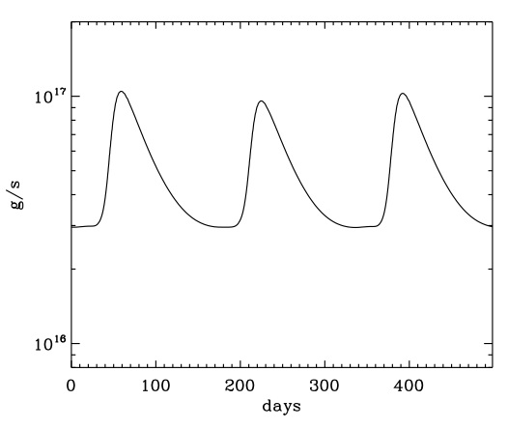
X-ray Properties
DIM predicted LC
Dubus (2005)

Slide 11
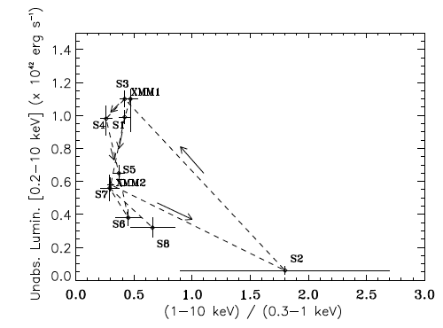
X-ray Properties
Hardness intensity diagram showing spectral hysteresis
High/Soft
EPIC pn
Farrell+ in prep
Galactic black hole
X-ray binary spectral
hysteresis curve
Low/hard
Godet et al. (2009)

Slide 12
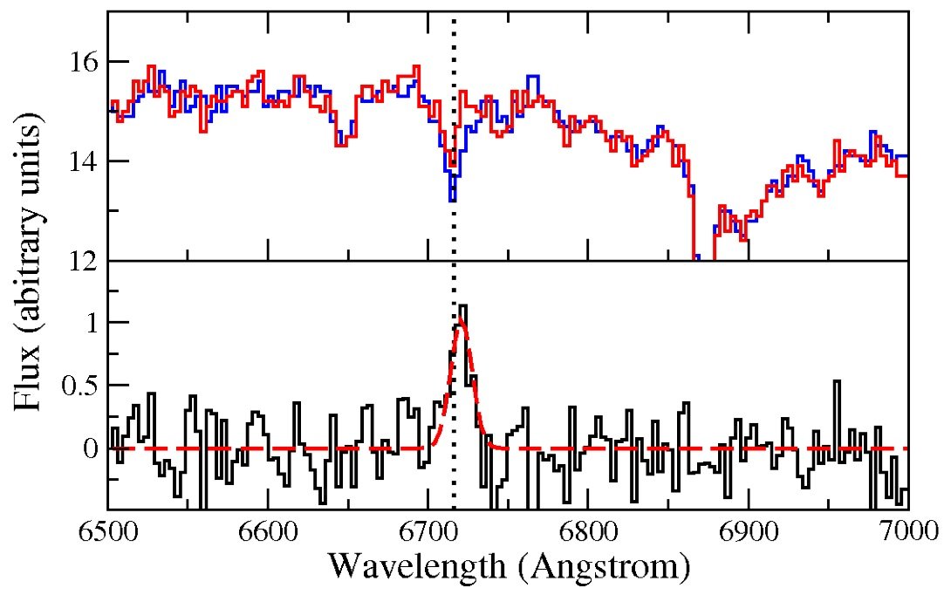
Optical
Faint (R = 23.8 mag) optical counterpart discovered by Soria et al. (2010)
Follow-up VLT imaging confirmed detection (Wiersema et al. 2010)
Spectrum is dominated by continuum emission with no obvious emission lines (expected for background galaxy or coronally active foreground star)
Hα absorption line apparent in spectrum of galaxy, with obvious rotation
Background subtracted HLX-1 spectrum detects 11.3σ emission line at 6721Å, consistent with Hα at galaxy redshift of z = 0.022 (~+170 km/s shift)
Definitely in ESO 243-49, so not a foreground or background object!
VT 2-D spectrum
After subtracting smoothed 2-D spectrum
HLX-1
Bkg
Hα
HLX-1
Hα
VLT I-band image
After subtracting smoothed image
Wiersema et al. (2010)
Wiersema et al. (2010)

Slide 13
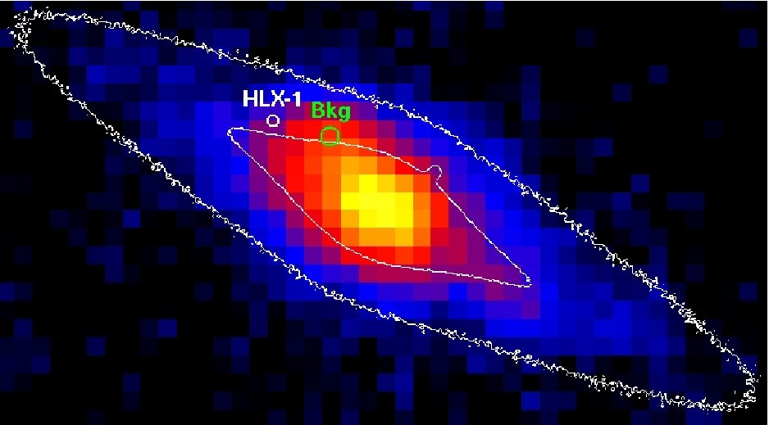
Ultra-violet
Extended UV emission detected in low-res GALEX & Swift UVOT data, possibly associated with HLX-1
Indication of hot accretion disc around intermediate mass BH?
Evidence of star formation driven by galaxy interactions?
However, also consistent with emission line source in VLT spectrum
Webb et al. (2010)

Slide 14
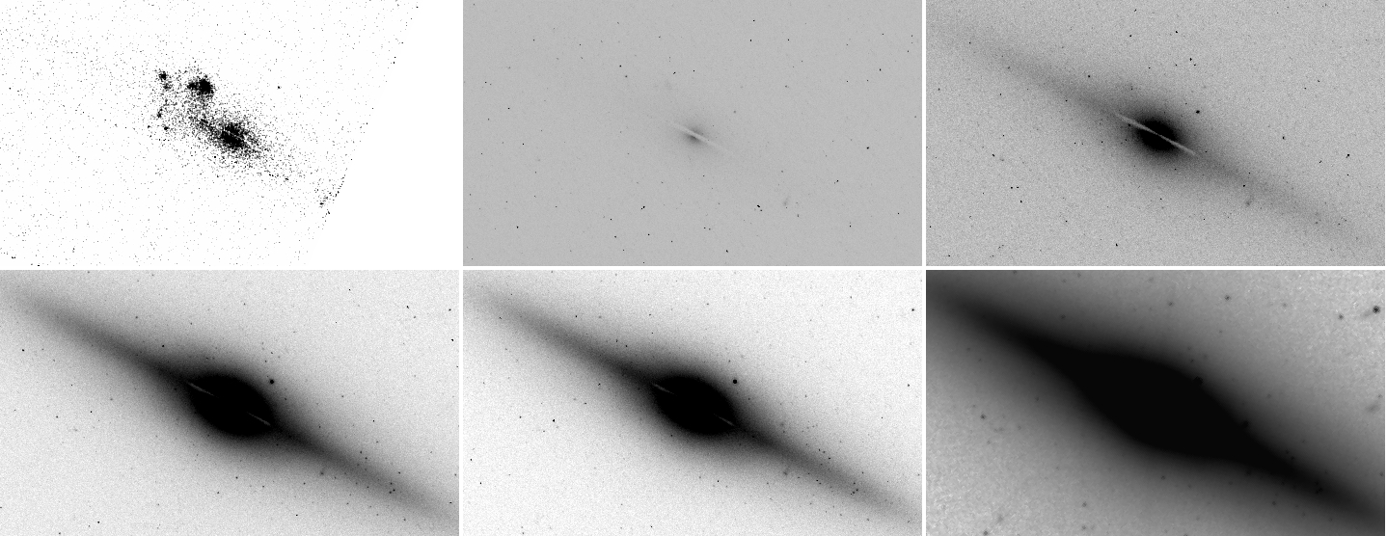
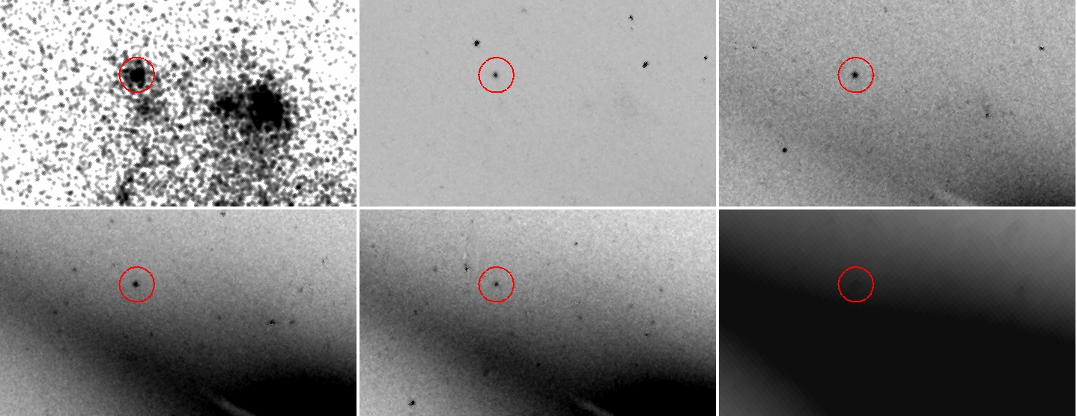
HST NIR/Optical/UV
Obtained HST imaging in 6 bands from near-IR → far-UV with WFC3/ UVIS, WFC3/IR & ACS/SBC (+ simultaneous Swift XRT) in September
HLX-1 counterpart clearly detected in all but H-band, with flat spectrum (~24 mag)
FUV
NUV
C
V
I
H
H
Farrell et al. in prep

Slide 15
HST NIR/Optical/UV
Extended UV emission detected in low-res GALEX & Swift UVOT data, possibly associated with HLX-1
Indication of hot accretion disc around intermediate mass BH?
Evidence of star formation driven by galaxy interactions?
However, also consistent with emission line source in VLT spectrum
HLX-1
Bkg gal
Composite 6-band HST image

Slide 16
HST NIR/Optical/UV
HLX-1
Bkg Gal?
UVOT uvw2
HST Far-UV

Slide 17
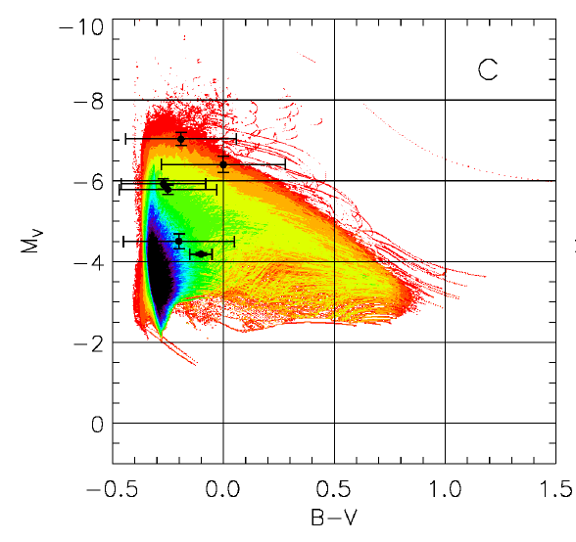
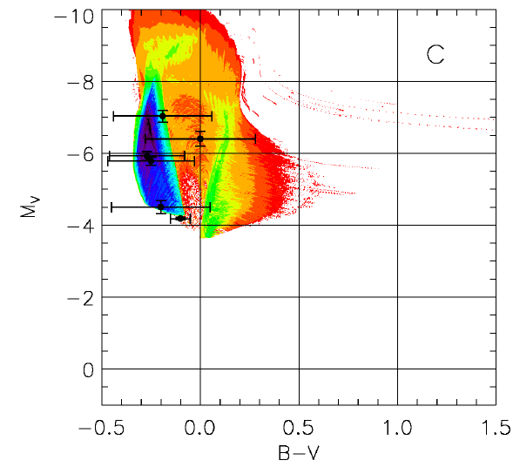
HST NIR/Optical/UV
HLX-1
Predicted colour-magnitude diagram for 10 M_{sun} BH
& 1,000 M_{sun} BH
(Madhusudhan et al. 2008)
10 M_{sun}
1,000 M_{sun}

Slide 18
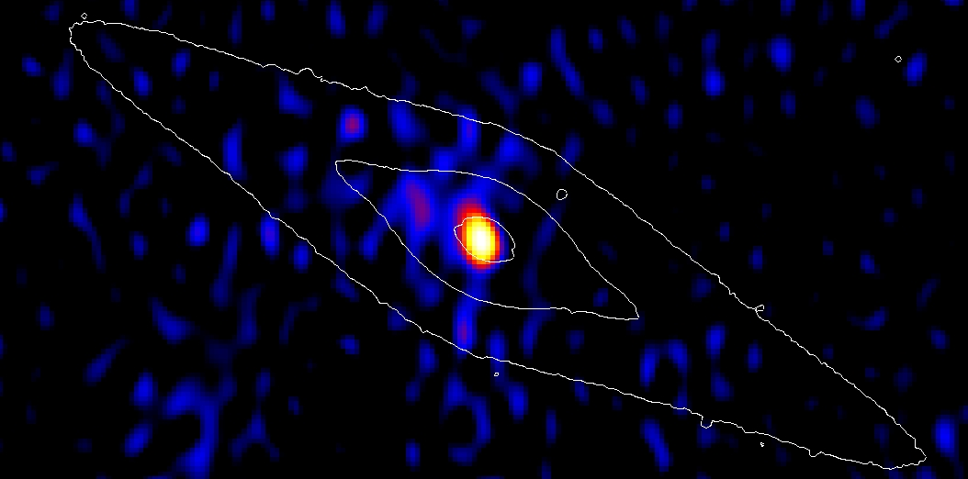
Radio
Obtained ATCA 3cm + 6cm radio observation following re-brightening in Sept
~45 μJy (4σ) source detected at HLX-1 position. Flaring from jet ejection?
HLX-1
Webb et al. in prep

Slide 19
Radio
Black Hole Fundamental Plane Relationship (e.g. Körding et al. 2006)
HLX-1
GBHBs emit radio flares during transition from L/H → H/S (Fender+2009)
Flare L_{R} can be ~10 times brighter than non-flare emission
Mass estimate of ~200,000 M_{sun} therefore an upper limit
10¹ M_{sun}
HLX-1?
HLX-1
10² M_{sun}
10³ M_{sun}
10⁴ M_{sun}
10⁵ M_{sun}
10⁶ M_{sun}
Webb et al. in prep

Slide 20
Conclusions
Redshift of Hα line consistent with ESO 243-49 → definitely in galaxy!
Appears to follow hysteresis curve, but orders of mag brighter than GBHBs
Continuum fitting of disc suggests mass ~10,000 – 60,000 M_{sun}
Detection of radio counterpart implies upper limit of ~200,000 M_{sun} for mass (need additional data to confirm flaring behaviour)
BH fundamental plane relation suggests its too faint to be super-massive, too bright to be stellar mass (if radio emission from jets)
Preliminary analysis of HST data indicates emission consistent with very large disc around massive BH
Data continues to suggest BH > 500 M_{sun} (probably more like ~10,000 M_{sun})

