Slide 1
Spectra and variability properties of accretion flows
Chris Done
University of Durham

Slide 2
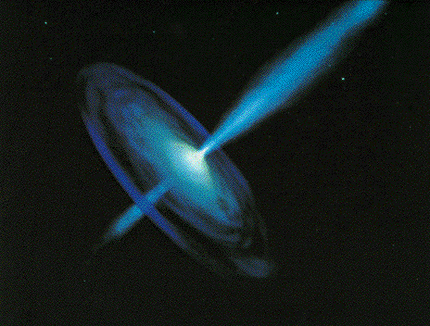
Black holes
A quick review of black hole spectral states
Nature of the low/hard state
Truncated disc/hot inner flow to explain spectra
Supported by quantatitve model for the low frequency QPO and broadband variability (Adam Ingram and Chris Fragile)

Slide 3
Transients
Huge amounts of data, long term variability (days –years) in mass accretion rate (due to H ionisation instability in disc)
Observational template of accretion flow as a function of L/L_{Edd} onto ~10 M BH (very homogeneous!)
2 years
DGK07

Slide 4
Spectral states
Dramatic changes in continuum – single object, different days
Underlying pattern in all systems
High L/L_{Edd}: soft spectrum, peaks at kT_{max} often disc-like, plus tail
Lower L/L_{Edd}: hard spectrum, peaks at high energies, not like a disc (McClintock & Remillard 2006)
very high
disk dominated
high/soft
Gierlinski & Done 2003

Slide 5
Variability of disc:long timescale
L/L_{Edd} ∝AT⁴_{max} (Ebisawa et al 1993; Kubota et al 1999; 2001)
Constant size scale – last stable orbit!! BH spin

Slide 6
Variability of disc:short timescale
Accretion rate through disc changes on timescales of days
tvisc= α⁻¹ (H/R)⁻² tdyn = 5 α⁻¹ (H/R)⁻² (r/6) ^{-3/2} ms ~ 500s even at last stable orbit for 10M BH
No rapid variability of disc in disc dominated states!
0.5 1.0 2.0

Slide 7
But what about the rest??
Disc dominated look like a disc and vary like a disc on both long (L-T⁴) and short (nothing) timescales
Very high at least knows something about a disc
Low/hard state look really different, not at all like a disc!
Gierlinski & Done 2003

Slide 8
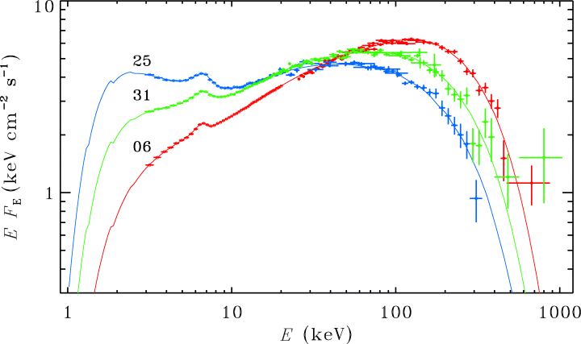
But what about the rest? Low/hard state
Cyg X-1 fit to power law
Ibragimov et al 2005

Slide 9
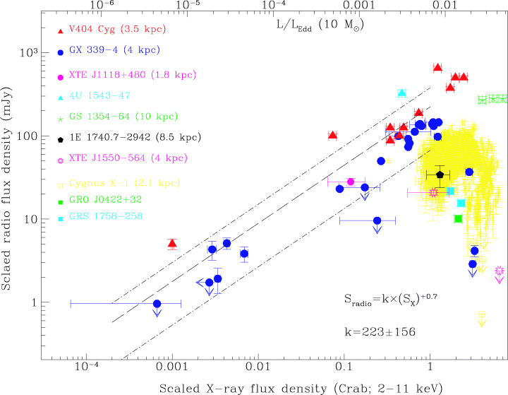
And the radio jet… link to spin?
No special μQSO class – they ALL produce jets, consistent with same radio/X ray evolution
Jet links to spectral state – hard state has steady radio jet which gets brighter as the hard X-rays get brighter
Then collapses as make transition to disc
(Fender et al 2004)
L(radio) jet
L(X-ray) accretion flow
Gallo et al 2003
Notes:
Scaling these models up to the supermassive black holes in quasars, the only change should be that the disc emission is in the UV rather than X-ray region. The problem is knowing how far to scale them for an individual qso, knowing the BH mass. This has only recently become possible with the discovery of the relationships between the BH mass and the properties of the galaxy as a whole. Big BH live in big galaxies, little BH live in small ones. Also, only recently that enough high s/n data has become available to test these models – xmm-newton database

Slide 10
Observed disc variability
Accretion rate through disc changes on timescales of days
tvisc= α⁻¹ (H/R)⁻² tdyn = 5 α⁻¹ (H/R)⁻² (r/6) ^{-3/2} ms ~ 500s even at
But low/hard compton tail very variable on short timescales (0.05s)
If viscous timescale then H/R~1
0.5 1.0 2.0

Slide 11
Low/hard state variability
Hard X-rays show much more dramatic change on short timescales down to few ms
tvisc= α⁻¹ (H/R)⁻² tdyn = 5 α⁻¹ (H/R)⁻² (r/6) ^{-3/2} ms
IF viscous timescale then H/R~1
0.5 1.0 2.0

Slide 12
Accretion flows without discs
Disc models assumed thermal plasma – not true at low L/L_{Edd}
Instead: hot, optically thin, geometrically thick inner flow replacing the inner disc (Shapiro et al. 1976; Narayan & Yi 1995)
Hot electrons Compton upscatter photons from outer cool disc
Few seed photons, so spectrum is hard
Jet from large scale height flow
Log ν f(ν)
Log ν
Notes:
The disc models assumed that the emission thermalised. That’s not necessarily true at low L/Ledd where the flow is not very dense. If its not thermalising then its not cooling as efficiently so the flow heats up. This can lead to a hot, optically thin, geometrically thick inner flow replacing the inner disc. The hot electrons in this flow can compton upscatter any low energy photons from a residual outer disc, but there are not many of these, so the spectrum is hard

Slide 13
No inner disc
Disc models assumed thermal plasma – not true at low L/L_{Edd}
Instead: hot, optically thin, geometrically thick inner flow replacing the inner disc (Shapiro et al. 1976; Narayan & Yi 1995)
Hot electrons Compton upscatter photons from outer cool disc
Few seed photons, so spectrum is hard
Jet from large scale height flow
Log ν f(ν)
Log ν
Notes:
The disc models assumed that the emission thermalised. That’s not necessarily true at low L/Ledd where the flow is not very dense. If its not thermalising then its not cooling as efficiently so the flow heats up. This can lead to a hot, optically thin, geometrically thick inner flow replacing the inner disc. The hot electrons in this flow can compton upscatter any low energy photons from a residual outer disc, but there are not many of these, so the spectrum is hard

Slide 14
No inner disc
Disc models assumed thermal plasma – not true at low L/L_{Edd}
Instead: hot, optically thin, geometrically thick inner flow replacing the inner disc (Shapiro et al. 1976; Narayan & Yi 1995)
Hot electrons Compton upscatter photons from outer cool disc
Few seed photons, so spectrum is hard
Jet from large scale height flow
Log ν f(ν)
Log ν
Notes:
The disc models assumed that the emission thermalised. That’s not necessarily true at low L/Ledd where the flow is not very dense. If its not thermalising then its not cooling as efficiently so the flow heats up. This can lead to a hot, optically thin, geometrically thick inner flow replacing the inner disc. The hot electrons in this flow can compton upscatter any low energy photons from a residual outer disc, but there are not many of these, so the spectrum is hard

Slide 15
Collapse of hot inner flow
Disc models assumed thermal plasma – not true at low L/L_{Edd}
Instead: hot, optically thin, geometrically thick inner flow replacing the inner disc (Shapiro et al. 1976; Narayan & Yi 1995)
Hot electrons Compton upscatter photons from outer cool disc
Few seed photons, so spectrum is hard
Jet from large scale height flow collapse of flow=collapse of jet
Log ν f(ν)
Log ν
Notes:
The disc models assumed that the emission thermalised. That’s not necessarily true at low L/Ledd where the flow is not very dense. If its not thermalising then its not cooling as efficiently so the flow heats up. This can lead to a hot, optically thin, geometrically thick inner flow replacing the inner disc. The hot electrons in this flow can compton upscatter any low energy photons from a residual outer disc, but there are not many of these, so the spectrum is hard

Slide 16
GX339-4 hard state
MOS data from XMM observation is by far the most convincing extreme broad iron line seen in the low/hard state: Miller et al 2006; 2008; Reis et al 2008; 2009; 2010
Miller et al 2006

Slide 17
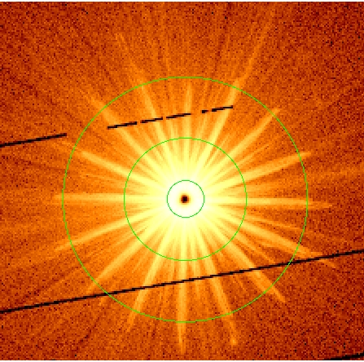
GX339-4 XMM data
Flux gives MOS count rate 200x > than pileup limit
Exclude core. 18-120” singles, data still piled up Done & Diaz-Trigo 2009

Slide 18
Line is much narrower in pn
Simultaneous PN (timing mode, not piled up) is narrower!
Done & Diaz-Trigo 2009

Slide 19
Moving disc
Disc closer in, more soft photons from disc so softer spectra
Especially when overlaps with hot flow. Decrease radius, increase overlap, increases seed photons dramatically
Disc down to last stable orbit and collapse of hot flow gives physical mechanism for hard/soft transition
DGK07

Slide 20
Moving disc – moving QPO
Energy spectra need disc to move from 50-6ish Rg as make transition
Power spectra: low frequency break moves, high frequency power more or less constant! Large radius moves, Small radii constant
Low frequency QPO moves with low frequency break
QPO big, must be fundamental (Adam Ingrams talk)
DGK07

Slide 21
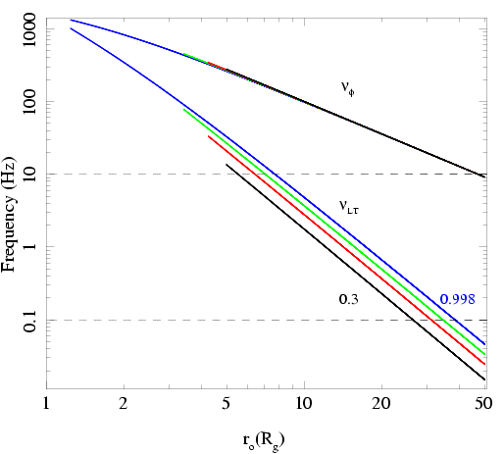
Low frequency QPO
Spectra need disc to move from R_{tr} = 50-6ish R_{g} as make transition
Observed QPO frequencies go from ~0.1-10 Hz
See similar range in ALL BHB – so either all BHB have same spin or not much spin dependence on QPO
Not ν(ϕ) as too fast!
Ingram, Done & Fragile 2009

Slide 22
Low frequency QPO
Stella & Vietri 1998 – GR potential not spherically symmetric so vertically offset circular orbit has ν(θ) ≠ ν(ϕ)
Lense-Thirring precession ν_{LT} = ν(θ) - ν(ϕ)
Lamb & Markovic

Slide 23
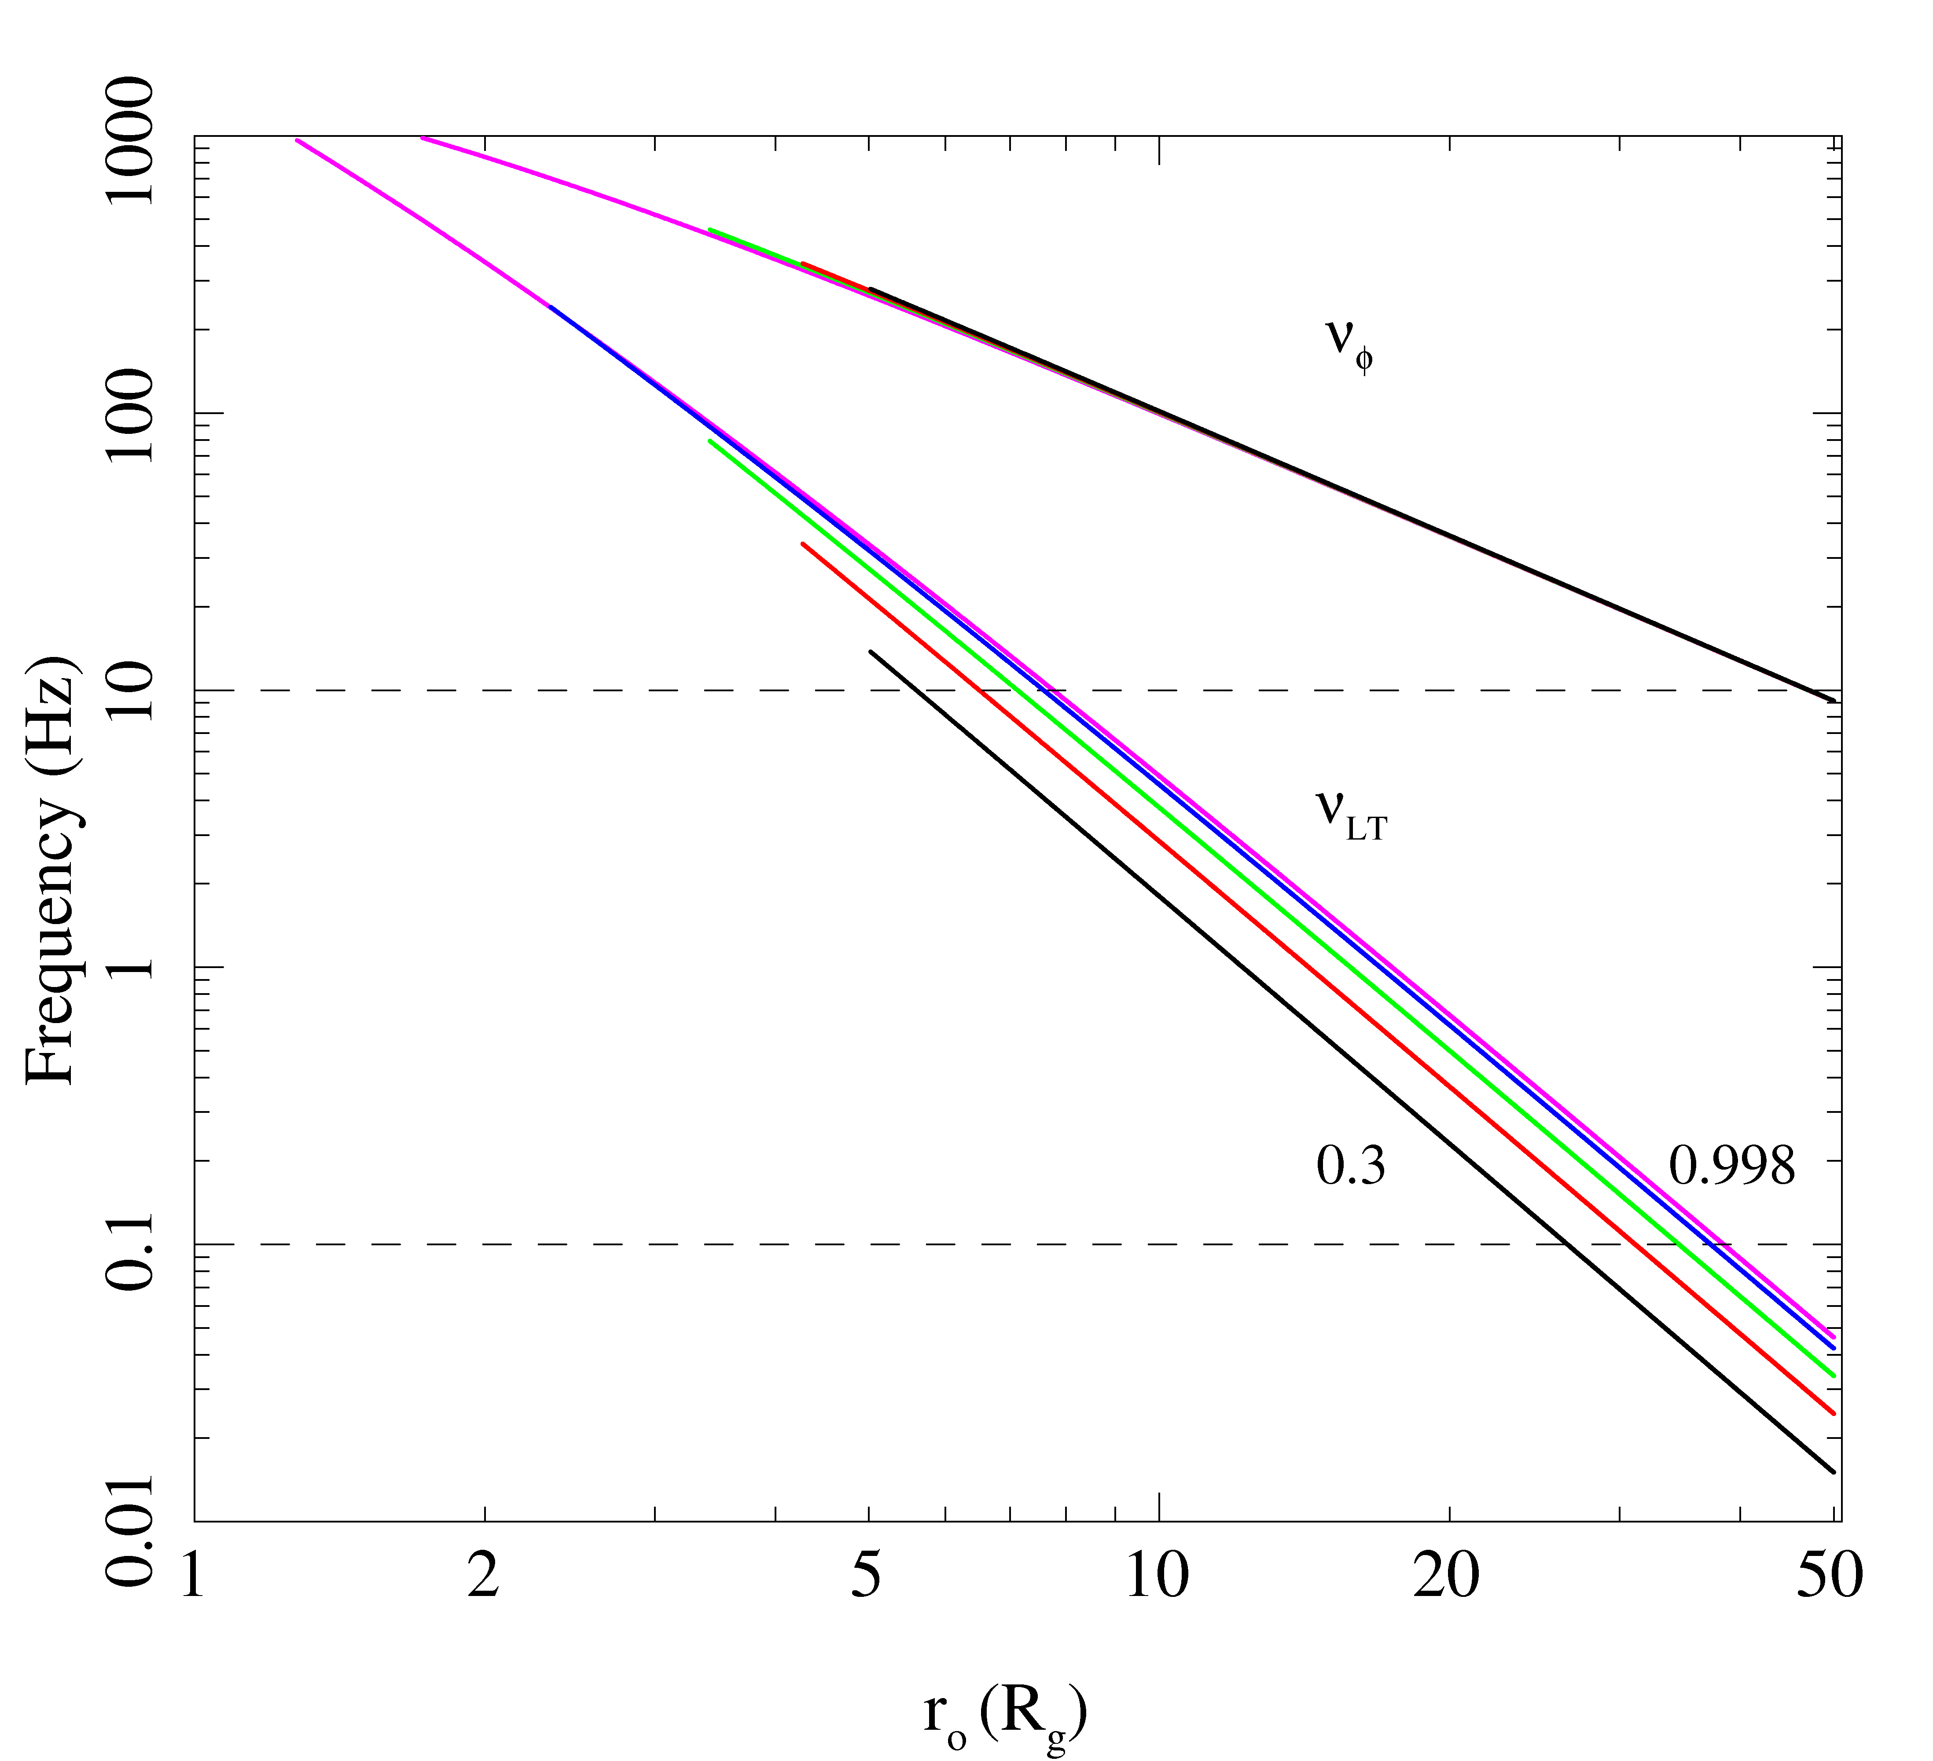
Does it work ?
No!!
And moderate spin gives QPO much faster than observed
BUT this is for single radius. Actually expect whole hot inner flow to precess.
Ingram, Done & Fragile 2009

Slide 24
How does it modulate?
Spectrum of LF QPO is same as Comptonisation to zeroth order
NOT the disc - most obvious close to transition
Zycki & Sobolewska 2005; 2006
DGK07
Ingram, Done & Fragile 2009

Slide 25
< H/R
precession
> H/R
Warped disc
Ingram, Done & Fragile 2009

Slide 26
Chris Fragile 2007

Slide 27
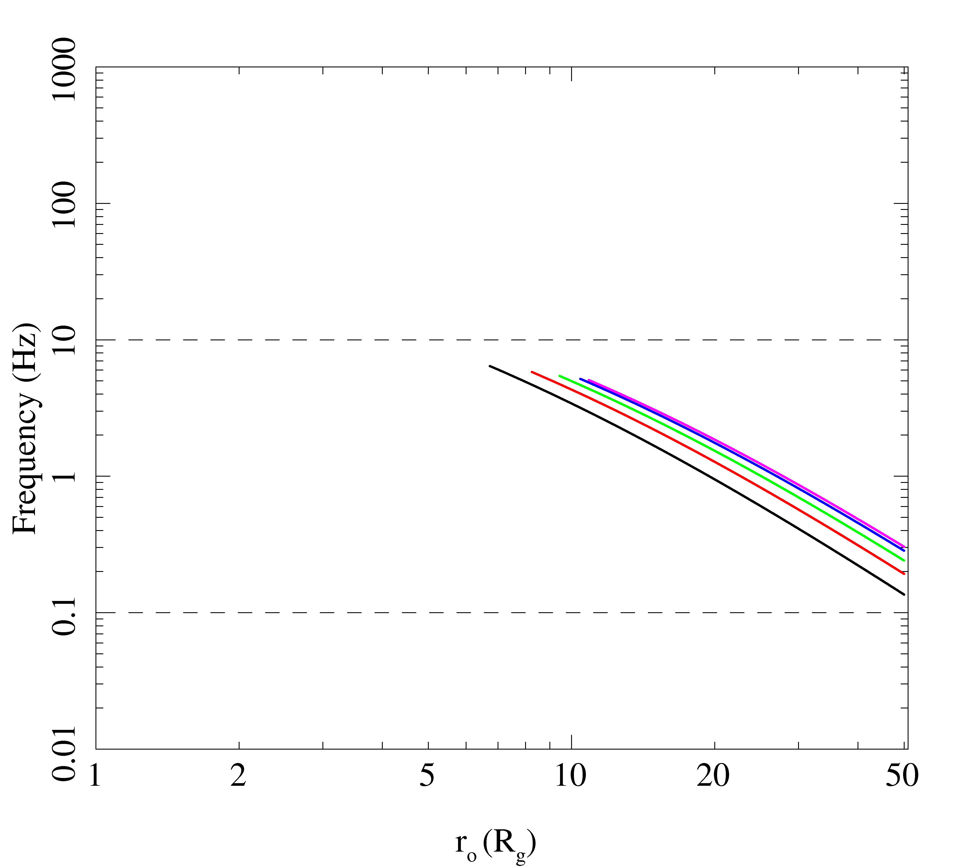
LT precession of hot flow?
Truncates at ~ bending wave radius
QPO frequency given by weighted average of LT precession frequency over all radii in hot flow
Gets the frequencies correct!!
No large spin dependence
Ingram, Done & Fragile 2009

Slide 28
How does it modulate?
Optical depth of ~ unity so translucent. Get change in projected area as function of precession
plus self occultation if inclination within opening angle of torus
Both these modulate the emission from the hot flow – gives harmonic structure!!

Slide 29
Moving disc – moving QPO
Energy spectra need disc to move from 50-6ish Rg as make transition
Power spectra: low frequency break moves, high frequency power more or less constant! Large radius moves, Small radii constant
DGK07

Slide 30
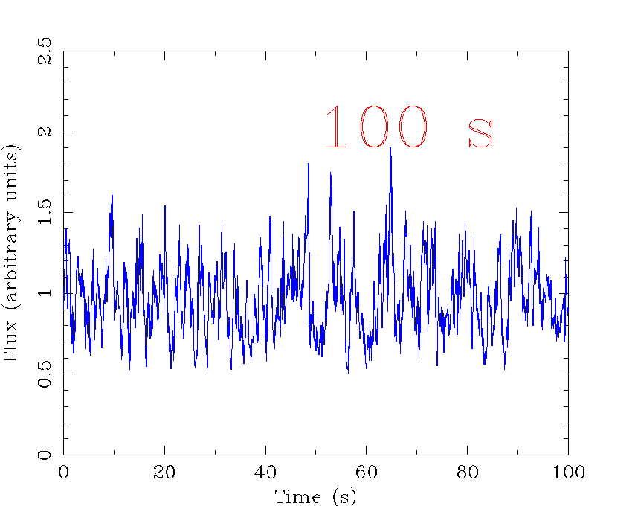
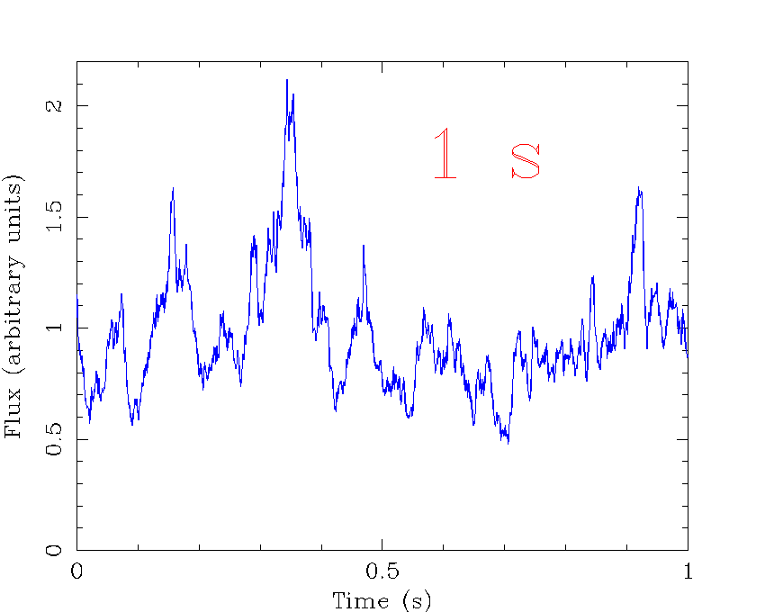
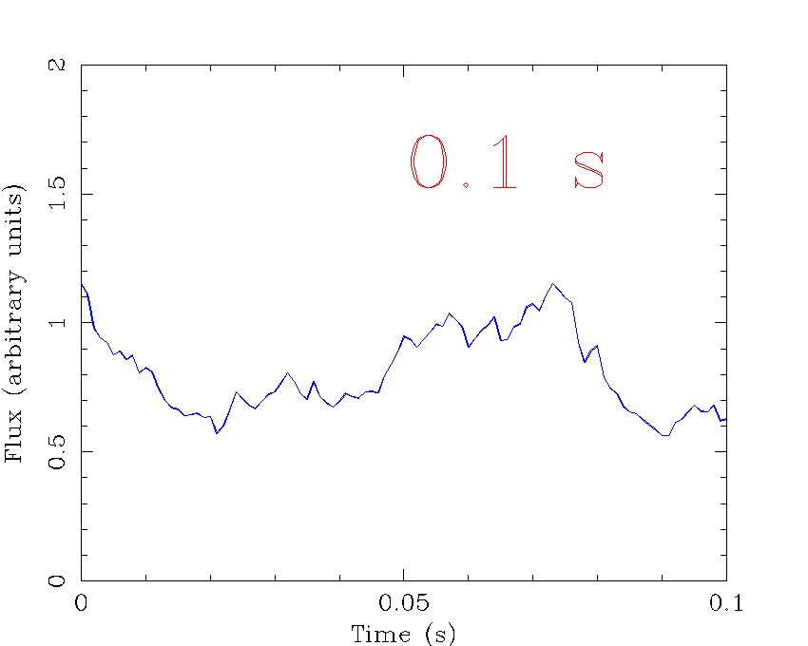
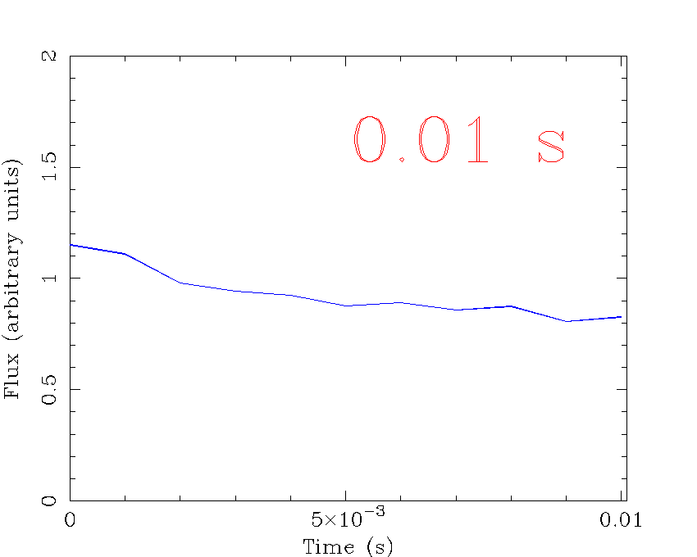
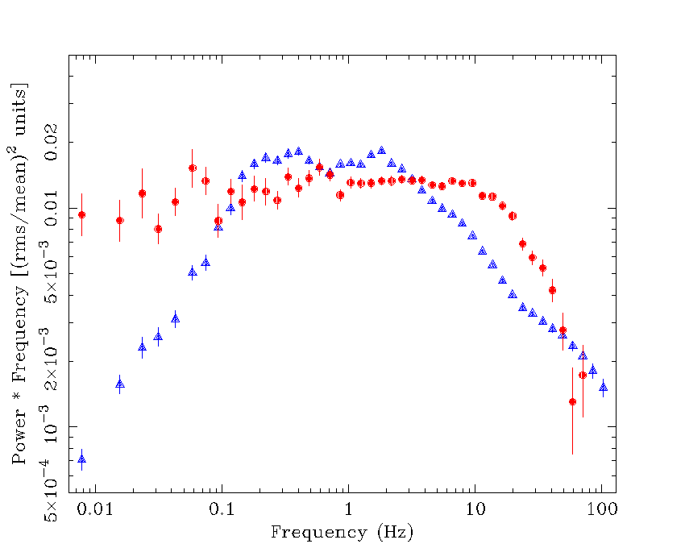
Quantifying variability: the power spectral density (PSD) of Cyg X-1
P(f)∝f⁻¹
P(f)∝f⁰
P(f)∝f⁻²
Phil Uttley

Slide 31
Origin of variability: MRI
Krolik, de Villiers, Hawley

Slide 32
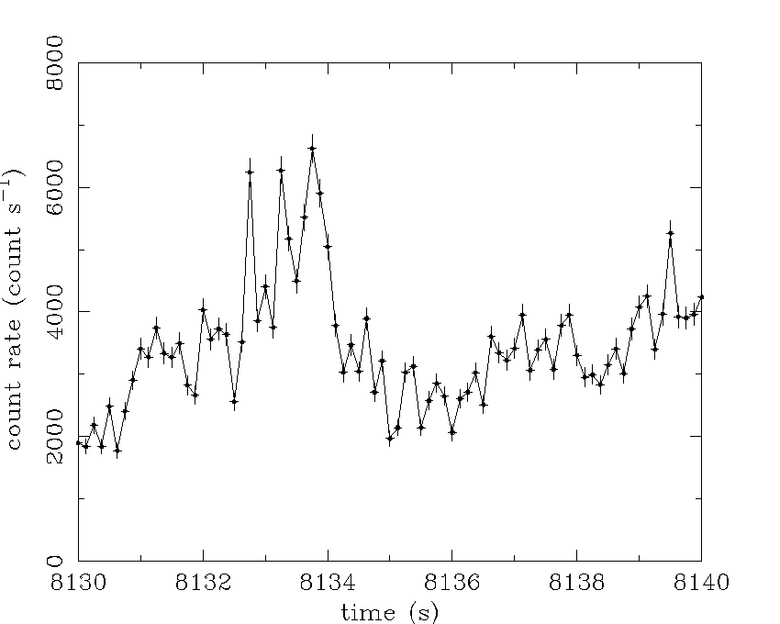
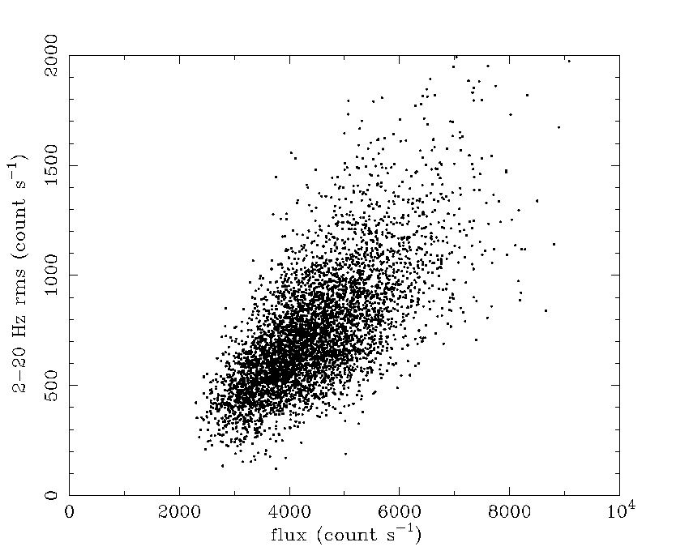
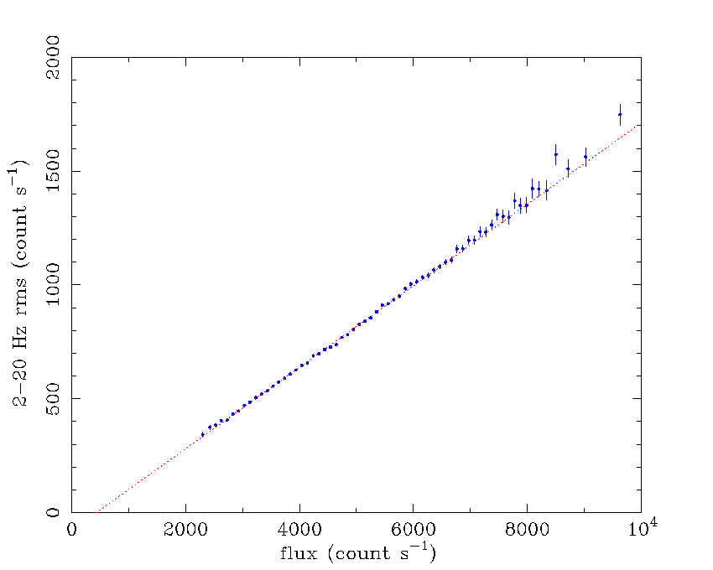
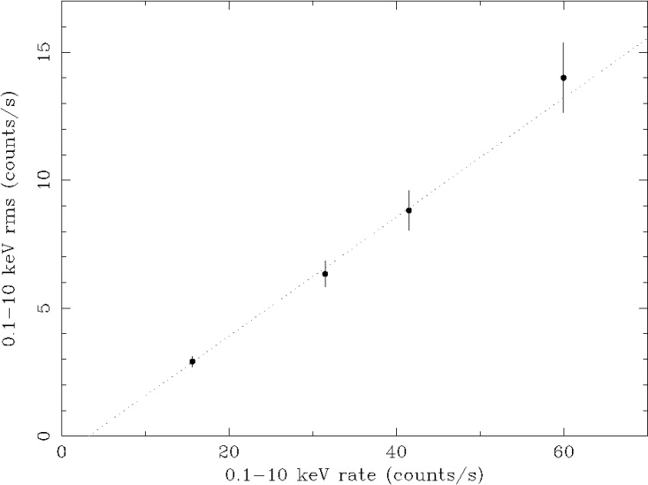
The rms-flux relation
rms-flux relation of Cygnus X-1 [Uttley & M^{c}Hardy 2001 (UM01)]
1 s segments
Unbinned 2-20 Hz
rms vs flux
Binned 2-20 Hz
rms vs. flux
0 1 2 3 4 5 6 7 8 9 10
NGC 4051
rms-flux
rms = sqrt [ (1/N) ∑_{i=1,N} (flux_{i} - mean)² ]
Linear rms-flux relations are
also seen in AGN, e.g.
NGC 4051
(UM01, M^{c}Hardy et al. 2004)

Slide 33
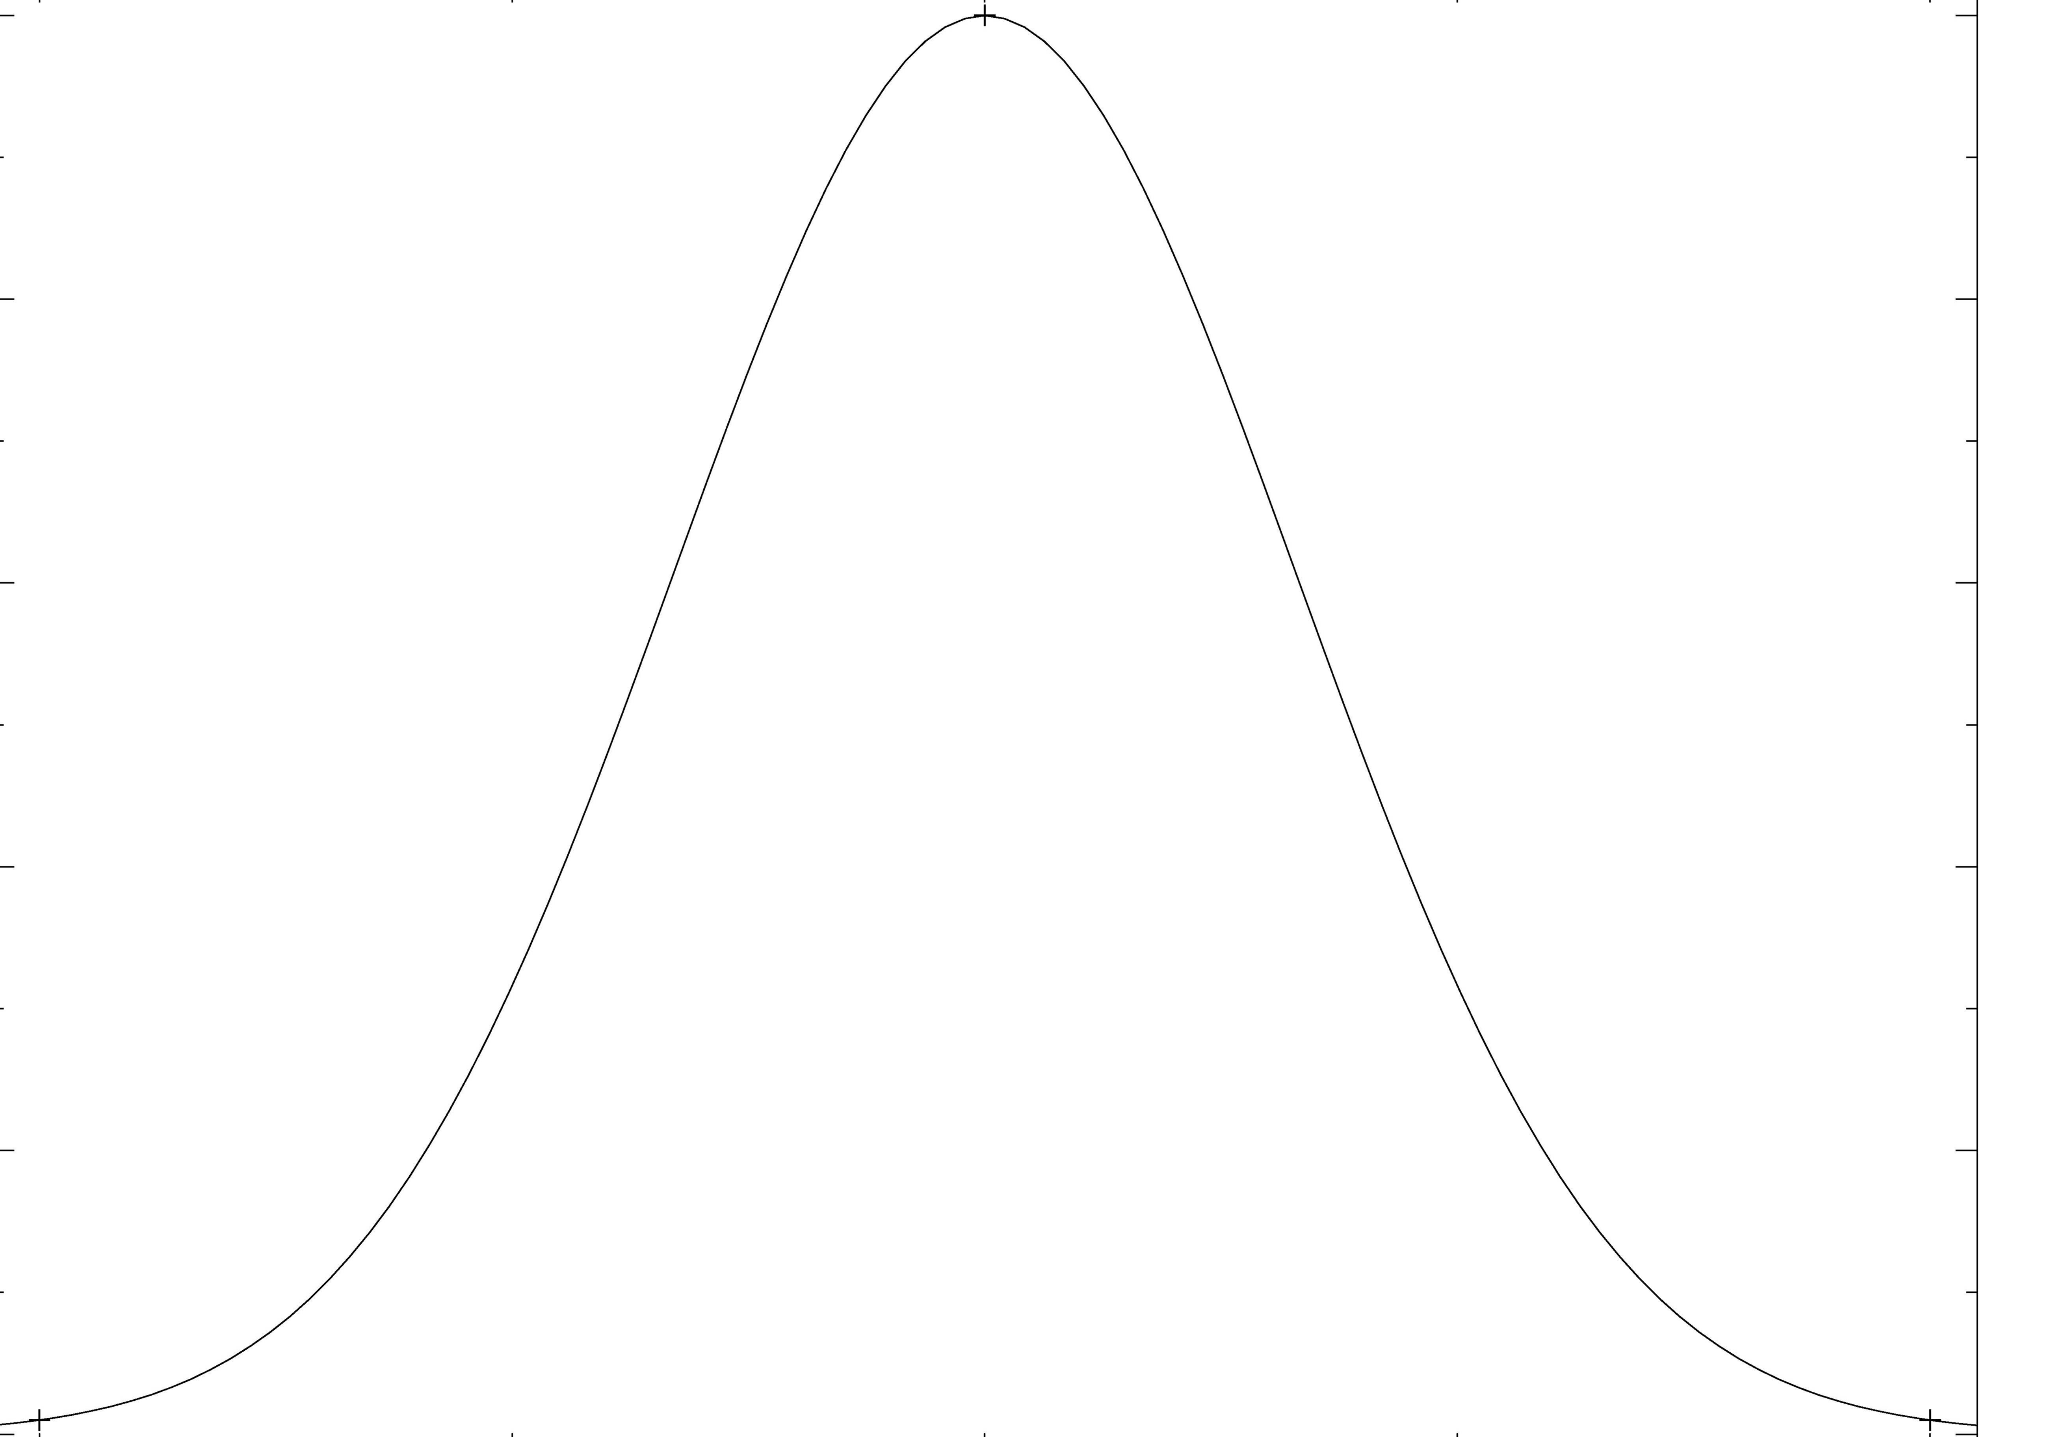
Implies log normal flux distribution
Normalised flux
-0.2 0 0.2
log (flux)
Cannot get this from SHOTS, or any SUM of independent events
Or from reservoir models (wait till critical value triggers event)
Uttley, McHardy & Vaughan 2005

Slide 34
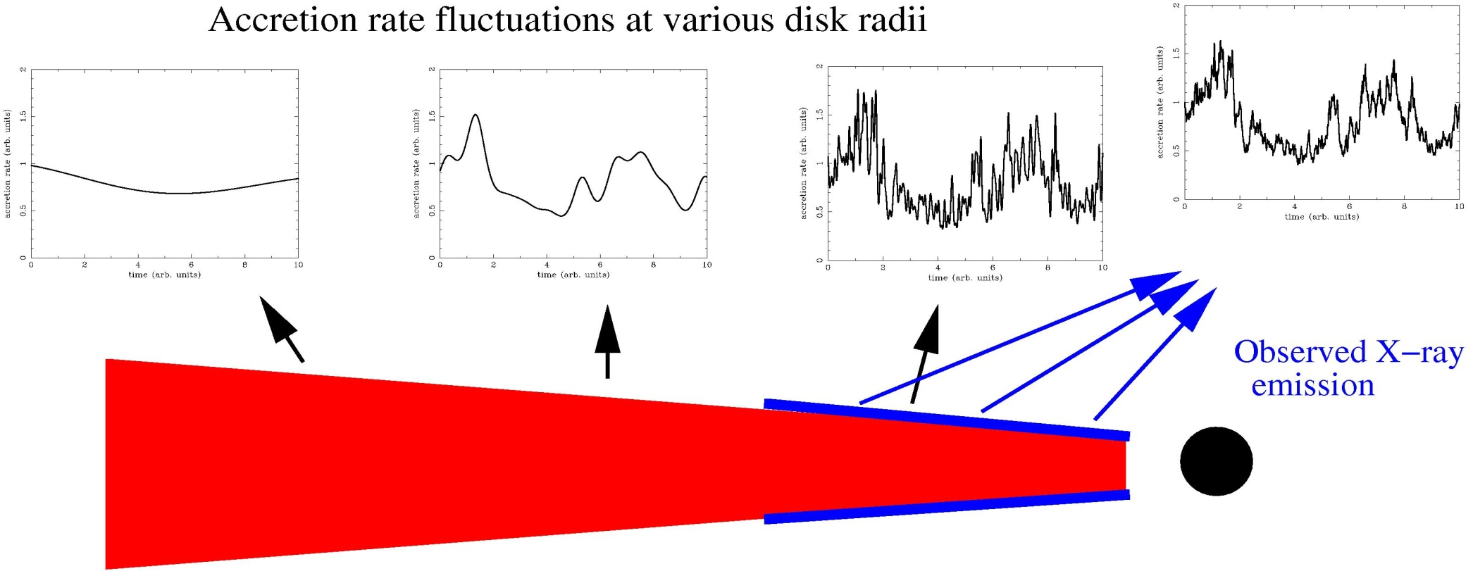
Origin of variability
The model is multiplicative, not additive: fractional mdot variations on different time-scales multiply together: Uttley 2006

Slide 35
And the rest of the variability?
Broadband noise also produced in hot flow – spectrum of variabilty is hard. Disc constant!
MRI drives fluctuations
Equal power from all radii with same H/R
Rin stays fixed while Rt varies – changes low frequency break ν(b) together with ν(QPO). Wijnands & van der Klis 1999
SAME flow gives QPO
Rt
Rin
Log νP_{ν}
Log ν
ν(b)
ν(high)
Ingram & Done 2009

Slide 36
So how can we test it?
Overlap region can be important if Rt small – smaller H/R so smaller normalisation
Mass accretion rate from each radius propagates down to modulate accretion rate in next annulus
central region modulated on all timescales
tvisc(Rt) - tvisc(Rin) setting
ν(b) - ν(high)
Rt
Rin
Log νP_{ν}
Log ν
ν(b)
ν(high)
Ingram & Done 2009

Slide 37
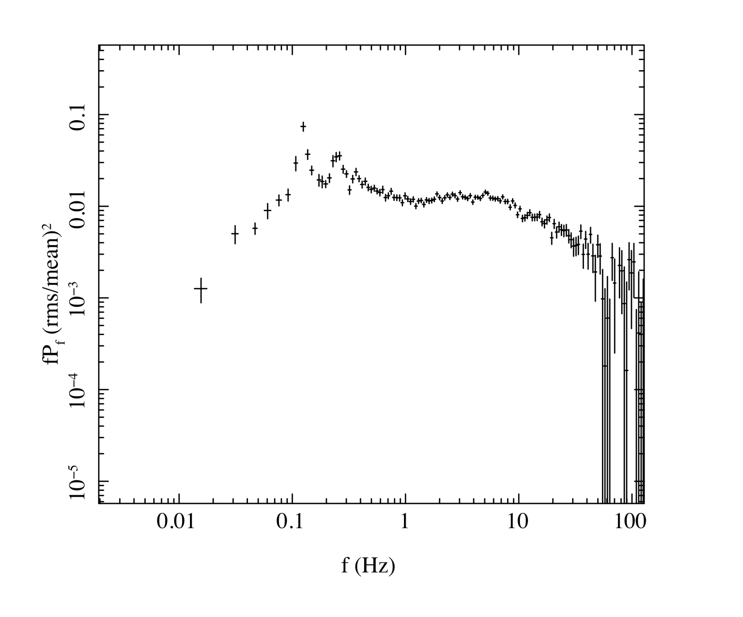
Fitting to observations of XTE 1550-564
Ingram & Done 2010 in prep

Slide 38
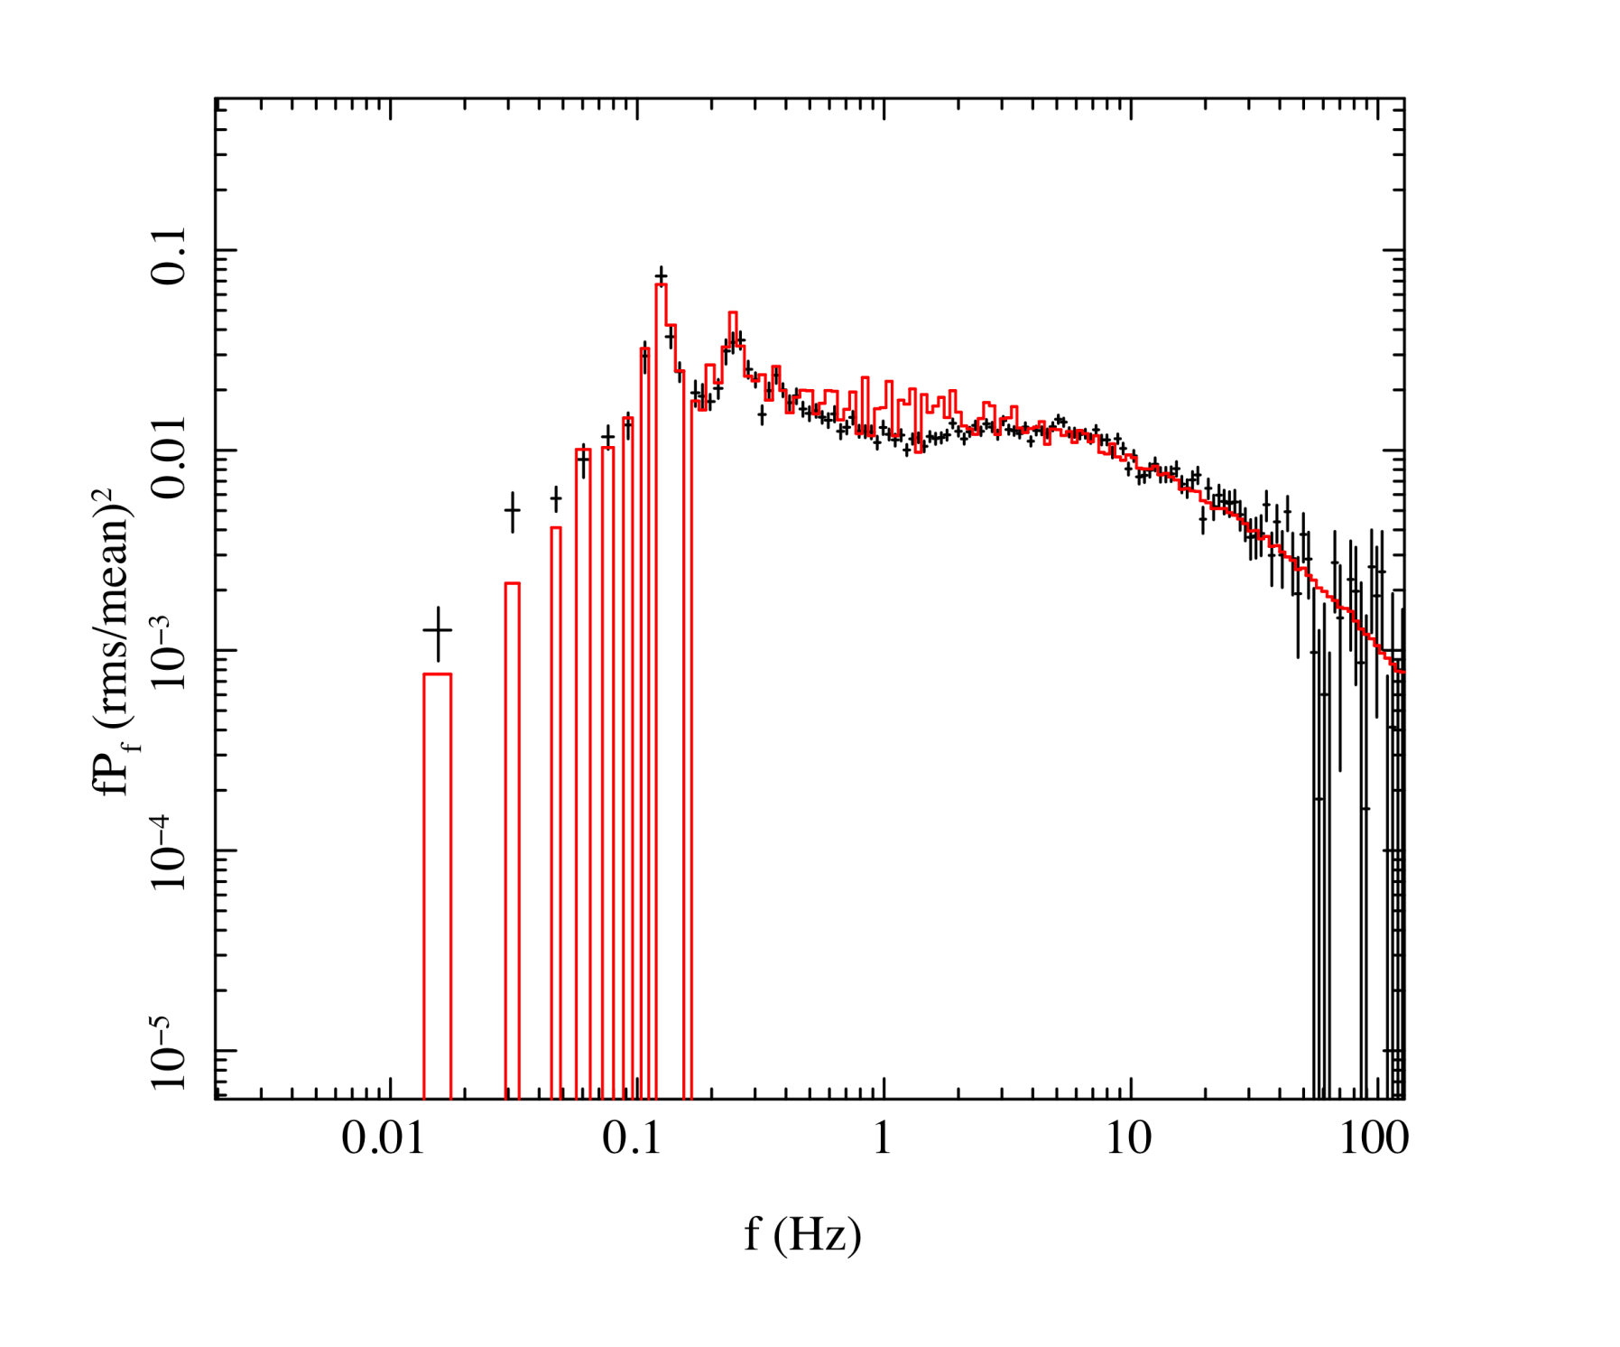
Fitting to observations of XTE 1550-564
r_{o} = 64.7
Ingram & Done 2010 in prep

Slide 39
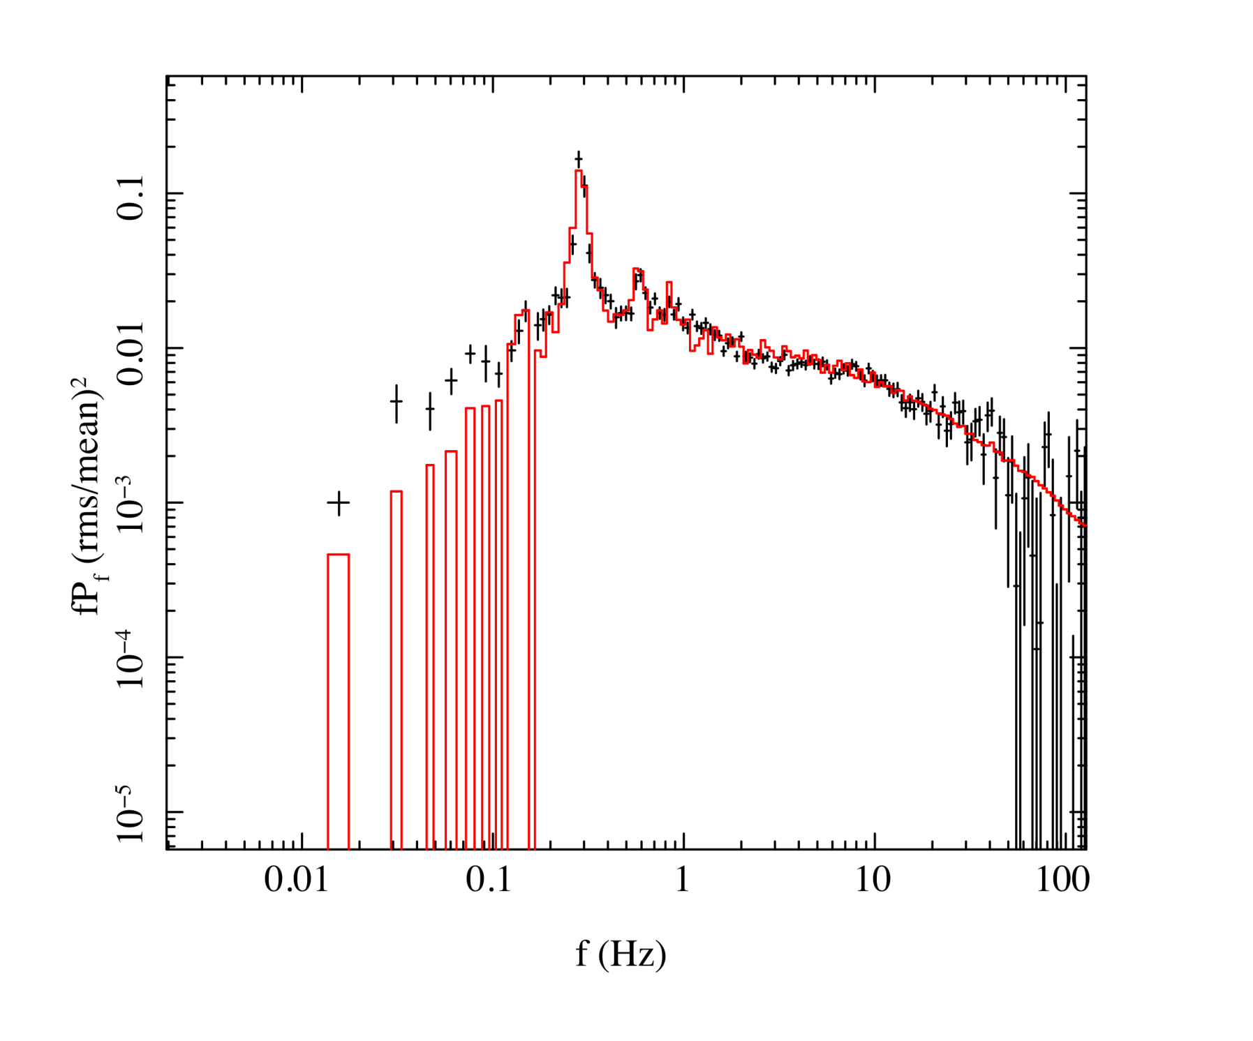
Fitting to observations of XTE 1550-564
r_{o} = 42.3
Ingram & Done 2010 in prep

Slide 40
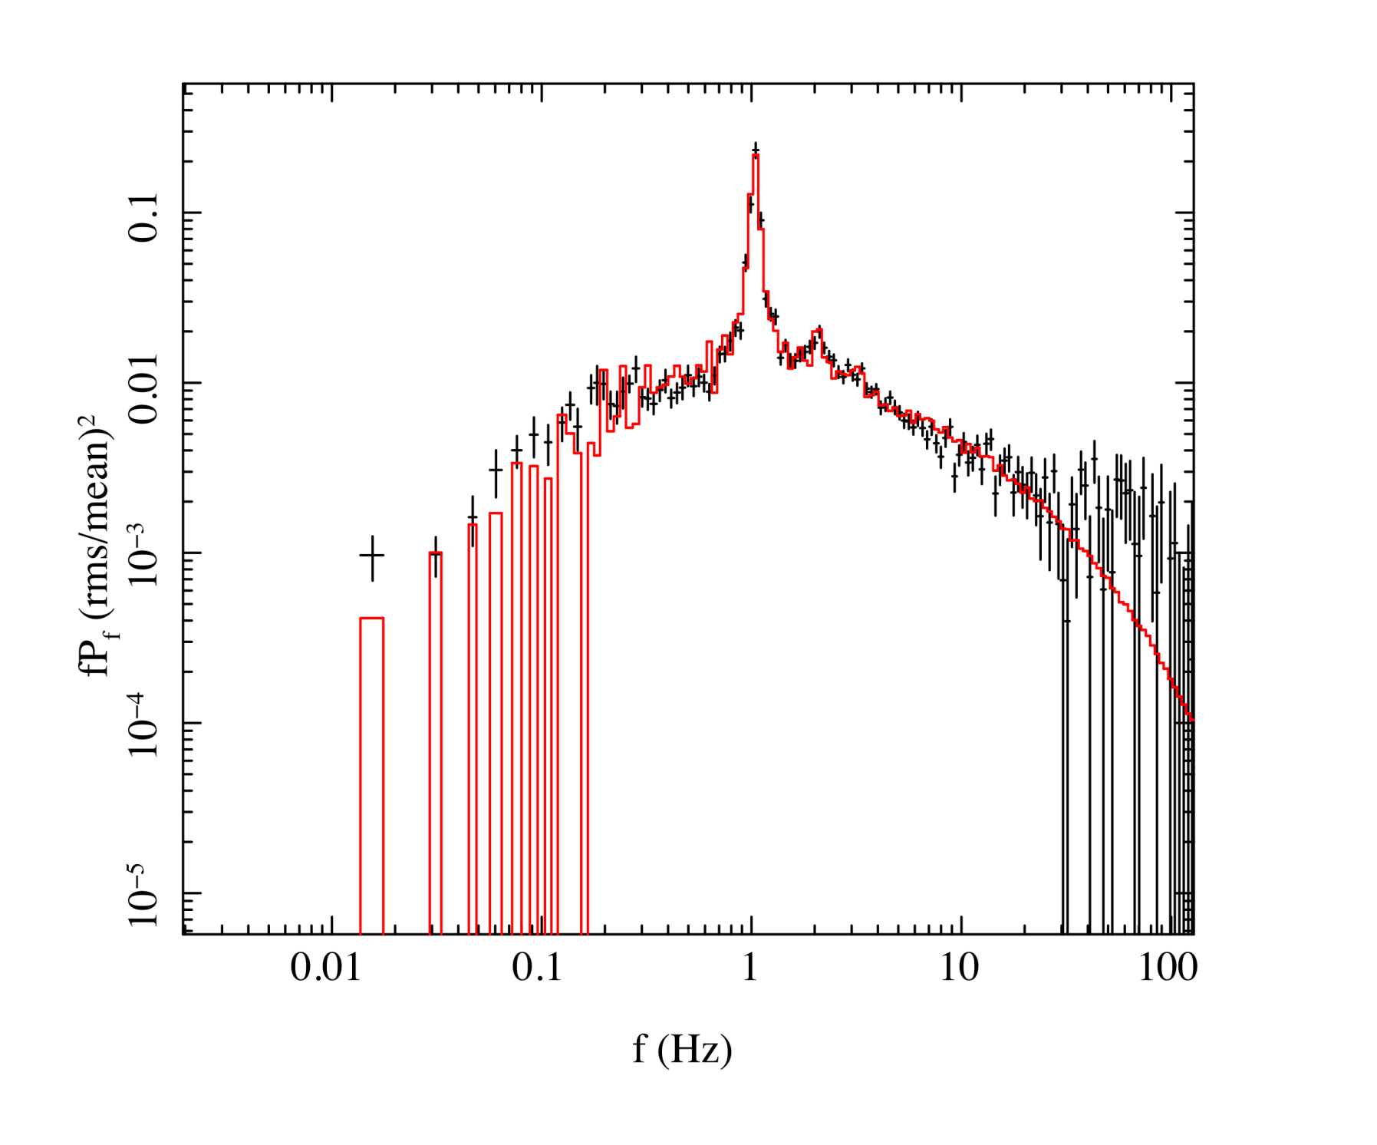
Fitting to observations of XTE 1550-564
r_{o} = 24.1
Ingram & Done 2010 in prep

Slide 41
Fitting to observations of XTE 1550-564
r_{o} = 16.8
Ingram & Done 2010 in prep

Slide 42
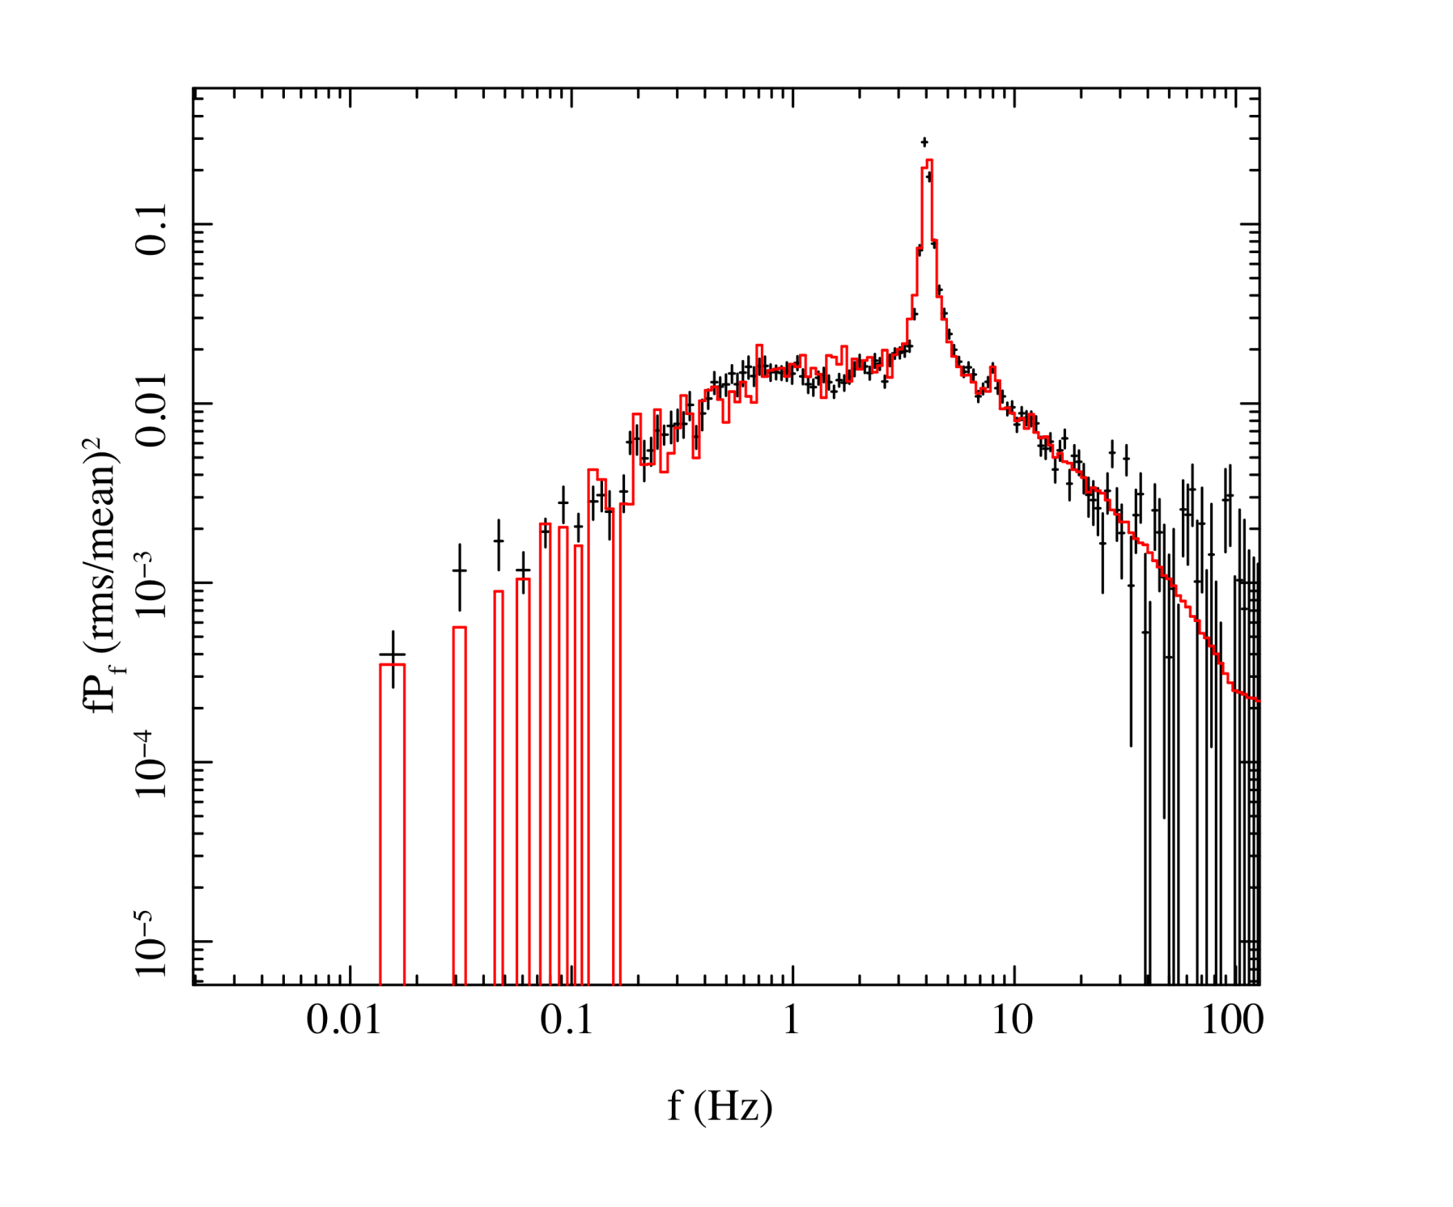
Fitting to observations of XTE 1550-564
r_{o} = 13.5
Ingram & Done 2010 in prep

Slide 43
Inhomogeneous spectra ?
Overlap softer (and more reflection)
Inner region harder (and less reflection)
WE SEE THIS!!
Log ν f(ν)
Log ν
Notes:
The disc models assumed that the emission thermalised. That’s not necessarily true at low L/Ledd where the flow is not very dense. If its not thermalising then its not cooling as efficiently so the flow heats up. This can lead to a hot, optically thin, geometrically thick inner flow replacing the inner disc. The hot electrons in this flow can compton upscatter any low energy photons from a residual outer disc, but there are not many of these, so the spectrum is hard

Slide 44
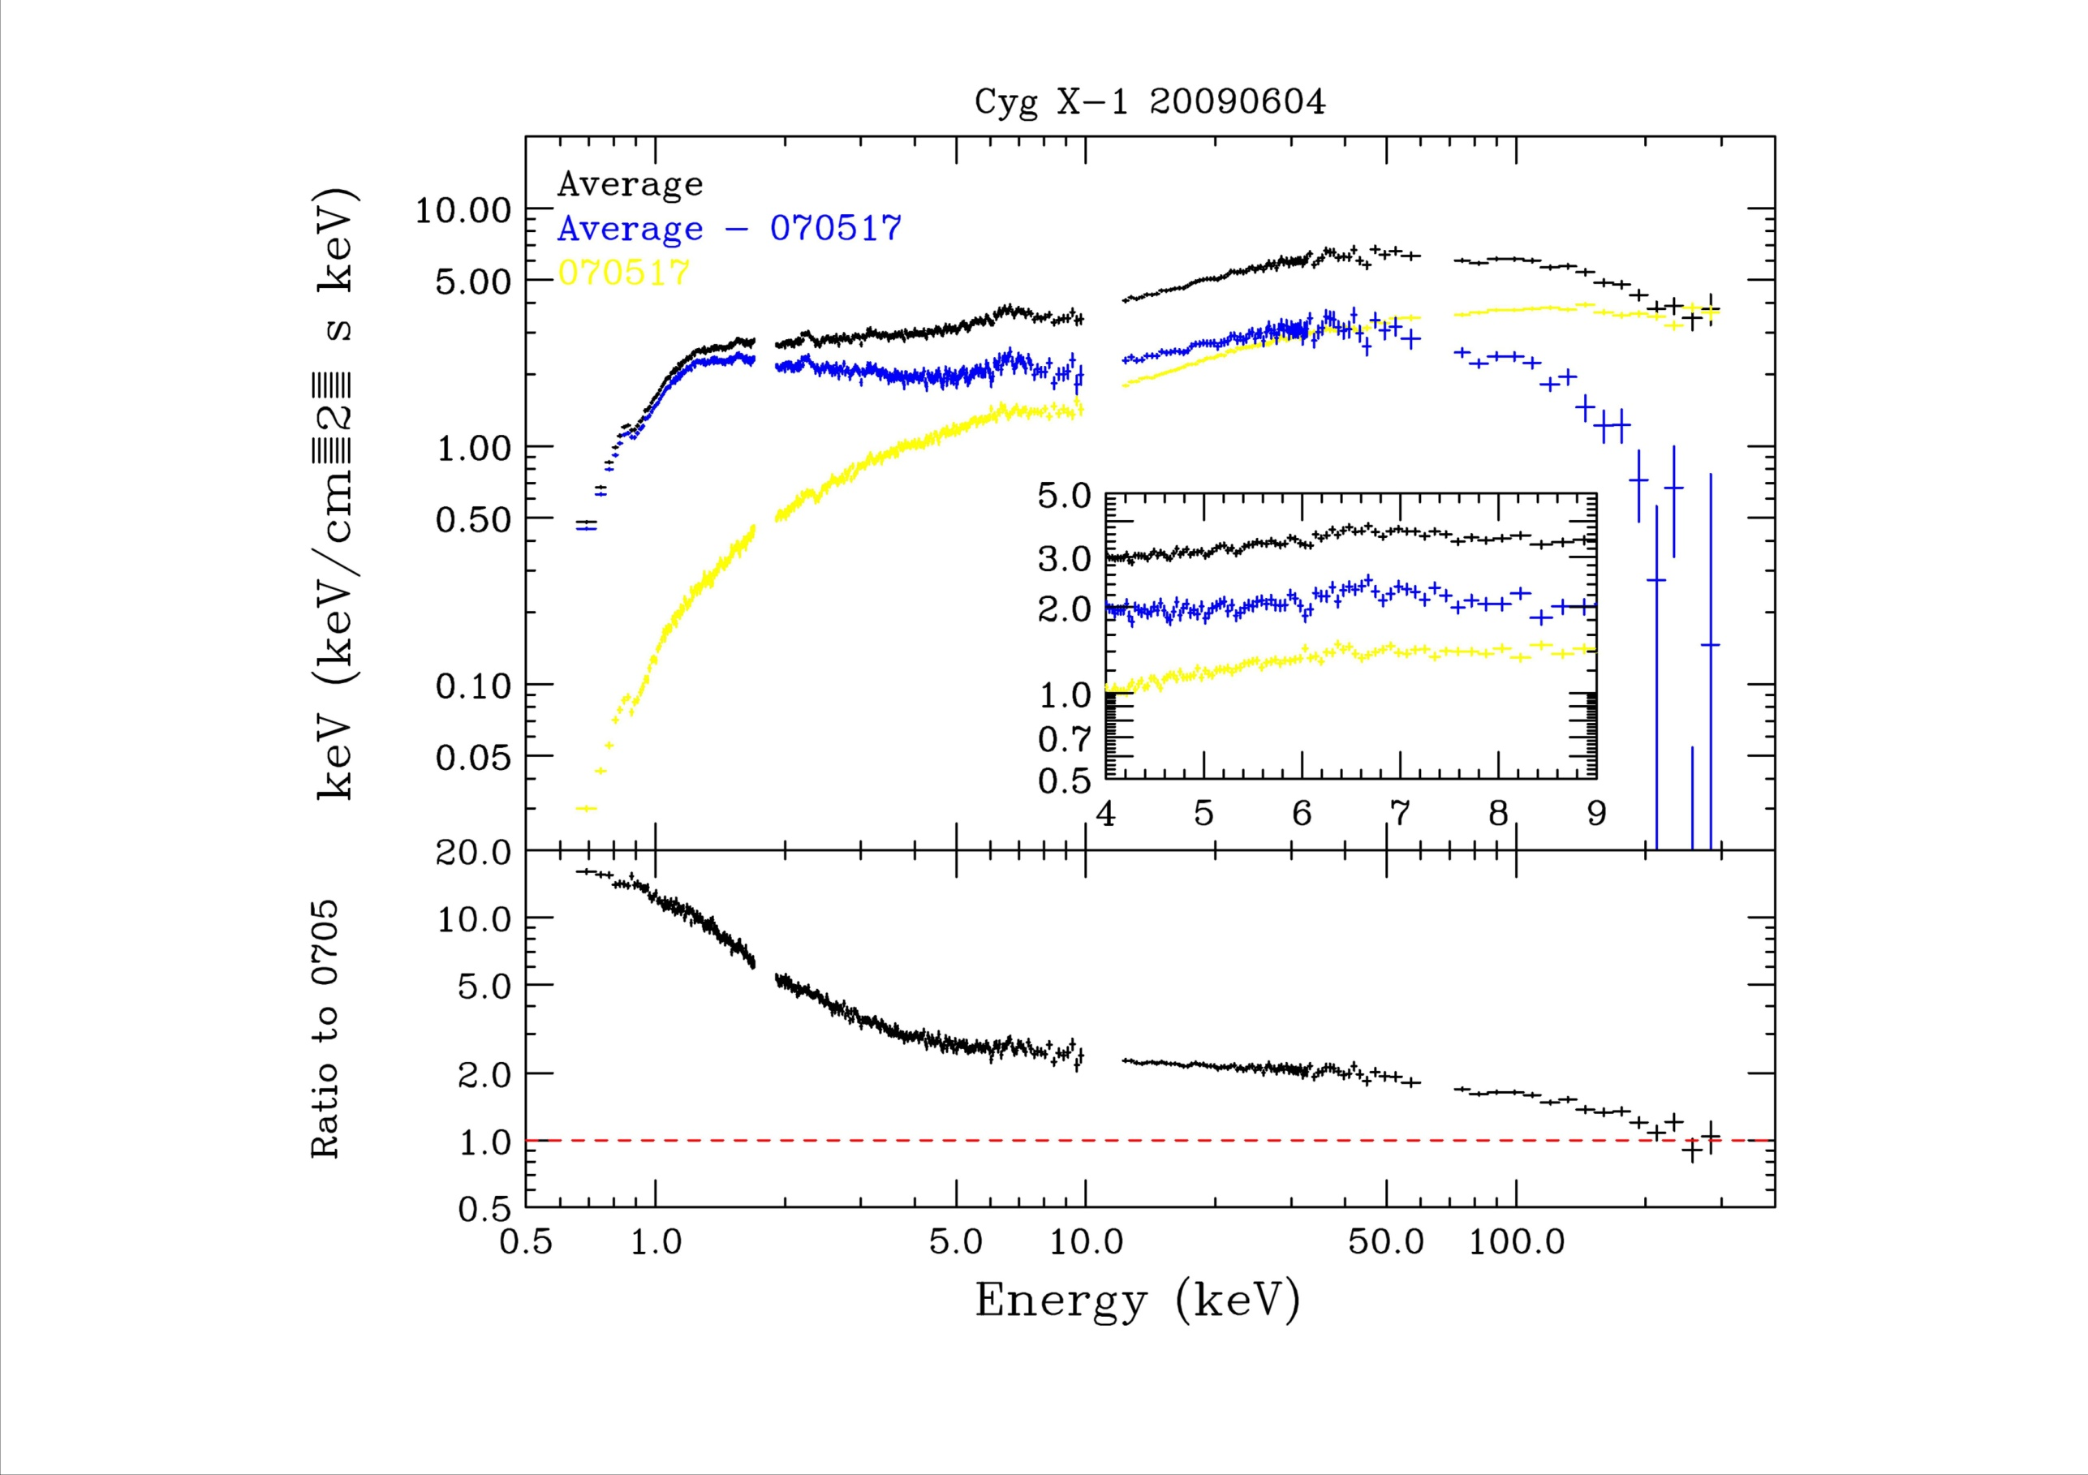
Makishima, Torii, Takahashi…..

Slide 45
Origin of broad band variability
Fluctuations start at large radii – first, soft and slow with R propagate down to smaller radii – lagged, harder and faster less R

Slide 46
Inhomogeneous close to transition
Overlap softer, and more reflection, slow variability
Fluctuations propagate down to inner region – smaller so faster variability. Fewer seed photons so harder spectrum and less reflection
WE SEE THIS Revnivtsev et al 1999
slow variability: hard lag soft due to propagation time – decreasing lag with higher frequency Miyamoto & Kitamoto 1988
Notes:
The disc models assumed that the emission thermalised. That’s not necessarily true at low L/Ledd where the flow is not very dense. If its not thermalising then its not cooling as efficiently so the flow heats up. This can lead to a hot, optically thin, geometrically thick inner flow replacing the inner disc. The hot electrons in this flow can compton upscatter any low energy photons from a residual outer disc, but there are not many of these, so the spectrum is hard

Slide 47
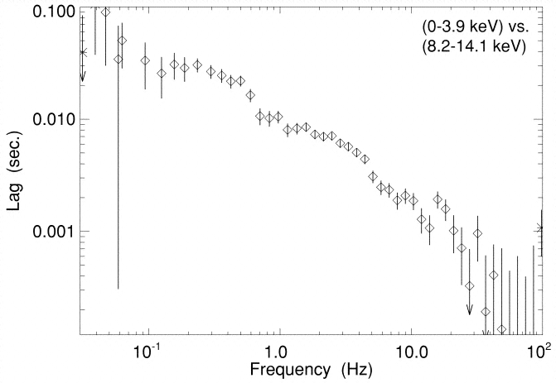
Inhomogeneous close to transition
Overlap softer, slower variability
Fluctuations propagate down to inner region – lagged. But this has harder spectrum. So hard lags soft. But smaller region so faster variability.
Miyamoto & Kitamoto 1988; Kotov et al 2001, Nowak et al 1999, Arevalo & Uttley 2006
Notes:
The disc models assumed that the emission thermalised. That’s not necessarily true at low L/Ledd where the flow is not very dense. If its not thermalising then its not cooling as efficiently so the flow heats up. This can lead to a hot, optically thin, geometrically thick inner flow replacing the inner disc. The hot electrons in this flow can compton upscatter any low energy photons from a residual outer disc, but there are not many of these, so the spectrum is hard

Slide 48
Conclusions
Truncated disc/hot inner flow models can explain more or less everything we see in LHS-VHS transition!!!
Hard spectra, soften as disc overlaps more with inner flow
Spectral transition and jet collapse when disc gets to lso
Variability from propagating fluctations (MRI) in hot flow
Low frequency break in power spectrum as disc comes in
Low frequency QPO from Lense-Thirring precession of entire hot flow – not down to lso as bending waves truncate it
Challenges!
High frequency QPO from some other mode!
Broad iron line in low.hard state? (XTEJ1752 Reis et al 2010)
Notes:
Fabulous time, both in terms of data available and for me personally. For the first time there is enough data

