Slide 1
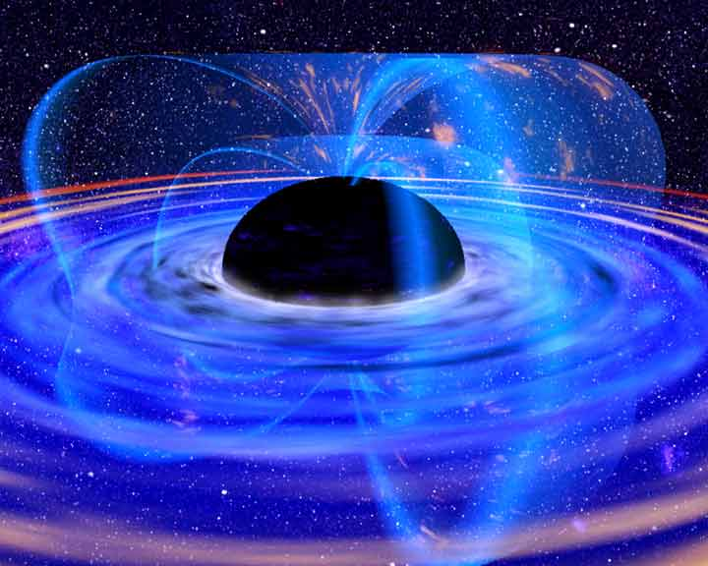
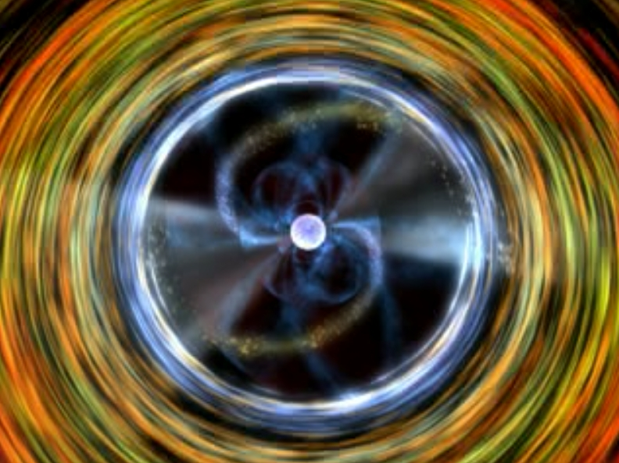
Broad Band Spectra of Low Mass
X-ray Binaries:
Looking at the inner accretion flow with
X-ray spectroscopy
Tiziana Di Salvo
DSFA
Università di Palermo
In collaboration with:
A. D'Aì, R. Iaria, N. R. Robba (Univ. Palermo), L. Burderi, E. Egron (Univ. Cagliari), A. Papitto, A. Riggio (INAF-OAC), G. Matt (Univ. Roma Tre)

Slide 2
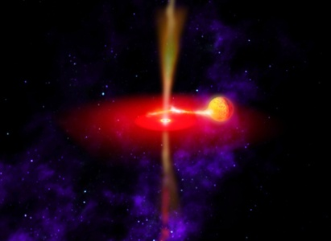
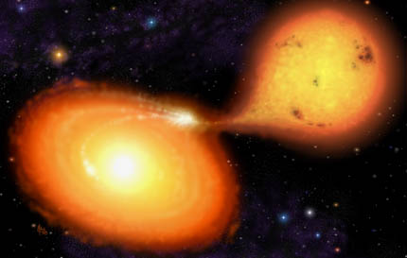
Low Mass X-ray Binaries: Classification
Black Hole Candidates in X-ray binaries:
Most of them have a low mass companion
but a massive primary
Most (if not all) are transient
Low magnetic field neutron
stars in X-ray binaries:
Low luminosity Atoll sources
High luminosity Atolls (GX)
High luminosity Z-sources
High inclination sources

Slide 3
NS Low Mass X-ray Binaries
Close X-ray binaries:
Rich time variability, such as twin QPOs at kHz frequencies (from 400 to 1300 Hz, increasing with increasing mass accretion rate); kHz QPOs are thought to reflect Keplerian frequencies at the inner accretion disk.
Type-I X-ray bursts, with nearly coherent oscillations in the range 300-600 Hz (reflecting the NS spin frequency).
Most are transient, with quiescent luminosities of 10³²-10³³ erg/s and outburst luminosities of 10³⁶-10³⁸ erg/s.
Companion star:
M < 1 M_{SUN}
Compact object:
NS with B < 10¹⁰ G
Accretion
disk

Slide 4
Neutron star low mass x-ray binaries classification
Atoll sources:
Lx ~ 0.01-0.1 L(Edd)
type I X-ray bursts
most are transients
Hard & Soft spectral states
X-ray millisec pulsars
Z-sources:
Lx ~ 0.1-1.0 L(Edd)
a few X-ray bursts
all persistent
(except for XTE J1701-462,
the first transient Z source,
Homan et al. 2007, ApJ)

Slide 5
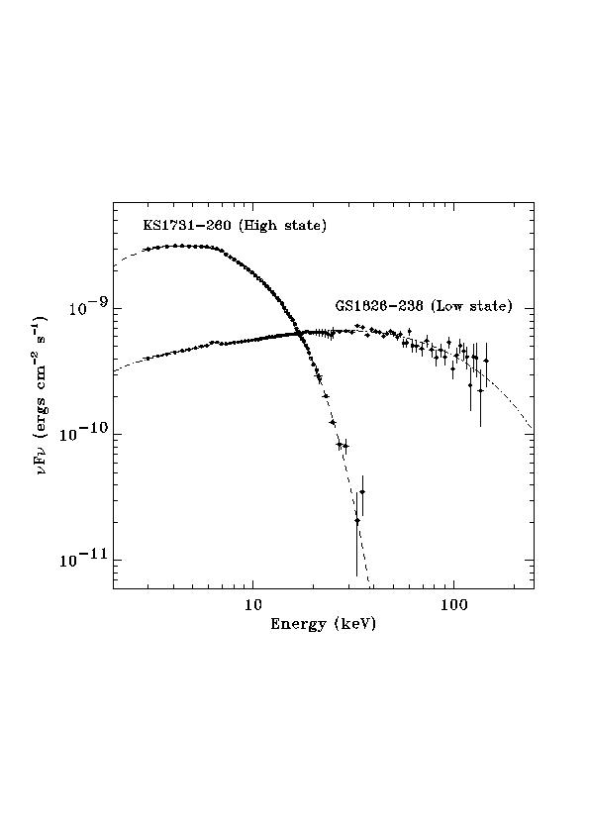
Atoll sources: energy spectra
- Soft component (few 0.1 keV)
(blackbody or disk-blackbody model)
- Power law with exponential
cutoff (5-20 keV): Thermal
Comptonization.
- Soft and hard states:
in the hard state the cutoff shifts
to higher energies (up to > 200 keV)
- Iron emission (fluorescence) line
at ~6.4 - 6.7 keV
- Evidence for a reflection component
Soft and Hard States

Slide 6
X-ray energy spectra of Z sources up to ~20 keV
Very soft (thermal) spectra. Two components needed (at least).
Most popular proposed interpretations:
- Eastern model (Mitsuda et al. 1984):
multitemperature-blackbody + blackbody/Comptonized spectra
(disk emission with kT = a R^{-3/4}, and NS surface comptonized emission)
- Western model (White et al. 1986):
blackbody + Comptonized blackbody spectra
(NS or disk emission, and disk emission modified by
Comptonization in a hotter region).
- Birmingham model (Church et al. 1997, 2006):
blackbody + Comptonized spectra
(NS emission, and Comptonized emission from an extended ADC).

Slide 7
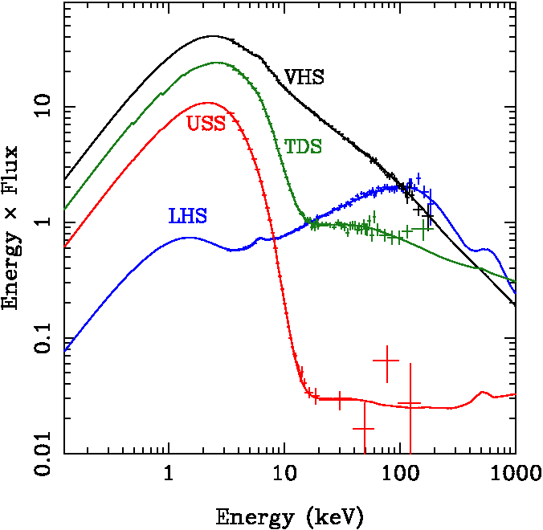
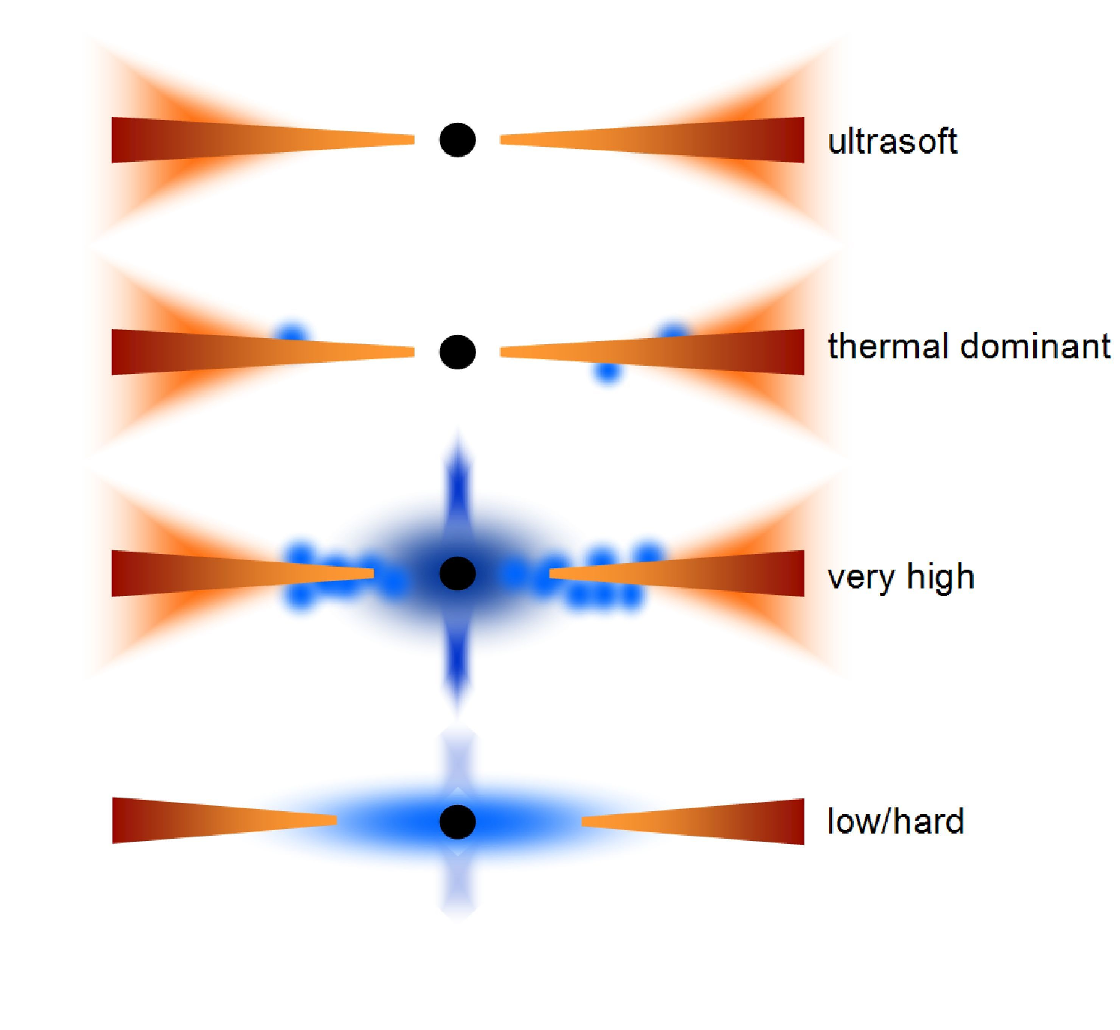
Broad band Spectra of BHXBs
(From Done et al. 2007, A&ARv)

Slide 8
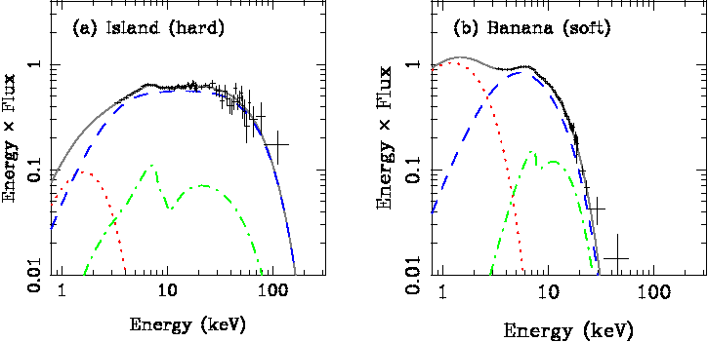
Spectra of NS LMXBs: Strong Analogies with the Spectra of BHCs
RXTE spectra of the X-ray burster, atoll source 4U 1705-44
(From Done et al. 2007, A&ARv)
Strong analogies with spectra of BHXBs: presence of hard/low and soft/high states.
Possible difference in the temperatures of the Comptonizing region, because of extra cooling due to the soft emission from the NS surface?
Comptonized component always contributing a large fraction (up to 80%) of the energy in the spectrum.

Slide 9
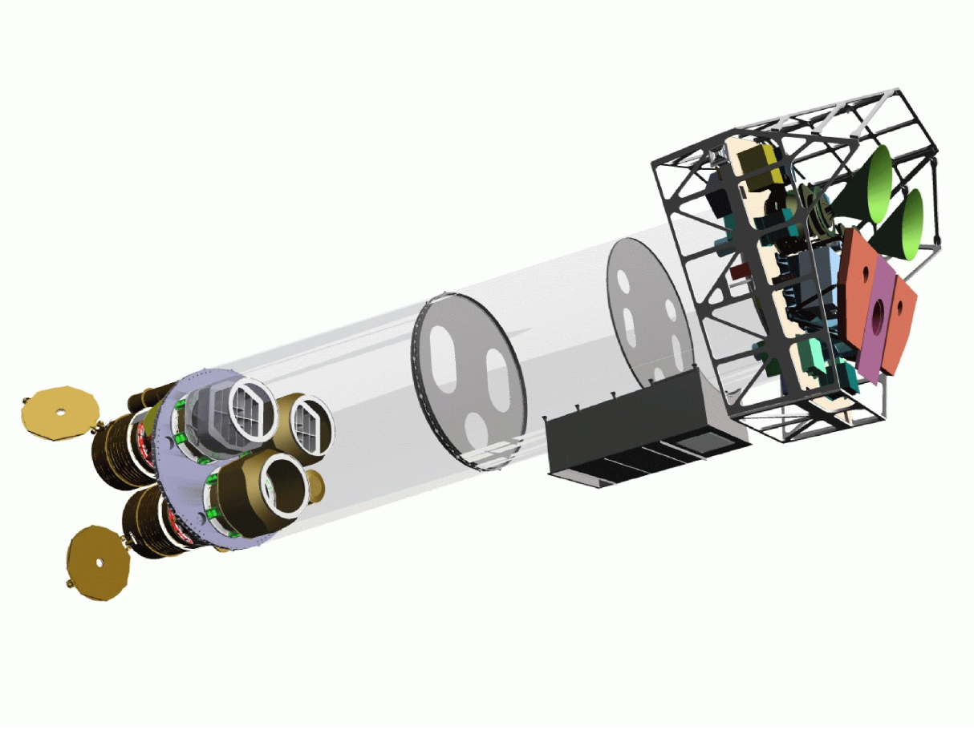
High inclination LMXBs: the so-called ADC sources
Corona
Companion Star
Accretion disk
Neutron Star
Inner Lagrangian point
Thick bulge at the impact point
Eclipses (when present) are partial -> extended corona needed

Slide 10
The ADC source 4U 1822-371
X-ray Binary seen at high inclination (81-84 deg, Jonker et al. 2003): presence of dips and eclipses in the light curve.
Persistent source (little variability of the light curve) with no type-I bursts. Observed unabsorbed luminosity of a few 10³⁶ ergs/s (Iaria et al. 2001).
Ratio Lx/Lopt = 20 (but average value for LMXBs 500) -> the intrinsic luminosity may be as high as 3 x 10³⁷ ergs/s
Orbital period (5.57 h) and spin period (0.59 sec, Jonker et al. 2001) known !
Orbital period (monitored in the last 30 years) increases at a rate of 1.50(7) x 10⁻¹⁰ s/s. Orbital evolution implies super-Eddington mass transfer rate -> the mass accretion rate onto the NS may be at the Eddington limit (Burderi et al. 2010; Bayless et al. 2010; Jain et al. 2010).

Slide 11
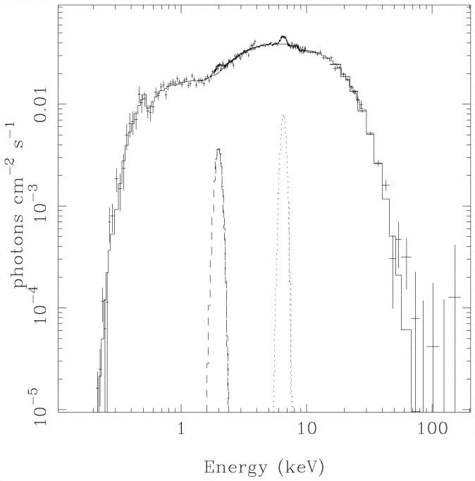
Broad band spectrum of 4U 1822-371: a Z-source seen at high inclination?
Soft spectrum fitted by a Comptonization component (compst), partially absorbed by neutral matter:
70% of the spectrum absorbed with NH = 4 x 10²² cm⁻² (interstellar absorption at least a factor of 4 lower).
kTe = 4.7 keV, tau = 14
(confirmed by an XMM observation, Iaria et al. A&A, submitted)
Discrete features are observed in emission.
BeppoSAX broad band spectrum of 4U1822-371
(Iaria et al. 2001, ApJ)

Slide 12
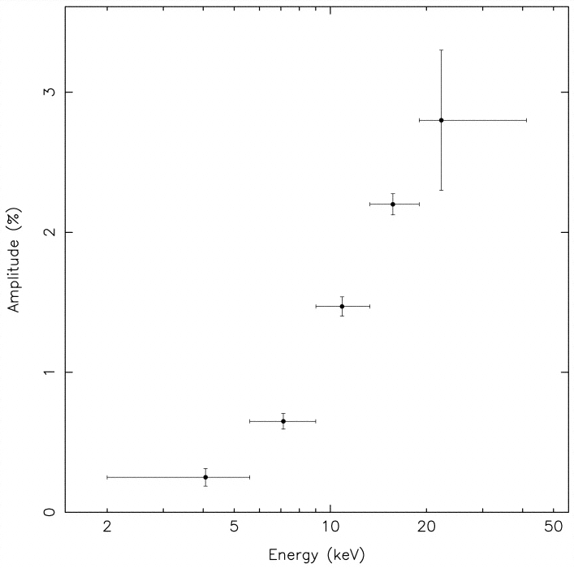
Can the extended corona be the source of the observed spectrum?
The Comptonized component is pulsed, with rms increasing with energy.
If the corona is optically thick (tau=14) and we look at the NS through the corona, we easily loose the pulsations.
Assumptions:
Rcor > R₂ (because of partial eclipses)
Rcor ~ 80% R_{L1} ~ 10¹¹ cm
tau = 14 = n σ Rcor -> n ~ 10¹⁵ cm⁻³
Pulse amplitude vs energy from RXTE data
(Jonker et al. 2001, ApJ)

Slide 13
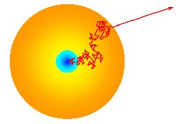
Can the extended corona be the source of the observed spectrum?
Unscattered photon fraction is
F = F₀ e^{-tau}
which is negligible for tau = 14. Photons escape after a random walk in the corona.
Number of steps needed to escape the corona: N = max(tau, tau²) = tau²
Travelled space: N λ = tau² λ
Average delay of the escaping photons:
Dt = tau² λ / c = 60 sec!!!
Spread in the arrival times of coherent photons:
Dt = tau λ / c ~ 4-5 sec!!!
Rcor ~ R_{L1} ~ 10¹¹ cm
tau = 14 -> n ~ 10¹⁵ cm⁻³

Slide 14
The extended corona should be optically thin
Let us suppose tau << 1 (1%)
Unscattered photon fraction is
F = F₀ e^{-tau} ~ F₀ (1 - tau) ~ F₀
Only 1% of the photons will be scattered in the corona. Escaping photons will be scattered 1 time maximum.
Maximum delay of the scattered photons:
Dt = 2 Rcor / c = 6 sec
Spread in the arrival times of coherent photons is still large in the worst case. This is probably the reason why the pulse fraction is so low.
The observed spectrum should reflect the emission from the central source
Rcor ~ R_{L1} ~ 10¹¹ cm
tau = 1% -> n ~ 10¹² cm⁻³
λ = 1 / (n σ) ~ 10¹² cm
λ >> Rcor

Slide 15
Iron line profiles may give unvaluable information on the inner accretion disc
From the profile of a disc line we can obtain information on the ionization parameter and element abundance, the emissivity index of the disc, disc inclination with respect to the line of sight, the inner and outer radii of the emitting region in the disc.
This information may be unaccessable with other observational methods.

Slide 16
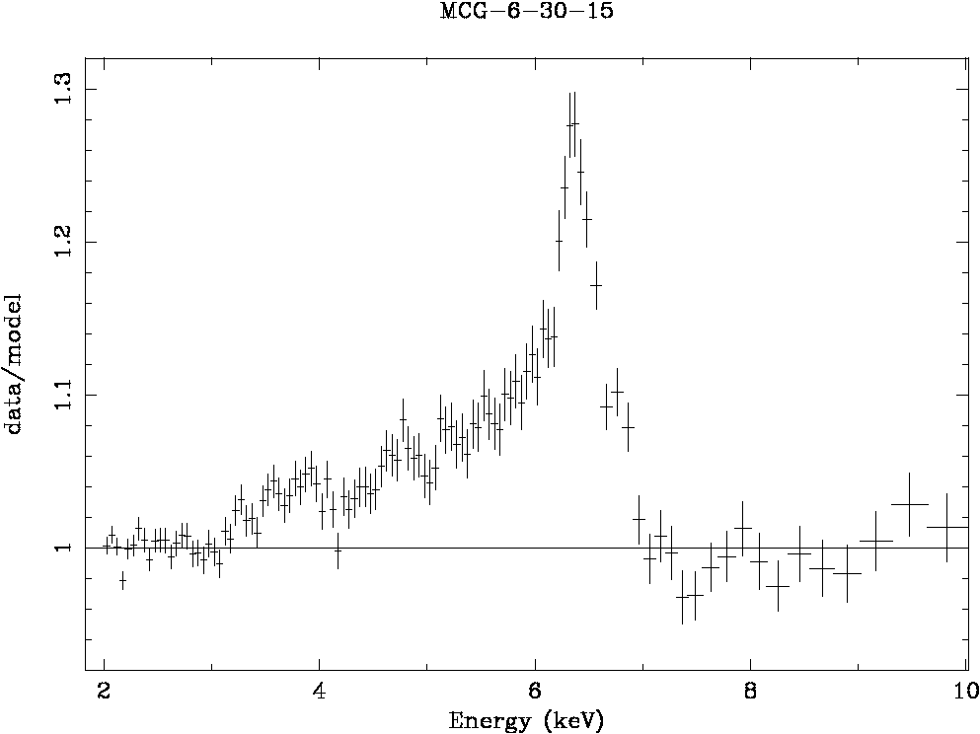
High resolution spectroscopy of massive BHs: MCG-6-30-15
XMM observation of the iron line region in MCG-6-30-15 taken in 2001. The red wing extends to less than 4 keV, indicating an inner radius of less than
6 G M / C².
Spinning black hole?
(a > 0.93)
Fabian et al. (2002)

Slide 17
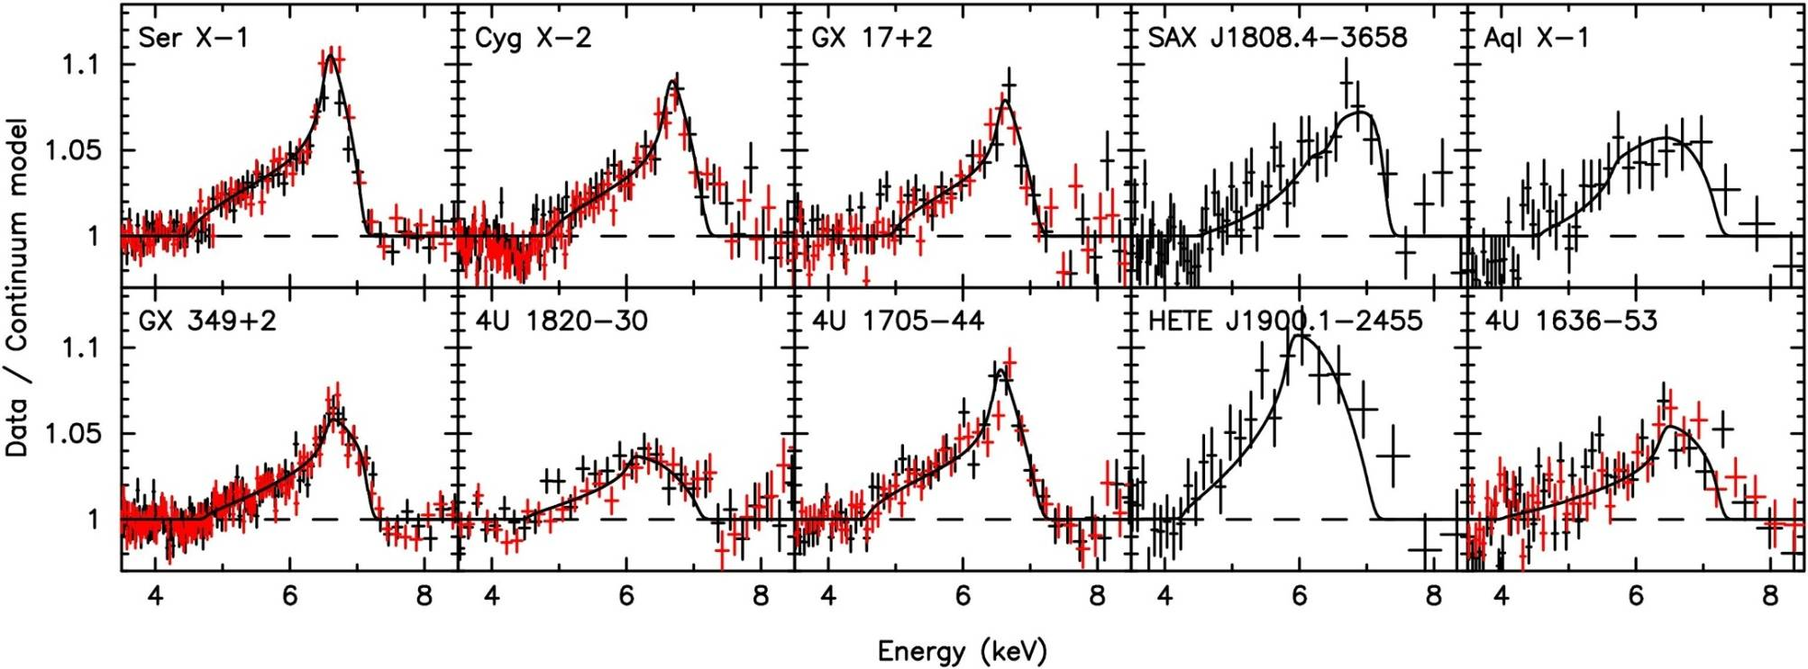
Line profiles in Neutron Star Binaries
Cackett et al. 2009
Suzaku data of 4U1705-44
(Reis et al. 2009)
Relativistic plus Compton broadening gives:
Rin = 10.5 Rg, i = 29.8 degrees

Slide 18
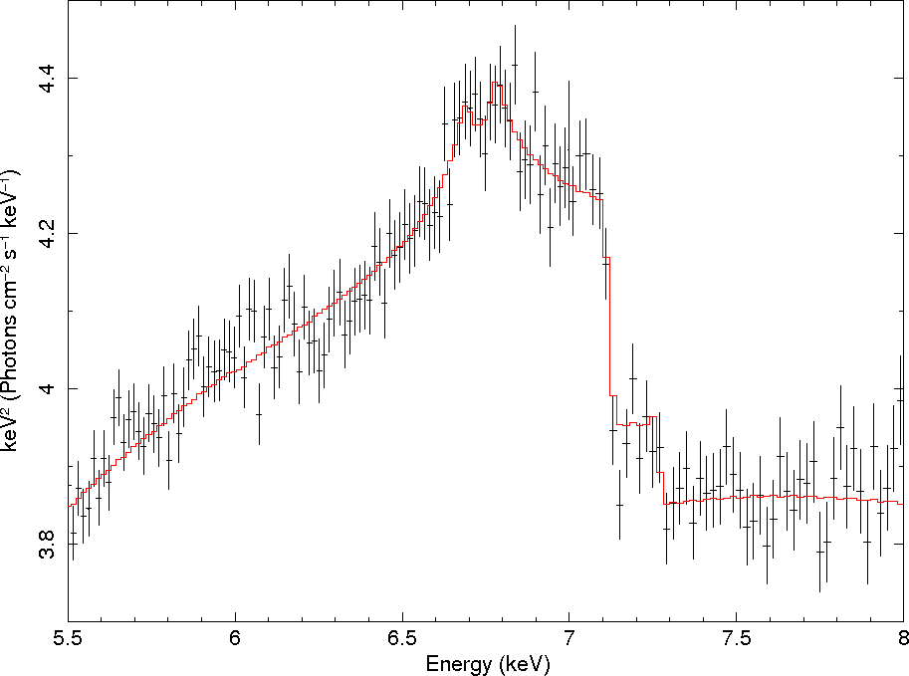
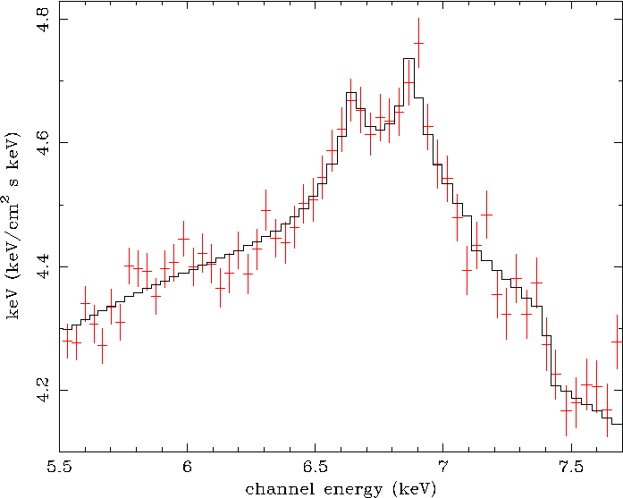
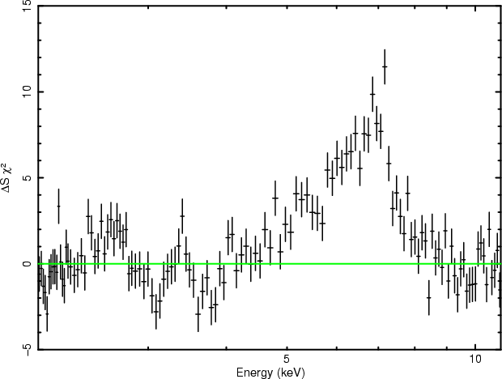
High resolution spectroscopy of NS Low Mass X-ray binaries with XMM
GX 340+0
GX 349+2
Iaria et al. (2009)
D’Aì et al. (2009)
SAX J1808.4-3658
Papitto et al. (2009)

Slide 19
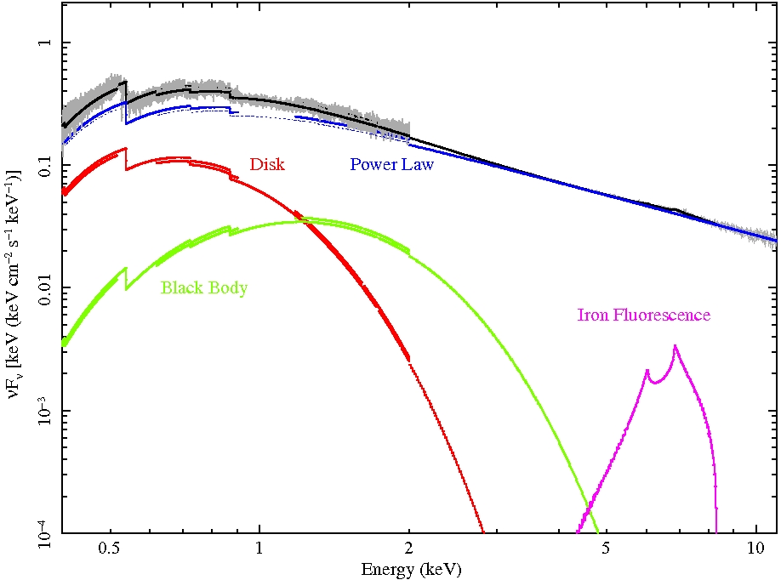
The XMM spectrum of SAX J1808.4-3658
SAX J1808.4-3658 firstly discovered as an AMSPs (Wijnands & van der Klis 1998), recurrent transient (approx every 2-3 yr)
Last outburst started in Sep 2008; 62 ks XMM-Newton observation performed on Oct 1st ; 700 c/s high statistics spectrum !
Millisec pulsars always show hard spectra during outburts, never go to a soft state.
Papitto et al. (2009, A&A)

Slide 20
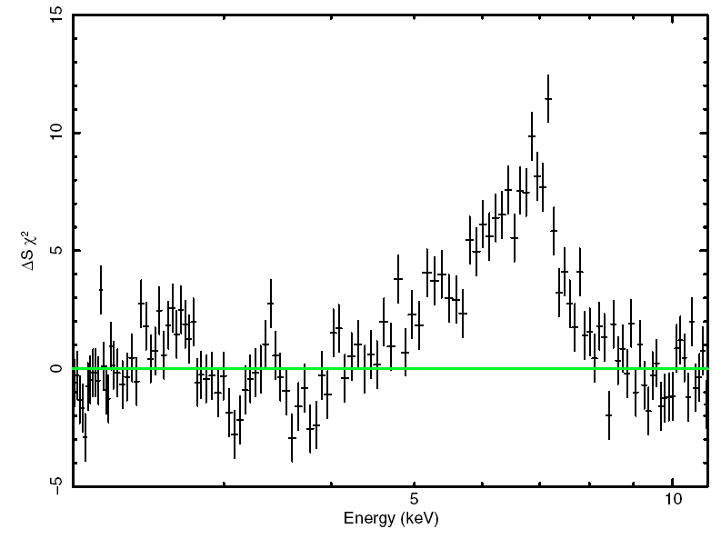
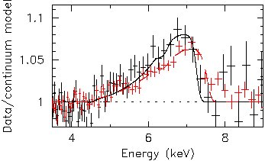
The Iron line profile
Broadly in agreement with Suzaku data taken the day after (Cackett et al. 2009)
Fe Kα line strongly required (more than 10 sigma)
Fe K edge = 7.1 keV and
Fluorescence line: E_{K} = 6.43 (8) keV
σ = 1.1 (2) keV

Slide 21
The inner disk radius in SAX J1808
For the first time in a pulsar, we measure the inner disc radius
R_{in} = 18.0^{+7.6}_{-5.6} m_{1.4} km
For a 2.5 ms pulsar accreting at Mdot = 5.6 x 10⁻¹⁰ M_{sun}/yr, with B=(1-5)x10⁸ G:
R_{in} ~ 12 - 26 km < 31 km -- well in agreement with our estimate
Our upper limit of 25.6 km is well within the corotation radius (31 km), and fits perfectly in the small zone around the pulsar where accretion is possible, thus giving an important confirmation of accretion theory for fast rotators
Alternatives?
Formation in the Comptonizing Corona is unlikely for kTe > 35 keV, τ~2 (e.g. Gierlinski et al. 2002)

Slide 22
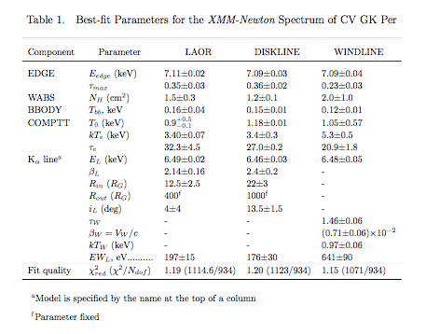
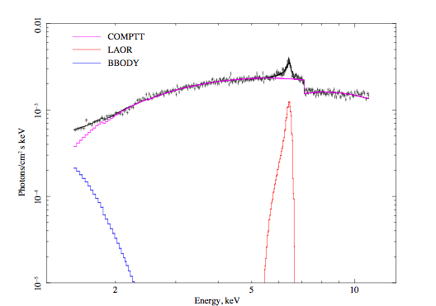
Relativistic Iron Lines in WDs?
XMM-Newton observation of the CV GK Per
Titarchuk et al. 2009

Slide 23
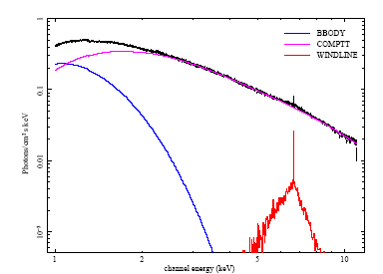
Proposed alternative model: Wind line profile
A model for red-skewed emission lines by repeated electron scattering in a diverging outflow or wind
[Titarchuk et al. (2003), Laming & Titarchuk (2004), Laurent & Titarchuk (2007)]
The red-skewed part of the spectrum is formed by photons undergoing multiple Compton scatterings in an outflowing wind, while the primary peak is formed by photons escaping directly to the observer.

Slide 24
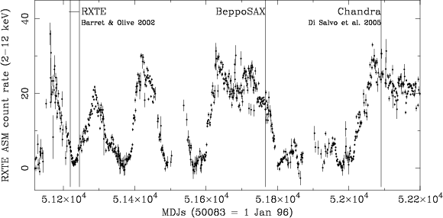
The source: 4U 1705-44
4U 1705-44: Atoll source and X-ray burster
It shows recurrent hard/low and soft/high states
Piraino et al. 2007
Piraino et al. 2007

Slide 25
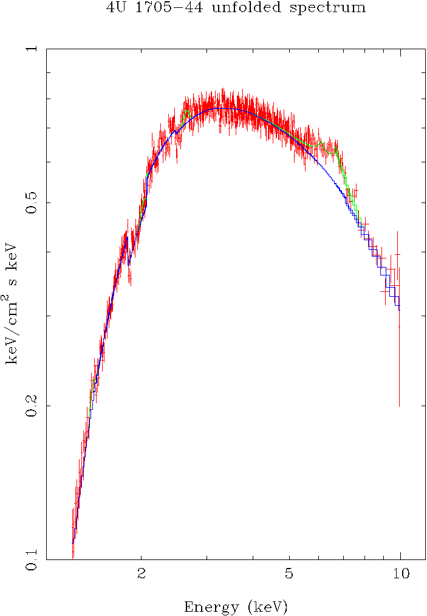
Discovery of a broad Fe K-shell Line in 4U 1705-44 during a soft state
The HETG shows that the broad iron line is not a blending of different ionization states.
Fitting the iron line profile with a disk (relativistic) line we find:
E_Fe = 6.40 keV
Rin = 7-11 Rg (15-23 km)
Inclination = 55 – 84 deg
Alternatively, Compton broadening in the external parts of the Comptonizing corona
(σ = 0.5 implies
τ = 1.4 for kT = 2 keV)
TE Mode 25 ks
Unfolded line profile
Chandra/HETG observation
Di Salvo et al. (2005)

Slide 26
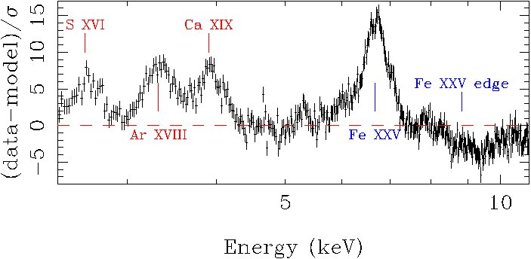
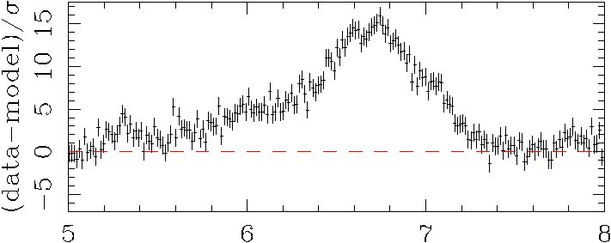
The XMM-Newton spectrum of 4U 1705-44 during a soft state
Residuals with respect to the continuum model
Di Salvo et al. (2009)
The iron line at 6.7 keV is
perfectly fitted by a diskline with very well determined parameters

Slide 27
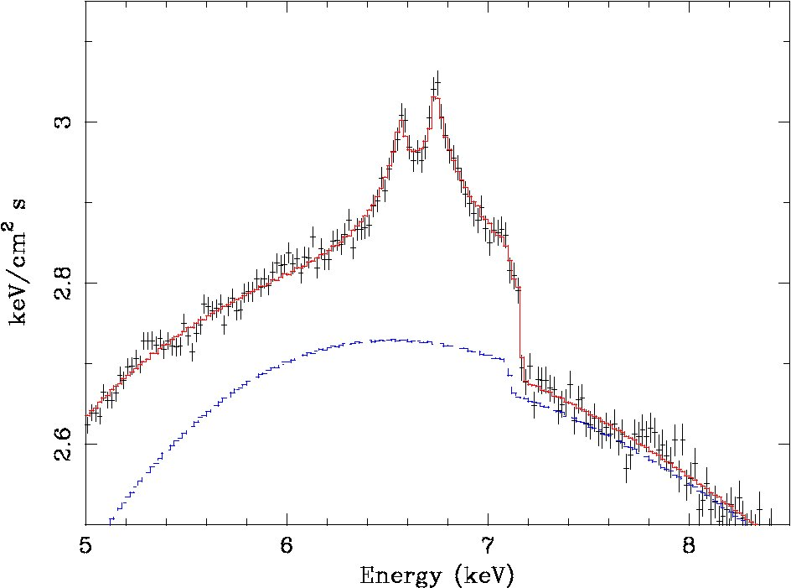
The relativistic line of 4U 1705-44
F-test with respect to a simple Gaussian model gives a prob of chance improvement of 3 x 10⁻¹¹ !
E_{Fe} = 6.66 ± 0.01 keV
Log ξ = 2.7 - 3
EqW = 56 ± 2 eV
Rin = 14 ± 2 Rg
i = 39 ± 1 degrees
Em index ~ -2.2
Rout = 3500 ± 1000 Rg
Di Salvo et al. (2009)

Slide 28
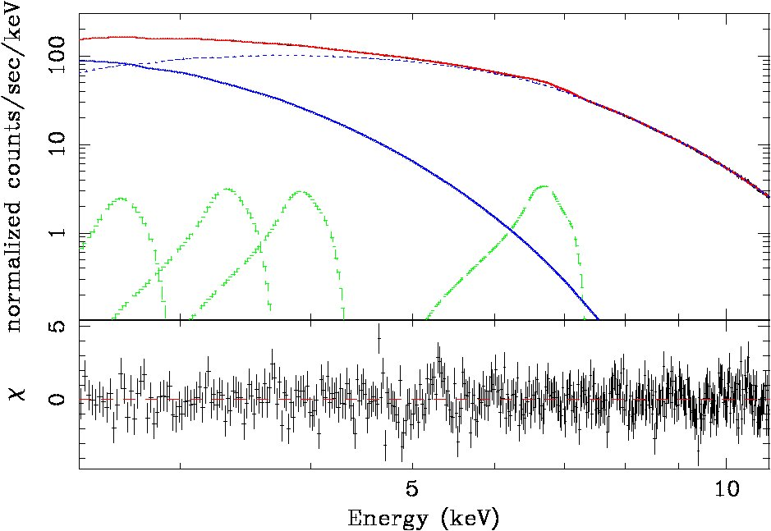
The XMM spectrum of 4U 1705-44
ToO observation performed in Aug 2008 during a soft state
45 ks XMM-Newton exposure time
With 700 c/s it is a high statistics spectrum !
Di Salvo et al. 2009
S XVI
Ar XVIII
Fe XXV
Ca XIX

Slide 29
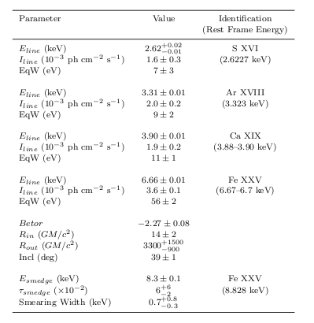
Summary of the results on the other features
Low energy lines fitted by disklines with parameters fixed to the correspondent value for the iron line.
The iron edge appears smaered and redshifted.
More details on the fitting of the whole spectrum with a self consistent reflection model in the talk of A. D’Aì
Disc
parameters

Slide 30
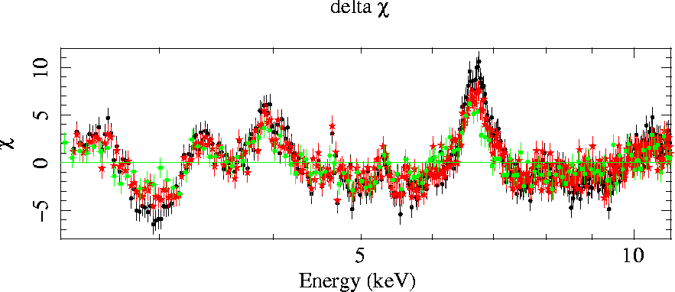
Pile-up in the XMM/pn data?
Black points: pn data as in Di Salvo et al. (2009)
Red points: pn data as in D’Aì et al. (2010, without the central row)
Green points: pn data as in Ng et al. (2010, without 7 central rows reject 90% of the source counts!)
Line parameters from the green dataset:
E = 6.3 – 6.5 keV
Rin = 12 - 23 Rg
i = 42 - 51 degrees
Em index ~ -(2.23 – 2.7)
Rout = 400 ± 1600 Rg

Slide 31
Diskline Parameters in 4U 1705-44 soft state
BeppoSAX (Piraino et al. 2007)
E_Fe = 6.7^{+0.2}_{–0.5} keV
Rin = 6-12 Rg (13-25 km)
Rout = 1000 Rg (fixed)
Inclination = 20 – 48 deg
Fe Eq.W = 109 eV
Rbbody = 31.0 +/- 1.3 km
(for D = 7.4 kpc)
XMM-Newton (Di Salvo et al. 2009)
E_Fe = 6.66 +/- 0.01 keV
Em Index = -2.27 +/- 0.08
Rin = 14 +/- 2 Rg (25-34 km)
Rout = 3300 +/- 1000 Rg (5–10 x 10³ km)
Inclination = 39 +/- 1 deg
Fe Eq.W = 56 +/- 2 eV
Rbbody = 38.0 +/- 1.8 km
(for D = 7.4 kpc)
Rdiskbb = 17 +/- 1 km
(for i = 39 deg,
D = 7.4 kpc)

Slide 32
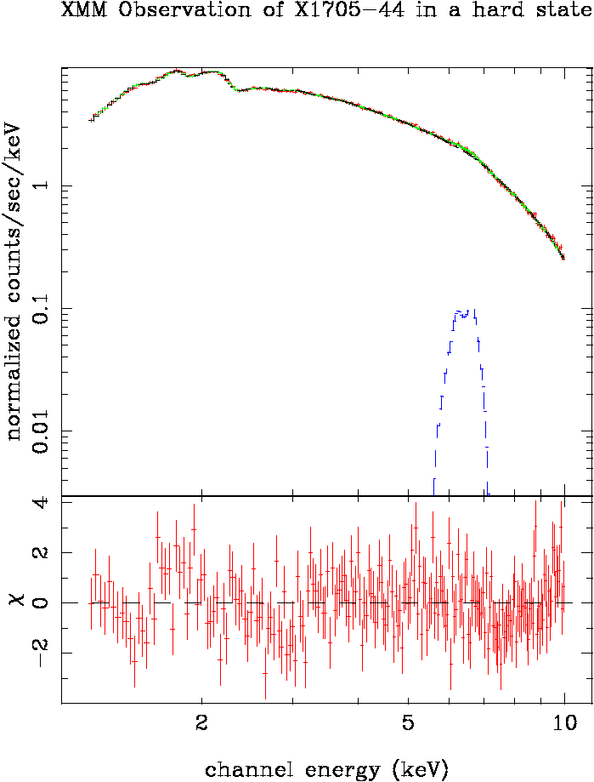
Fe K-shell line in 4U 1705-44 during a hard state observed by XMM-Newton
The iron line observed by XMM during a hard/low state appears less intense and narrower than during the soft state observed by Chandra, BeppoSAX, and XMM.
This is also confirmed by a second Chandra observation performed during a hard state.

Slide 33
4U1705-44 during a hard state
XMM-Newton (D’Aì et al. 2010)
E_Fe = 6.45-6.60 keV
Em Index = -(2.3-3.5)
Rin = 13-92 Rg (27-190 km)
Rout = 3500 Rg (fixed)
Inclination = 39 deg (fixed)
Fe Eq.W = 50 eV
Rdiskbb = 32 - 75 km
(for i = 39 deg, D = 7.4 kpc)
The iron line observed by XMM during a hard/low state appears less intense and narrower than during the soft state observed by Chandra, BeppoSAX and XMM.
The observation is in agreement with a larger inner disk radius.
Interestingly, the frequency of the upper kHz QPO varies from 500 Hz to 1100 Hz when the sources goes from the hard to the soft state, indicating that the inner disk radius varies from 16 to 30 km from the soft to the high state.

Slide 34
Conclusions
There is still al lot to learn about these sources.
To this aim we need good instruments (especially with good timing capability and energy resolution) able to observe such bright objects, in order to use the extraordinary statistics we obtain from bright, close by, sources.
We also need complete self-consistent models to be tested on good quality data able to prove or disprove a given scenario.

Slide 35
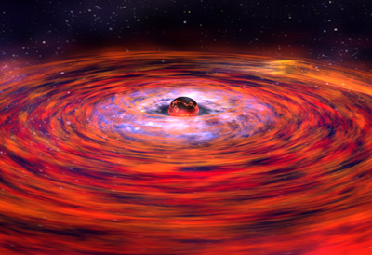
Aknowledgements
High Energy View of Accreting Objects: AGN and X-ray Binaries Agios Nikolaos, Crete, Greece 5 - 14 October 2010
Thank you very much!

